Slide 1


AECORLINK
YOUR BROADBAND PROVIDER AT SEA

Slide 2

ABOUT US
AecorLink - a pioneer in high-speed maritime broadband communication and a dedicated fast-growing maritime service provider.
The company offers ease of access to maritime networks by providing customers with turn-key solutions on favorable terms.

Slide 3
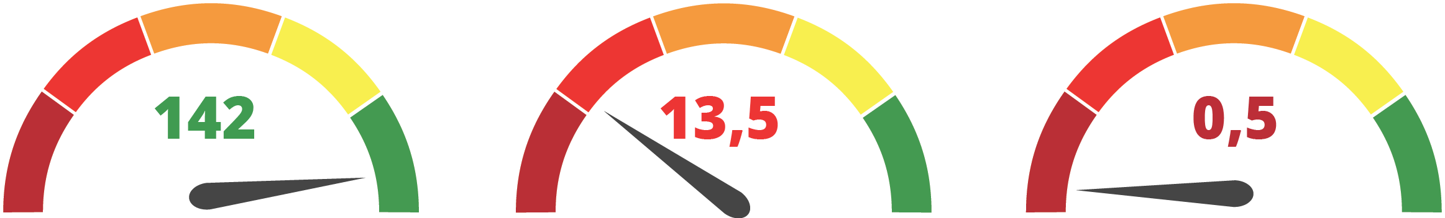

PROOF OF CONCEPT
AecorLink
3/4G (LTE)
Satellite (KA)
Download Speed (Mbps)
Wasa Line operating between Umeå Sweden – Vaasa Finland on a distance of ca 100KM, did a data traffic survey during 6 month using: Aecorlink, KA Band Satelitte and LTE, comparing parameters such as speed, uptime and latency.

Slide 4


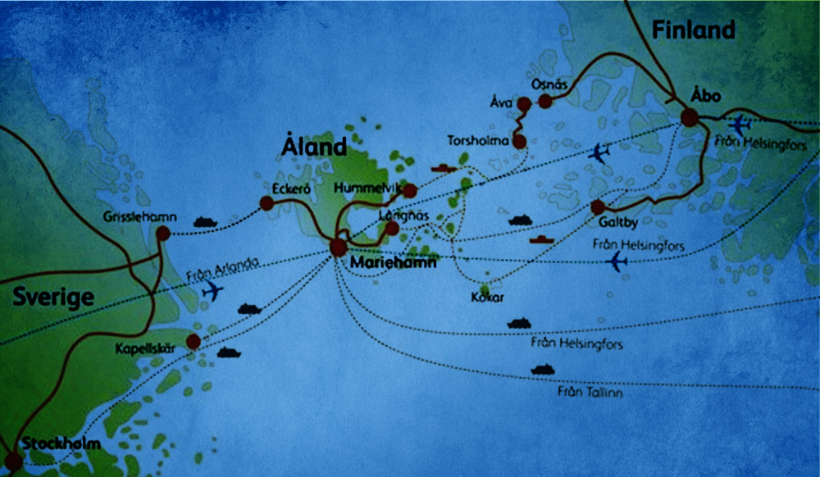
AECORLINK HAS BUILT THE FIRST LARGE-SCALE NETWORK AT SEA
In collaboration with the Swedish Maritime Administration, KBV, Viking Line and Lund University.
13 base stations covering the entire 315km fairway between Stockholm-Mariehamn – Turku.
AecorLink delivers 300 Mbps aggregate speed over the entire route to upto 15 vessels.
AecorLink Network has redundancy to create security for customers.
AecorLink will take in more customers over time and expand the network to include Helsinki and Tallinn.

Slide 5

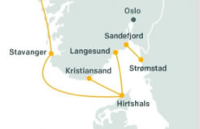
AECORLINK HAS STARTED
ANOTHER LARGE PROJECT IN NORWAY
Together with Fjord Line, AecorLink has now started a project that extends from Denmark's northern cape off, all the way to Bergen.
AecorLink will establish 26 base stations with full redundancy.
First route Sandefjord - Strömstad was commissioned in June 2019.

Slide 6
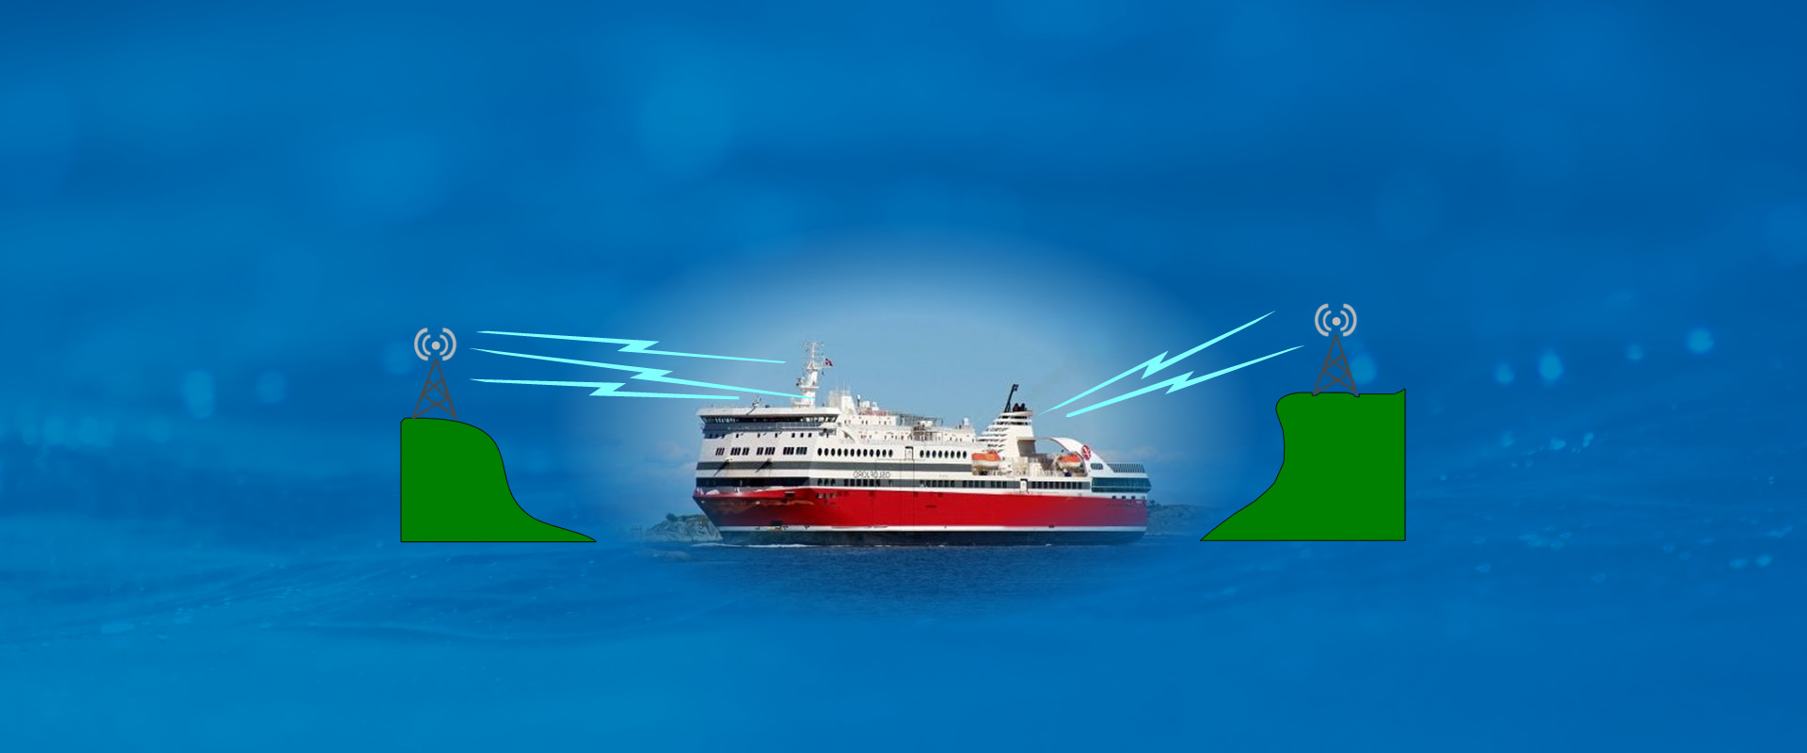

COMPANY STRUCTURE
Using microwave links improve stability, speed and reduce the latency
Four CTT – directional tracking antennas
One omni directional antenna
We create a WAN Network to connect all units from vessels to office.
You allocate your own capacity between the private and public networks.
We deliver data capacity to your Firewall on board the vessel.
No matter which internal network you use our solution is compatible.

Slide 7

AECORLINK OFFERS TWO TYPES OF SOLUTIONS
1
AecorLink builds its own network along routes where many shipping companies operate which enable the operating cost of land infrastructure to be shared between multiple shipping companies.
2
Using microwave links from shore to ship from 100-500 Mbps aggregated.

Slide 8




AECORLINK OFFERS NETWORKING FOR ALL NEEDS
High Stability
A route that runs between A and B, where one or more vessels operate.
A route that runs between A-B-C-D-E-F etc. Where several vessels operate on the entire route or parts.

Slide 9

AecorLink offers contracts from 24 to 60 months
Equipment & installations required per vessel to be purchased or under lease program.
Site survey free of charge
BUSINESS
MODEL
Fixed flat monthly fee for data connectivity.

Slide 10

ORDER PROCESS
1
After signed agreement
4
Terms of delivery tailormade program 12 weeks
2
Order processing
5
Installations 2 days per vessel.
3
Terms of delivery 4 weeks for standard routes
6
2 weeks FAT
(Fields Acceptance Test)

Slide 11
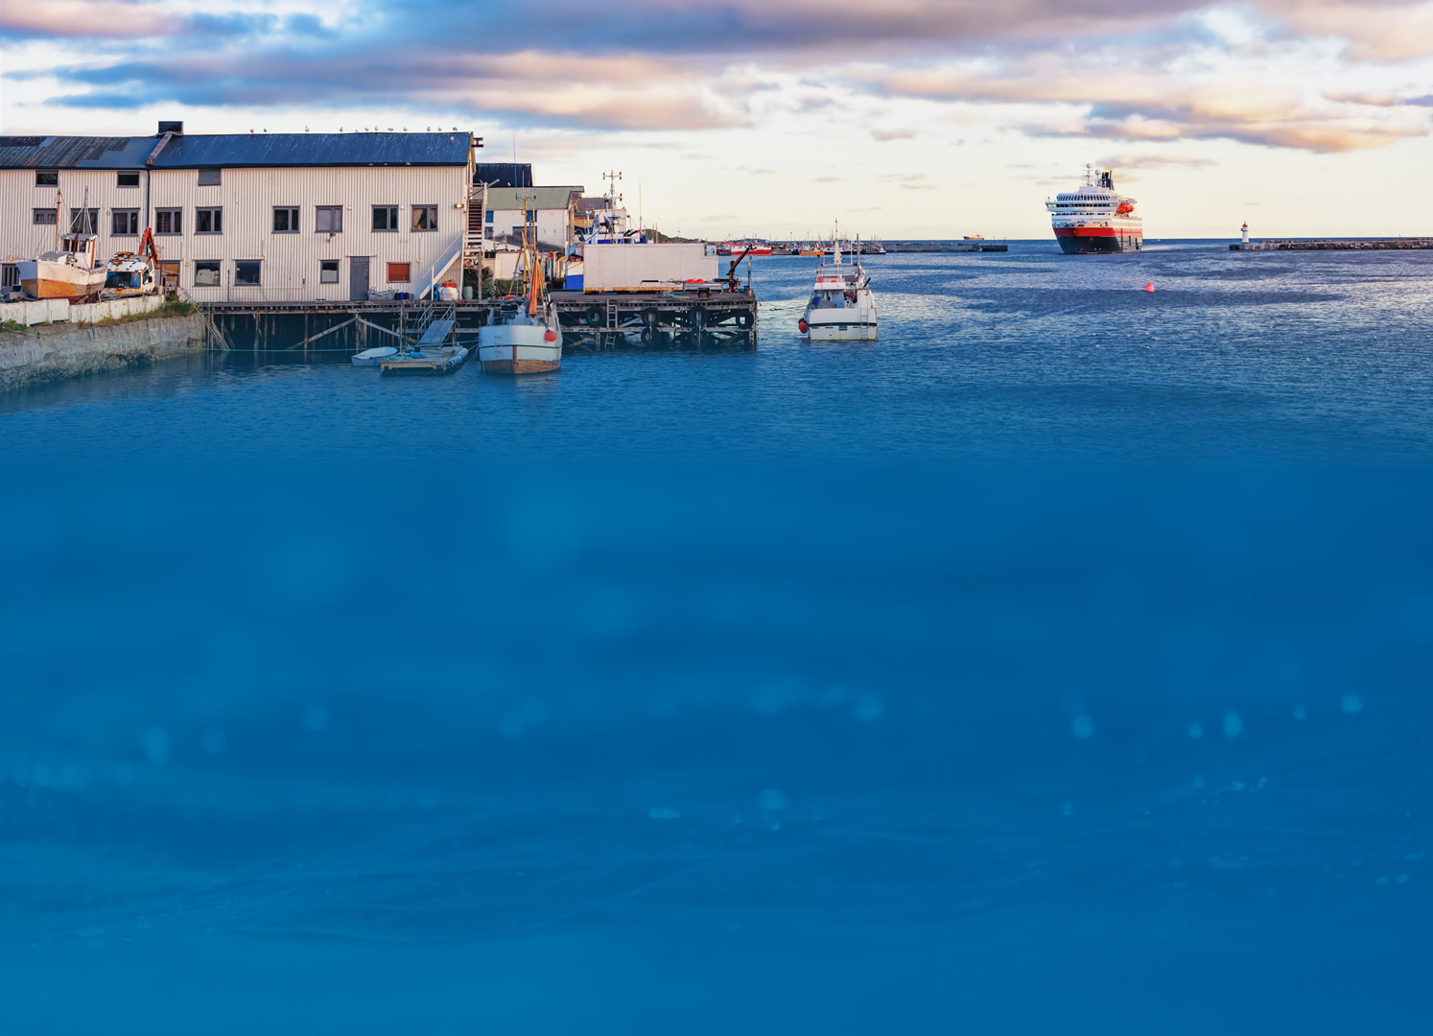

EQUIPMENT WARRANTY FOR THE VESSELS
High Stability
All equipment purchased from AecorLink has two years of fabric guarantee.
Extended warranty for longer contracts.
For equipment lease the warranty is valid during the duration of the contract period.

Slide 12






SLA
AecorLink’s control center is based in Oslo and the monitoring systems are located Norway.
All systems operated by AecorLink have redundancy to avoid disruption to the network.
Every link from ship to shore is monitored by our surveillance system and is shared with you as a client.
If there is an emergency call our technical team will meet the ship at the next port to provide technical assistance.
All scheduled updates software will be announced in advance.
SLA has a fixed monthly fee per vessel.

Slide 13

CUSTOMER RESPONSIBILITY
High Stability
1
To pull all cables from the antenna stations to the control room.
2
Ensure that there are cables from the ship's gyro.
3
Ensure that there are antenna stative in place during the installation.

