Slide 1
AECORLINK
YOUR BROADBAND PROVIDER AT SEA

Slide 2
OUR STORY
ABOUT US
AecorLink - a pioneer in high-speed maritime broadband communication and a dedicated fast-growing maritime service provider.
The company offers ease of access to maritime networks by providing customers with turn-key solutions on favorable terms.
Aecorlink's founder has worked with maritime satellite communications for almost two decades. During his three years at a market-leading satellite company, he realized there were large gaps in the market because the company's range of satellite services did not live up to customer expectations in terms of data speed, stability and signal delays. This inspired him to launch Aecorlink during 2015 when he observed the opportunity to fill those shortcomings by using microwave links from shore to ship instead of satellite. Today, Aecorlink has several patent pending technologies that provide solutions which satellites cannot fulfil.

Slide 3
AECORLINK FOUNDERS
Ulf Hårderup
Robert Hahmann
M.Sc.Eng LTH / MBA UB Barcelona
Grundare av Aecorlink AB
Grundare av Nordaq Fresh
Haman Scandinavia AB
Tourist Development for Azores Islands
Mikael Solberg
Björn Hårderup

Slide 4
PROOF OF CONCEPT
AecorLink
3/4G (LTE)
Satellite (KA)
Download Speed (Mbps)
Wasa Line operating between Umeå Sweden – Vaasa Finland on a distance of ca 100KM, did a data traffic survey during 6 month using: Aecorlink, KA Band Satelitte and LTE, comparing parameters such as speed, uptime and latency.

Slide 5
AECORLINK PROVIDES
High Stability
High stability
Low latency
High Speed
Microwaves links from shore to ship from 100-500 Mbps aggregated.

Slide 6
AECORLINK OFFERS TWO TYPES OF SOLUTIONS
1
AecorLink builds its own network along routes where many shipping companies operate which enable the operating cost of land infrastructure to be shared between multiple shipping companies.
2
Using microwave links from shore to ship from 100-500 Mbps aggregated.

Slide 7
AECORLINK OFFERS NETWORKING FOR ALL NEEDS
High Stability
A route that runs between A and B, where one or more vessels operate.
A route that runs between A-B-C-D-E-F etc. Where several vessels operate on the entire route or parts.

Slide 8
AecorLink offers contracts from 24 to 60 months
Equipment & installations required per vessel.
Site survey free of charge
BUSINESS
MODEL
Fixed flat monthly fee for data connectivity.

Slide 9
ORDER PROCESS
1
After signed agreement
4
Terms of delivery tailormade program 12 weeks
2
Order processing
5
Installations 2 days per vessel.
3
Terms of delivery 4 weeks for standard routes
6
2 weeks FAT (Fields Acceptance Test)

Slide 10
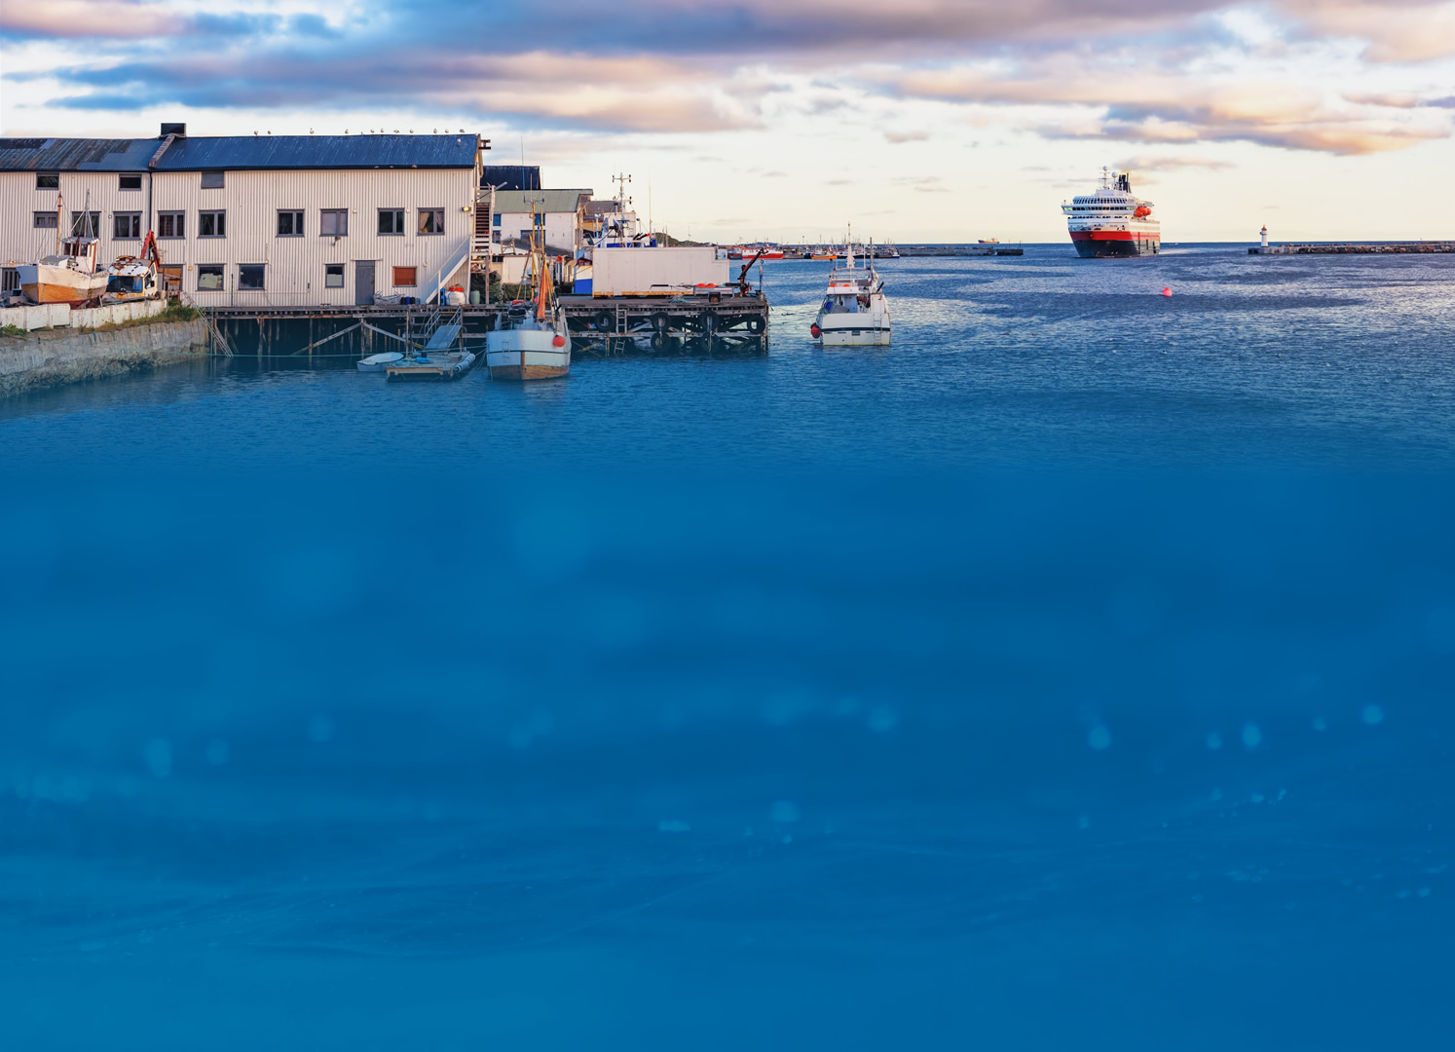
EQUIPMENT WARRANTY FOR THE VESSELS
High Stability
All equipment purchased from AecorLink has two years of fabric guarantee.
Extended warranty for longer contracts.
For equipment lease the warranty is valid during the duration of the contract period.

Slide 11
SLA
AecorLink’s control center is based in Oslo and the monitoring systems are located Norway.
All systems operated by AecorLink have redundancy to avoid disruption to the network.
Every link from ship to shore is monitored by our surveillance system and is shared with you as a client.
If there is an emergency call our technical team will meet the ship at the next port to provide technical assistance.
All scheduled updates software will be announced in advance.
SLA has a fixed monthly fee per vessel.

Slide 12
CUSTOMER RESPONSIBILITY
High Stability
1
To pull all cables from the antenna stations to the control room.
2
Ensure that there are cables from the ship's gyro.
3
Ensure that there are antenna stative in place during the installation.

