Slide 1
HOW LOW SHOULD YOU TARGET LDL-C?

Slide 2
Scientific Planning Committee (SPC)
Anthony D. D'Urzo MD, MSc, BPHE, CCFP
Associate Professor, University of Toronto
Department of Family and Community Medicine
Toronto, Ontario
Daniel Ngui, BSc, PT, MD, FCFP
Associate Professor, University of Toronto
Department of Family and Community Medicine
Toronto, Ontario
Marla Shapiro, C.M., MDCM, CCFP, MHSc, FRCPC, FCFP, NCMP
Professor, University of Toronto
Department of Family and Community Medicine
University Health Network
North York General, Mount Sinai
Toronto, Ontario

Slide 3
Disclosure of Commercial Support
This program has received financial support from [organization name] in the form of an educational grant.
This program has received in-kind support from [organization name] in the form of [describe support here – e.g. logistical support].
Potential for conflict(s) of interest:
[Speaker/Faculty name] has received [payment/funding, etc.] from [organization supporting this program AND/OR organization whose product(s) are being discussed in this program].
[Supporting organization name] [developed/licenses/distributes/benefits from the sale of, etc.] a product that will be discussed in this program: [insert generic and brand name here]

Slide 4
Faculty/Presenter
Robert P. Giugliano MD, SM, FACC, FAHA
Senior Investigator, TIMI Study Group Physician, Cardiovascular Medicine
Brigham and Women's Hospital Associate Professor
Harvard Medical School

Slide 5
Faculty/Presenter Disclosure
Faculty [Speaker’s name]
Relationships with commercial interests:
Grants/Research Support: PharmaCorp ABC
Speakers Bureau/Honoraria: XYZ Biopharmaceuticals Ltd.
Consulting Fees: MedX Group Inc.
Other: Employee of XXY Hospital Group

Slide 6
Mitigating Potential Bias
All content has been reviewed by a physician steering committee and the College of Family Physicians Canada
All data has been sourced from evidence that is clinically accepted
All support used in justification of patient care recommendations conform to generally accepted standards

Slide 7
Learning Objectives
By participating in this educational program, health care providers will be able to:
UNDERSTAND The burden of acute exacerbations in patients with COPD
OPTIMALLY Manage acute exacerbations of COPD (AECOPD)
APPLY Mon-pharmacologic and pharmacologic approaches to prevent future AECOPD
INCORPORATE Guideline recommendations into clinical practice to manage comorbidities and assess inhaler techniques of COPD patients

Slide 8
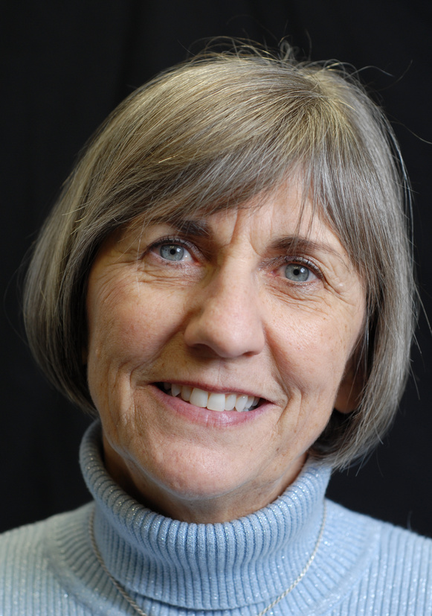
Patient Profile
65-year-old female, 1 ppd smoker x 45 yrs, quit 5 years ago
Progressive SOBOE for several years
COPD confirmed by spirometry – FEV1 50% of predicted at last visit
PMHx:
Hypertension
Diabetes
2 or 3 episodes of severe bronchitis every year over past 5 years
Treated with antibiotics
CURRENT MEDICATIONS
Perindopril erbumine 4 mg + indapamide 1.25 mg qd, metformin, daily ASA
Ipratropium bromide MDI 2 puffs bid
Salbutamol 2 puffs PRN

Slide 9
Goals of COPD Management
Goals of treatment of stable COPD
Relieve symptoms
Improve exercise tolerance
Improve Health Status
REDUCE SYMPTOMS
Prevent disease progression
Prevent and treat exacerbation
Reduce mortality
REDUCE RISK
Global Strategy for the Diagnosis MaPoC, Global Initiative for Chronic Obsctructive Lung Disease (GOLD) 2017. http://goldcopd.org.

Slide 10
Association of Disease Severity with the Frequency and Severity of Exacerbations
Hurst JR et al. N Engl J Med 2010; 363:1128-1138

Slide 11
Mortality Increases with the Frequency and Severity of AECOPD
Frequency of Exacerbations
Severity of Exacerbations
1.0
1.0
0.8
0.8
0.6
p<0.0002
NS
0.6
p<0.0001
Probability of surviving
Probability of surviving
p=0.005
p<0.0001
0.4
p=0.069
0.4
p<0.0001
NS
0.2
0.2
0.0
0.0
0
10
20
30
40
50
60
0
10
20
30
40
50
60
Time (months)
Time (months)
Patients with no acute exacerbations of COPD
No acute exacerbations of COPD
Patients with readmissions
Patients with 1-2 acute exacerbations of COPD requiring hospital management
Patients with acute exacerbations of COPD requiring emergency service visits without admission
Patients with acute exacerbations of COPD requiring hospital admission
Patients with ≥3 acute exacerbations of COPD
Soler-Cataluna JJ,et al. Thorax 2005;60:925–931

Slide 12
Prevalence of Co-morbidities in Canadian COPD Patients
82% of patients had co-morbidities
Number of Comorbidities | % of Patients
No co-morbidities | 18%
One co-morbidity | 22%
Two co-morbidities | 24%
Three co-morbidities | 16%
Four or more | 20%
Mean Number of Co-morbidities: 2.7
Hernandez et al. Can Respir J 2013; 20:97-105.

