Slide 1
COMPELLING LESSONS LEARNED, FROM: “Hope Never Dies”
HOPE NEVER DIES
HOW 20
LATE-STAGE AND TERMINAL
CANCER PATIENTS
“BEAT THE ODDS”
By Rick Shapiro, B.A., J.D., Author and Cancer Coach
RickShapiro16@gmail.com
Copyright © 2018, Rick Shapiro, Innovative Healing Press, LLC, All Rights Reserved
Notes:
The origin, development and experience of creating my book, Hope Never Dies, has been a Life Changing, and Enlightening Experience for me: I have learned many lessons from the people I interviewed, not only about the Integrative and Alternative Protocols they implemented, but about what’s truly important in life. The many patients and cancer specialists have helped me understand much about: how to live life with intention, about priorities, about what’s important, how to face fear, how to take control, and, in the cancer world, to not allow ‘nonsense and false rhetoric”, sometimes disguised as a flawed therapeutic approach, to be your guidepost. I have learned that personal transformation of any kind is possible, and sometimes transformation is more likely when we are faced with real adversity. I could talk to you for many hours about the “lessons learned” from the cancer patients and cancer specialists, I interviewed. My intent during this presentation is to inform you about things I have learned, collectively, from the remarkable patients and cancer specialists. (PAUSE) … Specifically: If you are dealing with a Cancer diagnosis, always remember: YOU ARE NOT A STATISTIC, YOU ARE AN INDIVIDUAL, AND THERE ARE MANY-MANY PEOPLE WHO HAVE BEATEN THE ODDS. PEOPLE WHO HAVE BEEN TOLD THEY ARE TERMINAL, AND WHO ARE THRIVING MANY-MANY YEARS LATER. I HAVE PERSONALLY MET HUNDREDS OF THESE PEOPLE, ACROSS THE COUNTRY. AND, I AM HERE TO TELL YOU: THERE IS REAL HOPE …

Slide 2
BACKGROUND INFORMATION
No Disclosures or Conflicts; No Monetary Exchange with Interviewees
Board Member: Annie Appleseed Project
Member: Society of Integrative Oncologists
Member: Oncology Association of Naturopathic Physicians
Rick Shapiro: Former practicing Attorney, “not” an M.D., N.D., Ph.D; Financial Advisor: “The Wheatley Group”, a Merger & Acquisition Firm
My Passion: Counsel, Inspire, Empower & Educate People about Safe, Evidence-Based Integrative/Alternative Cancer Therapies To Save Lives.

Slide 3
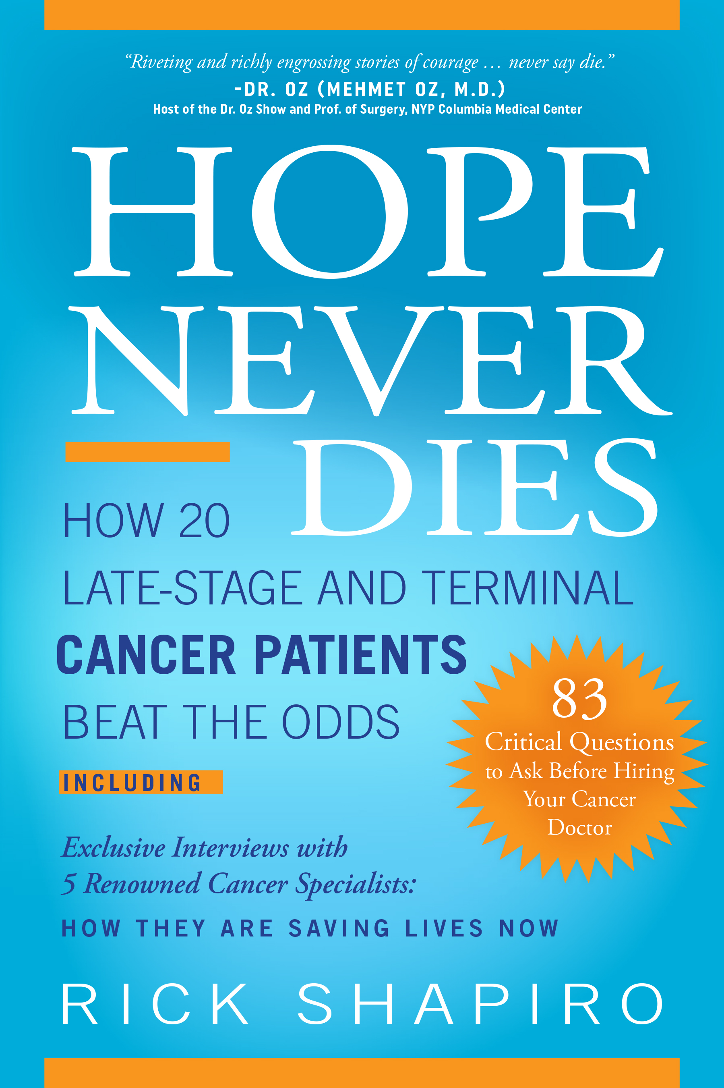
“Riveting and richly engrossing stories of courage... never say die.”
Dr. Oz (Mehmet Oz, M.D.)
Host of the Dr. Oz Show and Prof. of Surgery,
NYP Columbia Medical Center
“The title says it all. There is no false hope and statistics do not foretell the future. We all have the potential for self-induced healing. there is much to be learned from those who don’t die when they are supposed to and both doctors and patients need to be aware of the lessons to be learned”
Bernie Siegel, M.D.
Author of Love, Medicine and Miracles and the Art of Healing

Slide 4
HISTORY: Why …“Hope Never Dies”
My Dad: Aggressive Lymphoma
January 15, 1996: M.D., “We will bring out the Big Guns …” (Highly Potent Chemotherapy)
Horrific Side Effects, Almost Death: Dad said: “No more.”
February 15, 1996: M.D.: “We look at your Dad’s situation as terminal.” Helpless—Hopeless.
March 29, 1996: My father dies of cancer; Tough—Difficult time ...
My Personal Scare
2001: Cimbing Liver Enzymes; Scans/Tests: M.D.“ ... Biopsy on your Liver.”
“Make a Deal”: One month... Transformed Diet = Normal Liver Enzymes...

Slide 5
Research: “Is there a better way than solely ‘SOC’ (chemo, radiation, surgery)?”
PubMed.gov 27+ Million Studies, Investigated Numerous Studies
Dan Schectman, Ph.D. ‘82, “Ridiculed, Fool”; 2011 Nobel Prize Chemistry
2010, Annie Appleseed Project 24 Conferences, and Mexican Clinics
Objective, Rational Analysis WHY Do Some People “Beat the Odds?”
Notes:
IS THERE A BETTER WAY, BESIDES “STANDARD OF CARE?” IS THERE EVIDENCE THAT NON-STANDARD OF CARE CAN WORK, AND BE SAFE? NEED TO RECONSIDER THE BEST THERAPEUTIC APPROACHES …

Slide 6
Conclusions & Action… Write “Hope Never Dies” …
Unequivocal Conclusion From Hope Never Dies:
There are Better Models Than Solely the “Standard of Care.” We Need to Formulate a Better Paradigm ...
People Need to Know
I have met hundreds of people who were told to get their affairs in order. Regardless, many are surviving and thriving many years later. People need to hear the stories, and learn about their transformational, life-saving treatments.

Slide 7
Diane Klenke Original Diagnosis: 2004 PancCa, liver 3 months to live
Joshua Pock Original Diagnosis: 2005 Brain cancer 18 months to live
Elizabeth Panke Original Diagnosis: 1999 Ovarian, uterine, stomach
2 months to live

Slide 8
LESSONS LEARNED “You are not a Statistic”
“There are lies, damned lies and statistics”
Attributed to Benjamin Disraeli, British Prime Minister
Everyone is Different
Bio-chemistry, habits, health history… “You are an Individual.” Again - You are not a Statistic.
Everyone responds to “dire pronouncements” differently Many recede into depression and accept purported “expiration dates”; others seek out other non-standard of care medical options. Most people are not proactive about finding “out-of-the-box” therapies, beyond the standard-of-care.

Slide 9
LESSONS LEARNED: Attitude Matters

Slide 10
LESSONS LEARNED: Attitude Matters
Uniformly Prevalent
After initial shock, fear, anxiety and high stress...
Fighting Spirit
Goals, Purpose, Future Events...
No-Quit Attitude
Not Accepting Dire Predictions...
Knowing There is HOPE The success stories of others is Critical...

Slide 11
LESSONS LEARNED: Seeking and Implementing Other Evidence-Based Treatments and Therapies
“Other”, Non Standard-of-Care Therapies and Treatments, implemented and administered “with and/or without” standard of care, CAN BE Profoundly Influential.
The Great Majority of Patients implemented several approaches, simultaneously, “not” one-off, singular, “silver-bullet” approaches.

Slide 12
LESSONS LEARNED Mind-Body Therapies

Slide 13
LESSONS LEARNED Mind-Body Therapies
Stress, Fear, Anxiety and Depression Weakens Immune System Example: Placebo lost hair case (Radical Remission...)
Importance—Immune Systems Need strong, vital NK cells, T-Cells, B-Cells, Macrophages, other aspects, to DETECT and FIGHT Cancer.
Potential Mind-Body Therapies Meditation, Prayer, Humor, Music, Other Stress Relaxation Classes and Techniques Can be Impactful.

Slide 14
LESSONS LEARNED Mind-Body Therapies
“One example concerns an 11-year study of a stress management technique known as “progressive muscle relaxation” with breast cancer patients, at high risk of relapse, at the James Cancer Center of Ohio State University. The study found that regular practice of this technique reduced the risk of dying of breast cancer by 56 percent. There is no reason to expect that these benefits would be confined to a single cancer type.” Dwight McKee, M.D.
“I have also learned that patients who are motivated by something unfinished in their life, like raising a child, or those with a goal to achieve an unfinished work, do much better than those who are motivated primarily by fear of dying. Unfortunately, many people involved in treatments are motivated by the fear of dying versus a drive to accomplish specific things.”
Dwight McKee, M.D.

Slide 15
LESSONS LEARNED Supplementation Programs
Is There Evidence of Efficacy? ABSOLUTETY YES!
PUBMED.GOV; “Search”:
Curcumin Cancer = 4,233 studies as of – 1/21/18
Green Tea Cancer = 4,543 studies as of – 1/21/18
Vitamin D Cancer = 9,846 studies as of – 1/21/18
Supplements Cancer = 7,365 studies as of – 1/21/18

