Slide 1
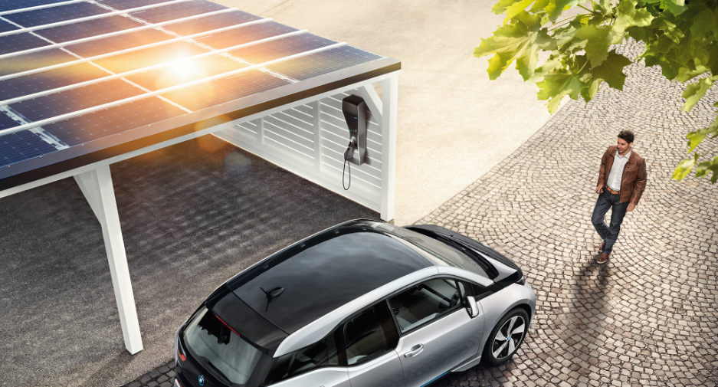
Date
Energy storage systems
AN introduction

Slide 2
Characteristics of energy storage techniques
Energy storage techniques can be classified corroding to these criteria:
The type of application: permanent or portable.
Storage duration: short or long term.
Type of product: maximum power needed.
It is therefore necessary to analyse critically the fundamental characteristics (technical and economical) of storage systems in order to establish comparison criteria are for selecting the best technology.
The main characteristic of storage systems on which the selection criteria are based the following.
Storage Capacity
This is the quality of available energy in the storage system after charging. Discharge is often incomplete. For this reason, it is defined on the basis of total energy stored, W_{st} (Wh), which is superior to that actually retrieved (operational), noted W_{ut} (Wh). The usable energy, limited by the depth of discharge, represents the limit of discharge depth (maximum-charge state). In conditions of the quick charge or discharge, the efficiency deteriorates and the retrievable energy can be much lower than storage capacity. On the other hand, selfdischarge is the attenuating factor under very slow regime (see Fig. 16).

Slide 3
Characteristics of energy storage techniques
Available power
This parameter determines the constitution and size of the motor-generator in the stored energy conversion chain. It is generally expressed an as average value, as well as a peak value often used to represent maximum power of charge or discharge, P_{max}(W)¹.
Depth of discharge or power transmission rate
Energy storage is a slow process that subsequently must quickly release energy on demand. The power output, or discharge, can be a limiting factor called the power transmission rate. This delivery rate determines the time needed to extract the stored energy. The power must be available for delivery during peak hours, that is to say the amount of energy used, if significant, is representative of a non-optimum system design, or a fundamental limit of the storage apparatus.

Slide 4
Electric Energy
First, electricity is consumed at the same time as it is generated. The proper amount of electricity must always be provided to meet the varying demand.
The second characteristic is that the places where electricity is generated are usually located far from the locations where it is consumed. Generators and consumers are connected through power grids and form a power system.
Therefore it is helpful to store energy for later use. Energy can be stored by using various technologies:

Slide 5
energy storage technologies
Mechanical Energy
Storage
Electrical Energy
Storage
Thermal Energy
Storage
Chemical Energy
Storage
Potential
Energy
Storage
Kinetic
Energy
Storage
Electrostatic
Energy
Storage
Magnet/current
Energy
Storage
Low Temperature
Energy
Storage
High Temperature
Energy
Storage
Chemical ES
Electro- chemical ES
Thermal ES
Compressed
Air
Capacitors
Aquifier LT-ES
Batteries
Pumped
Hydro
Supercapacitors
Cryogenic LT-ES
Fuel Cells
Flywheels
Superconducting
Magnetic Energy Storage
Sensible Heat Storage
Solar
Hydrogen
Latent Heat Storage
Solar Metal
Solar
Ammonia
Solar Methane

Slide 6
Mechanical Energy
Technology Type
Open-loop Pumped Hydro Storage (Time Shift)
Rated Power in kW
3,003,000
Duration at Rated Power
10:18.00
The Bath County Pumped Storage Station is a pumped storage hydroelectric power plant, which is described as the “largest battery in the world”, with a generation capacity of 3,003 MW[3] The station is located in the northern corner of Bath County, Virginia, on the southeast side of the Eastern Continental Divide, which forms this section of the border between Virginia and West Virginia. The station consists of two reservoirs separated by about 1,260 feet (380 m) in elevation.
It is the largest pumped-storage power station in the world. Construction on the power station, with an original capacity of 2,100 megawatts (2,800,000 hp), began in March 1977 and was completed in December 1985 at a cost of $1.6 billion, Voith-Siemens upgraded the six turbines between 2004 and 2009, increasing power generation to 500.5 MW and pumping power to 480 megawatts (640,000 hp) for each turbine.

Slide 7
Electrical Energy Storage
Supercapacitors
The super caps shining point is C rate (or power). So if you hand pick the app where you need a high C rate at low ambients it might work to do a Cap/ battery Hybrid.
They really don’t work in Tesla situation though where they have a huge battery so C rate is not that Critical and cycle life is not critical.
Supercaps are great for fast discharging AND fast charging. Cyclelife is the most important part for storage!
Graphene Supercapacitor

Slide 8
Electrical Energy Storage
Ultracapacitors
Ultracapacitors also last far longer, aren’t as temperature-sensitive (they’ve been used in F1 racing, after all), and don’t lose capacity as they age.
Mazda führ I-Eloop-System ein, mit dem die beim Bremsen entstehende Energie in einem Kondensator gespeichert
Maxwell’s entire line of ultracapacitor products

Slide 9
Thermal Energy
Cryogenic energy storage
Cryogenic energy storage (CES) is the use of low temperature (cryogenic) liquids such as liquid air or liquid nitrogen as energy storage.
HISTORY
A liquid air powered car called Liquid Air was built between 1899 and 1902 but it couldn't at the time compete in terms of efficiency with other engines More recently, a liquid nitrogen vehicle was built. Peter Dearman, a garage inventor in Hertfordshire, UK who had initially developed a liquid air powered car, then put the technology to use as grid energy storage.

Slide 10
Thermal Energy
Grid energy storage (Process)
When it is cheaper (usually at night), electricity is used to cool air from the atmosphere to -195 °C using the Claude Cycle to the point where it liquefies. The liquid air, which takes up one-thousandth of the volume of the gas, can be kept for a long time in a large vacuum flask at atmospheric pressure. At times of high demand for electricity, the liquid air is pumped at high pressure into a heat exchanger, which acts as a boiler. Air from the atmosphere at ambient temperature, or hot water from an industrial heat source, is used to heat the liquid and turn it back into a gas. The massive increase in volume and pressure from this is used to drive a turbine to generate electricity
Pilot plant
A 300 kW, 2.5MWh storage capacity pilot cryogenic energy system developed by
researchers at the University of Leeds and Highview Power Storage, that uses liquid air (with the CO2 and water removed as they would turn solid at the storage temperature) as the energy store, and low-grade waste heat to boost the thermal re-expansion of the air, has been operating at a 80MW biomass power station in Slough, UK, since 2010. The efficiency is less than 15% because of low efficiency hardware components used, but the engineers are targeting an efficiency of about 60 percent for the next generation of CES based on operation experiences of this system.
The system is based on proven technology, used safely in many industrial processes, and does not require any particularly rare elements or expensive components to manufacture. Dr Tim Fox, the head of Energy at the IMechE says "it uses standard industrial components...., it will last for decades, and it can be fixed with a spanner."

Slide 11
Chemical Energy: Fuel Cell
A fuel cell is a device that converts the chemical energy from a fuel into electricity through a chemical reaction of positively charged hydrogen ions with oxygen or another oxidizing agent. Fuel cells are different from batteries in that they require a continuous source of fuel and oxygen or air to sustain the chemical reaction, whereas in a battery the chemicals present in the battery react with each other to generate an electromotive force. Fuel cells can produce electricity continuously for as long as these inputs are supplied.
Comparison of fuel economy express in MPGe for hydrogen fuel cell vehicles Available for leasing in California and rated by the U.S. Environmental Protection Agency as of August 2015 ^{[23]}
Vehicle | Model Year | Combined Fuel Economy | City Fuel Economy | Highway Fuel Economy | Range | Annual Fuel Cost
Honda FCX Clarity | 2014 | 59 mpg-e | 58 mpg-e | 60 mpg-e | 231 mi (372 km) | NA
Hyundai Tuscon Fuel Cell | 2016 | 50 mpg-e | 49 mpg-e | 51 mpg-e | 265 mi (426 km) | US$1,700
Toyota Mirai | 2016 | 66 mpg-e | 66 mpg-e | 66 mpg-e | 321 mi (502 km) | US$1,250
Notes: One kg of hydrogen is rough equivalent to one U.S. gallon of gasoline.

Slide 12
Chemical Energy: Fuel Cell
Fuel cells for use in cars will never be commercially viable because of the inefficiency of producing, transporting and storing hydrogen and the flammability of the gas.

Slide 13
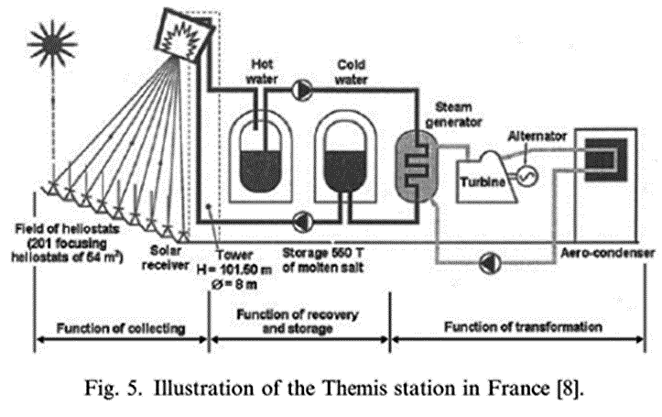
Sensible Heat Thermal storage
Sensible heat thermal storage is achieved by heating a bulk material (sodium, molten salt, pressurized water, etc.) that does not change states during the accumulation phase; the heat is then recovered to produce water vapor, which drives a turbo-alternator system.
The use of molten salt in the Themis station in France has made it possible to store heat economically and simplify the regulation of the solar panel (Fig. 5.)[8]. This system was designed to store 40,000 kWh of thermal energy, equivalent to almost 1 day of average sunlight, in 550 tonnes of fused electrolyte [8].

Slide 14
Worldwide installed storage capacity
Figure 1
Worldwide Installed Storage Capacity for Electrical Energy

Slide 15
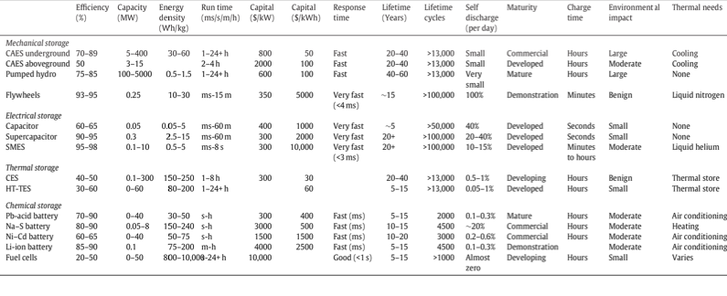
Comparison of energy storage technologies
 | Mechanical Storage |  |  |  | Electrical Storage
 | CAES underground | CAES aboveground | Pumped Hydro | Flywheels | Capacitor | Supercapcitor | SMES
Efficiency (%) | 70-89 | 50 | 75-85 | 93-95 | 60-65 | 90-95 | 95-98
Capacity (MW) | 5-400 | 3-15 | 100-5000 | 0.25 | 0.05 | 0.3 | 0.1-10
Energy Density (wh/kg) | 30-60 |  | 0.5-1.5 | 10-30 | 0.05-5 | 2.5-15 | 0.5-5
Rune Time (ms/s/m/h) | 1-24+h | 2-4h | 1-24+h | ms-15 m | ms-60 m | ms-60 m | ms-8 s
Capital ($/kW) | 800 | 2000 | 600 | 350 | 400 | 300 | 300
Capital ($|/kWh) | 50 | 100 | 100 | 5000 | 1000 | 2000 | 10,000
Response Time | Fast | Fast | Fast | Very Fast (<4ms) | Very Fast | Very Fast | Very Fast (<3 ms)
Lifetime (Years) | 20-40 | 20-40 | 40-60 | ~15 | ~5 | 20+ | 20+
Lifetime cycles | >13,000 | >13,000 | >13,000 | >100,000 | >50,000 | >100,000 | >100,000
Self discharge (per day) | Small | Small | Very Small | 100% | 40% | 20-40% | 10-15%
Maturity | Commercial | Developed | Mature | Demonstration | Developed | Developed | Developed
Charge time | Hours | Hours | Hours | Minutes | Seconds | Seconds | Minutes to hours
Environmental Impact | Large | Moderate | Large | Benign | Small | Small | Moderate
Thermal Needs | Cooling | Cooling | None | Liquid nitrogen | None | None | Liquid helium
Table 1.1 - Summary of energy storage technologies

Slide 16
Comparison of energy storage technologies
 | Thermal Storage |  | Chemical Storage
 | CES | HT-TES | Pb-acid battery | Na-S Battery | Ni-CD Battery | Li-ion Battery | Fuel Cells
Efficiency (%) | 40-50 | 30-60 | 70-90 | 80-90 | 60-65 | 85-90 | 20-50
Capacity (MW) | 0.1-300 | 0-60 | 0-40 | 0.05-8 | 0-40 | 0.1 | 0-50
Energy Density (wh/kg) | 150-250 | 80-200 | 30-50 | 150-240 | 50-75 | 72-200 | 800-10,000
Rune Time (ms/s/m/h) | 1-8h | 1-24+h | s-h | s-h | s-h | m-h | 1-24+h
Capital ($/kW) | 300 |  | 300 | 3000 | 1500 | 4000 | 10,000
Capital ($|/kWh) | 30 | 60 | 400 | 500 | 1500 | 2500
Response Time |  |  | Fast (ms) | Fast (ms) | Fast (ms) | Fast (ms) | Good (<1s)
Lifetime (Years) | 20-40 | 5-15 | 5-15 | 10-15 | 10-20 | 5-15 | 5-15
Lifetime cycles | >13,000 | >13,000 | 2000 | 4500 | 3000 | 4500 | >1000
Self discharge (per day) | 0.5-1% | 0.05-1% | 0.1-0.3% | ~20% | 0.2-0.6% | 0.1-0.3% | Almost zero
Maturity | Developing | Developed | Mature | Commercial | Commercial | Demonstration | Developing
Charge time | Hours | Hours | Hours | Hours | Hours |  | Hours
Environmental Impact | Benign | Small | Moderate | Moderate | Moderate | Moderate | Small
Thermal Needs | Thermal store | Thermal store | Air conditioning | Heating | Air conditioning | Air conditioning | Varies
Table 1.2 - Summary of energy storage technologies

Slide 17
Storage Techniques
10,000
High Power
E.C. Capacitors
High Power
Fly Wheels
Long Duration
Flywheels
Li-ion
Ni-Cd
1,000
Lead-Acid
Batteries
NaS
Battery
Flow Batteries
Zinc-Air
Batteries
Better for
Energy
Management Applications
Capital Cost per Unit Energy – 5kWh-output (Cost/capacity/efficiency)
Rechargeable
Long Duration
E.C. Capacitors
100
Pumped
Hydro
CAES
Metal-Air
Batteries
Better for UPS and
Power Quality Applications
10
100
300
1,000
3,000
10,000
Capital Cost per Unit Power - $/kW
Figure 24 – Distribution of storage techniques as a function of investment costs per unit of energy [10].

Slide 18
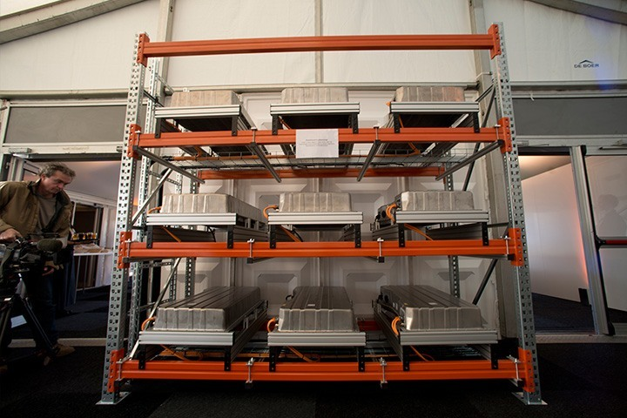
World's largest 2nd-use battery storage unit set to connect to the grid
13-megawatt battery storage unit to connect to the grid in early 2016
Levelling out fluctuations in the power grid as an active contribution towards the energy revolution
The world's largest 2nd-use battery storage unit will soon go into operation in the Westphalian town of Lünen and marketed in the German electricity balancing sector.

Slide 19
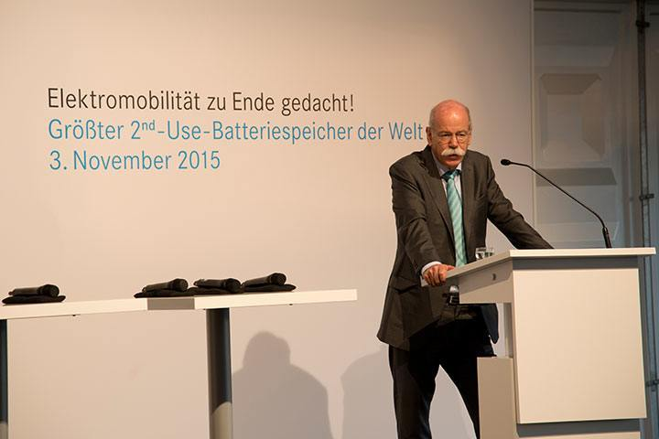
World's largest 2nd-use battery storage unit set to connect to the grid
A special feature of this venture is the use of second-life battery systems from electric vehicles.
In Lünen, systems from the second generation of smart electric drive vehicles are being incorporated into a stationary storage unit with a total capacity of 13 MWh.
The process demonstrably improves the environmental performance of electric vehicles, thereby helping to make e-mobility more economically efficient.

