Slide 1
Press F5 to begin

Slide 2
WHAT I CAN DO
FOR YOU

Slide 3
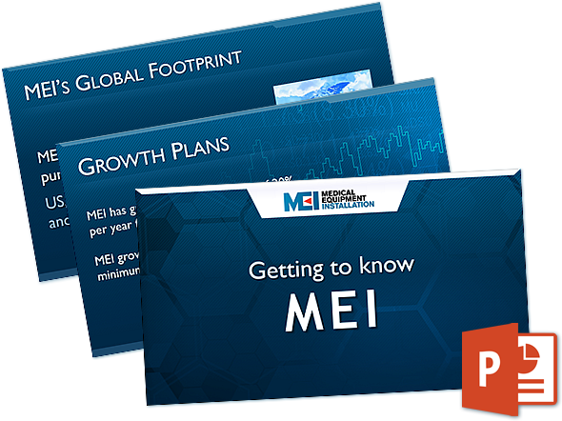
CREATE
A UNIQUE PRESENTATION
BASED ON YOUR CONTENT

Slide 4
DESIGN
GRAPHICS TAILORED SPECIFICALLY FOR
YOUR PRESENTATION

Slide 5
CREATE
CHARTS AND INFOGRAPHICS BASED
ON YOUR DATA

Slide 6
ANIMATE
KEYPOINTS AND IMAGES TO BRING EMPHASIS TO IMPORTANT DETAILS
EMPHASIS

Slide 7
WHO
AM I?

Slide 8
BRAD MCGINNISS
15+ YEARS EXPERIENCE AS WEB & GRAPHIC DESIGNER
100% PROJECT COMPLETION
80+ 5 STAR REVIEWS
FLUENT IN ENGLISH
FINE ARTS DEGREE MAJORING IN ELECTRONIC MEDIA

Slide 9
PORTFOLIO
POWERPOINT PRESENTATION
DESIGN EXAMPLES

Slide 10
MERTONS 10TH ANNIVERSARY
CELEBRATION
MERTONS
The presentation is looking great we are really impressed with Brad's work, the latest version looks great - I've just shown Mark (Managing Director) and he loves it!
Brad is professional and easy to work with. He kept us up to date on progress. He worked with our original concept and shaped it into a high quality final product that we are extremely satisfied with
Kelly Personal Assistant

Slide 11
MEDICAL EQUIPMENT INSTALLATION
MICHAEL HAMMOND
Amazing! Helped us out of a total nightmare, calm, friendly, fast & great to work with. Will definitely rehire as soon as possible. A huge five stars from us! THANK YOU!
Holly Art Director & Designer

Slide 12
ENERGY STORAGE SYSTEMS
VORTRAG SOLUTIONS
Great work! I like this. Very clean - the current format is good. It's great! You nailed it. I'm happy with the result. I will need another one in the future for sure. Will hire again!
Nel Seo Senior Researcher

Slide 13
CONTACT ME
WANT A CUTTING EDGE PRESENTATION?
WEBDESIGNX.COM.AU
FREELANCER.COM PROFILE

