Slide 1
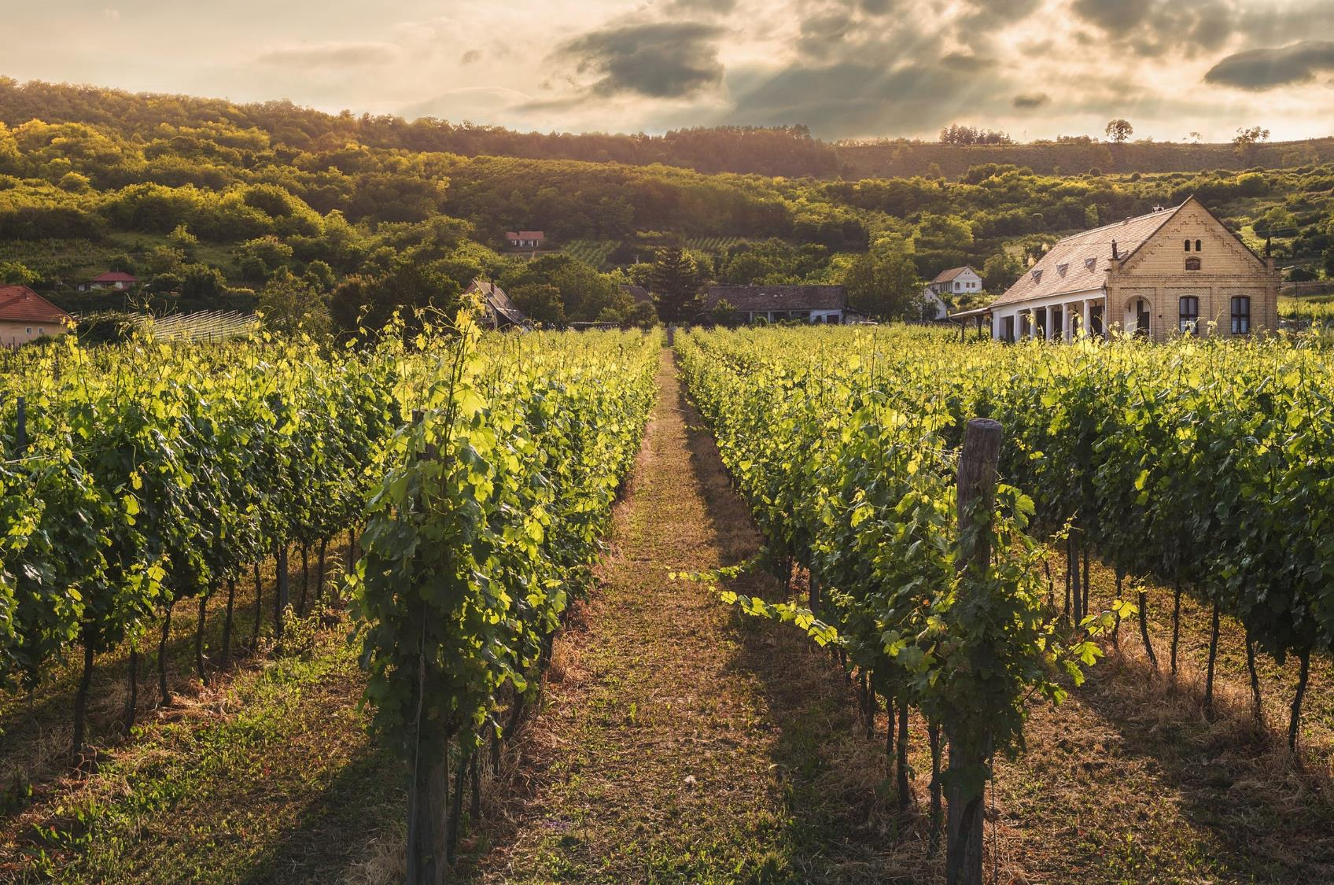
WINE
INVESTMENT
PROPOSAL
BPWI Ltd.
London | December 2019

Slide 2
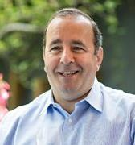

Who are we?
Peter Lunzer
Peter is the founder of Lunzer Wine Group with more than 30 years experience in the wine sector.
Bo Ekberg
Bo is an experienced entrepreneur and business executive with a particular passion for start-ups that seek to disrupt existing industries in a way that benefits the consumer.
Peter formulated the Price Step Theory and subsequently developed the Wine Price Ratio which is a data driven process to analyse investing opportunities in the fine wine market.
Working with globally distinguished companies Peter sees the consumption patterns of wines through the corporate events that he hosts and in turn this knowledge guides investment decisions based on what is in demand and also what is tasting good.
In 2011 he co-founded Task360. It became the UK’s leading iOS based crowdsourcing platform for information collection and completion of temporary tasks. It was sold to Private Equity investors in 2017.
He now acts as a Consultant and trusted Board level Advisor to businesses of various sizes across multiple industries.
Leveraging his strong financial background and passion for wine he currently sits on the Advisory Board of Bordeaux based Chateau Meaume.

Slide 3
What are we actually proposing?
Our vision is to provide transparent and attractive financial returns from investments into fine wine,
combined with access to the pleasures of the fine wine world.
BPWI Ltd. Proposal
An invitation for you to become an integral part of the world of fine wine and to achieve attractive financial returns as a Partner in an LLP that invests in wine.
As a Partner you will benefit directly from our combined depth of knowledge of, and access to the inside track of the wine industry.
Capital, after agreed fees and expenses, will be exclusively invested in a tradeable portfolio of wines which is wholly owned by the LLP.
The LLP can invest completely independently compared to a merchant managing their portfolio positions.
Our buying expertise and transparent approach to the world of fine wine will also give you exceptional access to personal deal flows outside the remit of the LLP.
As a Partner you can also enjoy bespoke arranged events both in the UK and internationally; e.g. at world renowned vineyards.

Slide 4

The Fine Wine Market
+/- £1.5 bio traded every year; equal to roughly 20% of available inventory.
London dominates global trading (+/-80%), followed by Hong Kong (+/-15%).
Dominated by Bordeaux, Burgundy and Champagne.
Rhone, Italy, USA and Australia emerging with some interesting wines but often with low production volumes, making them challenging to source.
Global Fine Wine Inventory stable at
+/- £7.0 bio.
Roughly 400 Fine Wine Merchants globally (Liv-Ex members)
  with the Top 6 representing +/- 25% of turnover:
  BI Fine Wine & Spirits Merchant
  Farr Vintners
  Berry Brothers & Rudd
  Corney & Barrow
  Justerini & Brooks
  Vinum Fine Wines

Slide 5
Fine Wine Versus Other Assets
‘Alternatives’, including Wine, remain popular due to low interest rates.
Wine as an investment is becoming better understood and provides diversification to a portfolio.
Trading exchanges provide increasing liquidity and - importantly – transparency.
Wine is an ‘inexpensive’ luxury compared to yachts, jets and cars.
Wealthy consumers tend not to turn their backs on fine wines.
Fine wine is produced in finite quantities.
When the economies are strong, the availability of the most sought-after wines can decrease rapidly
Index | Level (31/10) | MOM (%) | YTD (%) | 1y (%) | 5y (%)
Liv-Ex Fine Wine 50 | 343 | -1.6% | -2.0% | -3.5% | 29.4%
Liv-Ex Fine Wine 100 | 308 | -1.0% | -1.2% | -1.8% | 29.6%
Liv-Ex Bordeaux 500 | 313 | -0.7% | -1.5% | -2.3% | 32.6%
Liv-Ex Fine Wine 100 | 357 | -1.2% | -1.9% | -0.4% | 46.6%
Liv-Ex Fine Wine Investable | 339 | -1.0% | -1.2% | -2.2% | 32.8%
FTSE 100 | 7,248 | -2.2% | 7.7% | 1.7% | 10.7%
S&P 500 | 3,038 | 2.0% | 21.2% | 12.0% | 50.5%
Gold | 1,500 | 0.1% | 17.1% | 23.5% | 28.1%

Slide 6
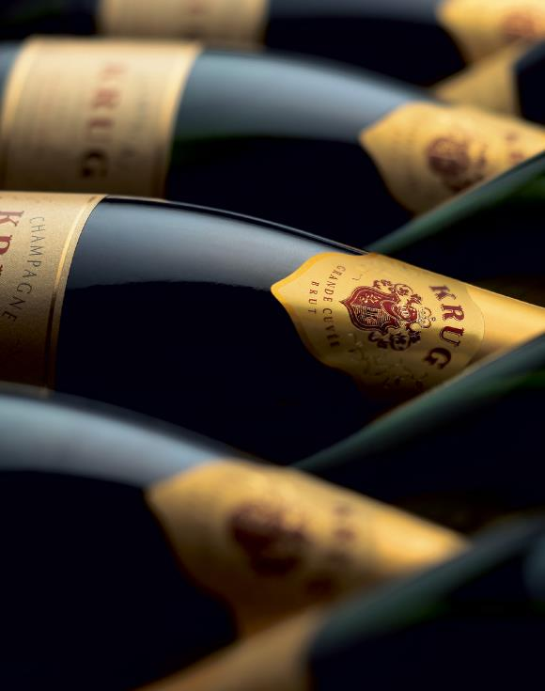
Recent Market Trends
From 2003 to 2011 it was normal to see returns of 10% p.a. net of all fees (from sympathetically priced investment vehicles).
Regime change in China in 2012 coincided with many investors losing money on 2009 and 2010 En-Primeur purchases after they had become physical. The entire wine market reacted when Chinese buyers tried to exit their positions.
Wine prices declined steadily for 3 years until 2015.
As has happened before historically, when wines become too affordable the market reacts. From 2015 to 2018 wines gently rose in price.
Global currency volatility and US-China trade wars are just two contributors to investor uncertainty since 2018.

Slide 7
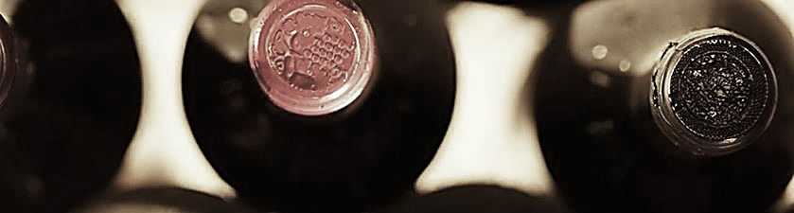
Market Potential
Market Opportunities
Market Risks
The market has plateaued for a few years and we anticipate that owning a portfolio before prices move again will be potentially beneficial.
Chinese buyers are growing in numbers year on year and supply is unlikely to keep pace with their growing demand let alone the traditional European demand for great wines.
The wine import taxes in India have held back collectors for many years. If the government were to soften their approach, then we believe it would cause a significant increase in prices due to new demand.
Repeat of price slump of the 2009 Bordeaux vintage which happened in 2012.
Polarised ownership of wine - should wine funds become mainstream then they will move the market if investors all redeem at the same time.
Trade wars might threaten the free movement of Fine Wines.

Slide 8
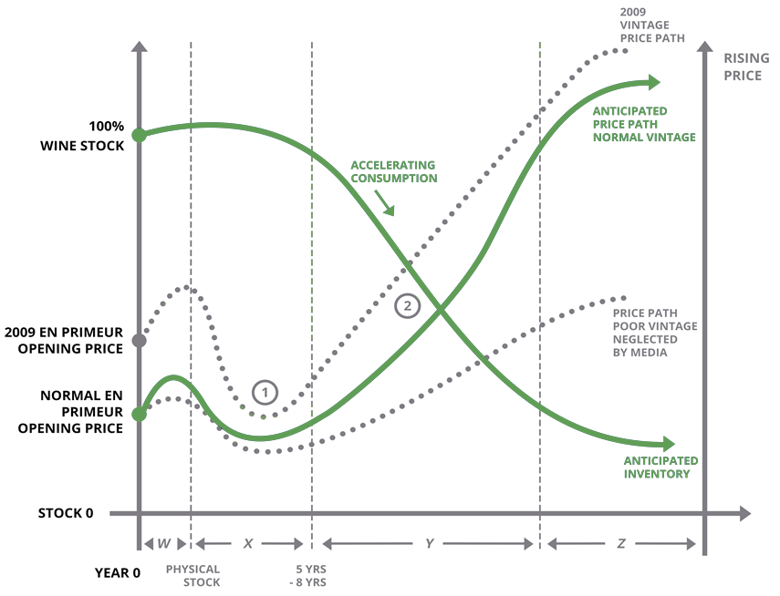
The Wine Price Ratio Model
The Wine Price Ratio Model
Production Volumes and Product Quality are driven almost entirely by the weather
Pricing for a vintage at launch is driven by Product Quality and Points awarded by Critics. However, at marker ① wines are often neglected and become less expensive
Pricing over time is driven by diminishing supply against constant or growing demand
Pricing tends to accelerate when a wine hits its peak consumption window driven by increased consumption and demand, illustrated at marker ②
STOCK
TIME

Slide 9
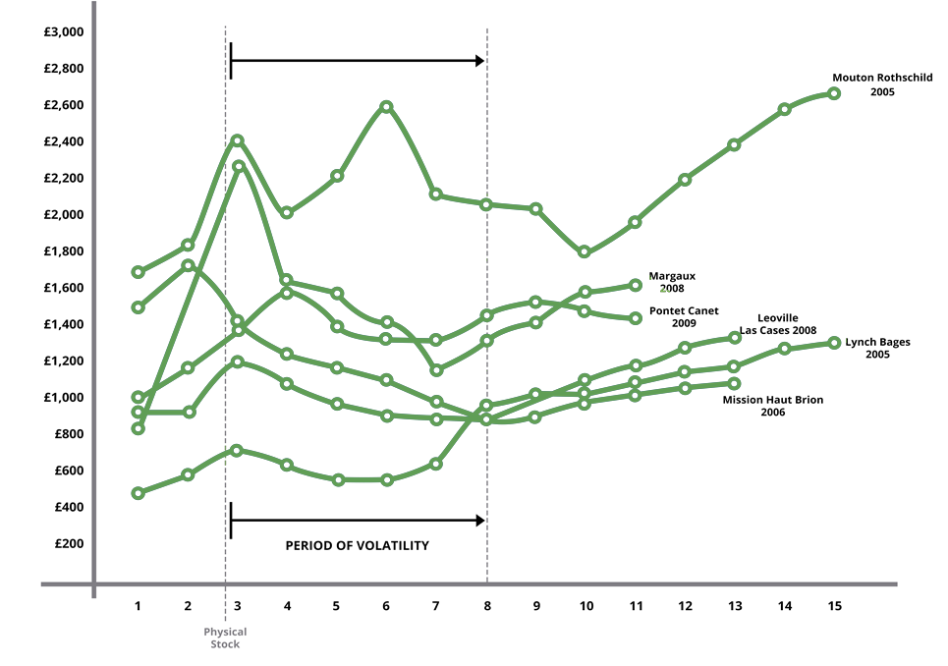
Fine Wine Pricing Examples
Actual Wine Pricing
Actual pricing echoes our Wine Price Ratio Model, as each wine moves from its En-Primeur price.
Prices do frequently rise after En Primeur, and sometimes until just after the wines are bottled.
We see that after bottling, wine prices can become volatile until the wine is old enough to be consumed.
PRICE
YEARS SINCE PRODUCTION

Slide 10
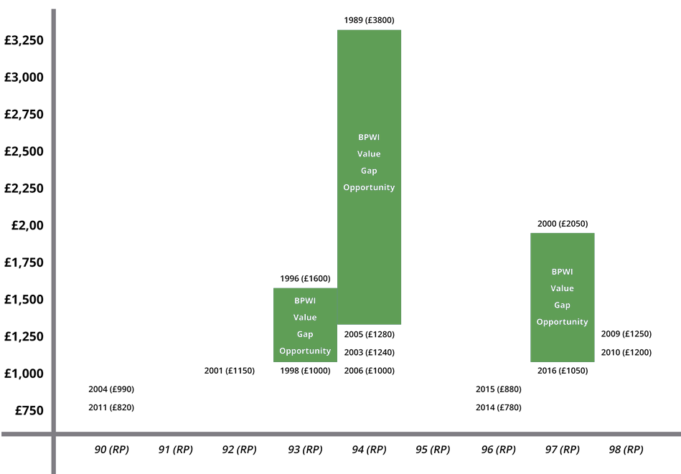
Identifying Value Opportunities
Prices for Chateau Lynch Bages
Buying Opportunities exist for a wine with comparable critic points across vintages – with younger vintages presenting value opportunities
The advent of Liv-Ex (and other exchanges) allows Member Companies to make transparent and data driven trading decisions
MID PRICE
POINTS AWARDED BY ROBERT PARKER

Slide 11
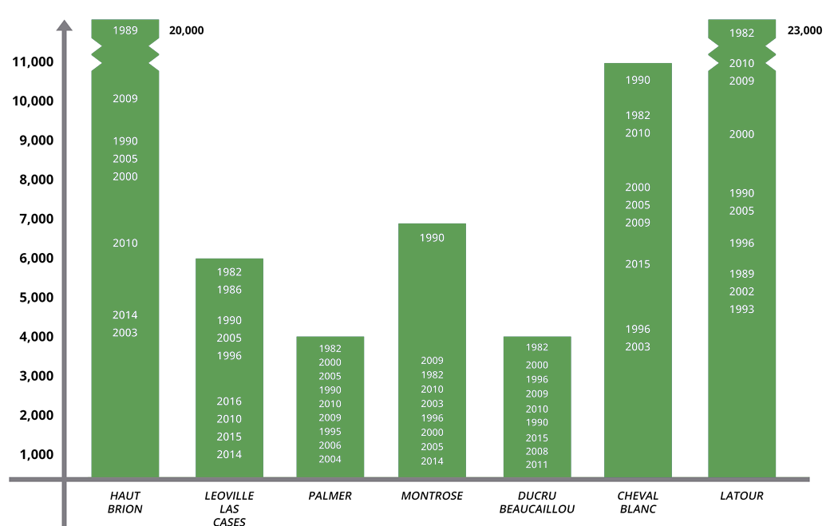
Identifying Value Opportunities
Wine Price Ceiling
For a particular wine, a ‘glass ceiling’ exists for how expensive it can or may become.
Understanding this provides valuable guidance on timing to sell and/or the remaining opportunity when buying.
Cross referencing wine critic scores, Value Gaps and ‘Price Ceilings’ provide valuable data driven support in making investment decisions.
PRICE

Slide 12
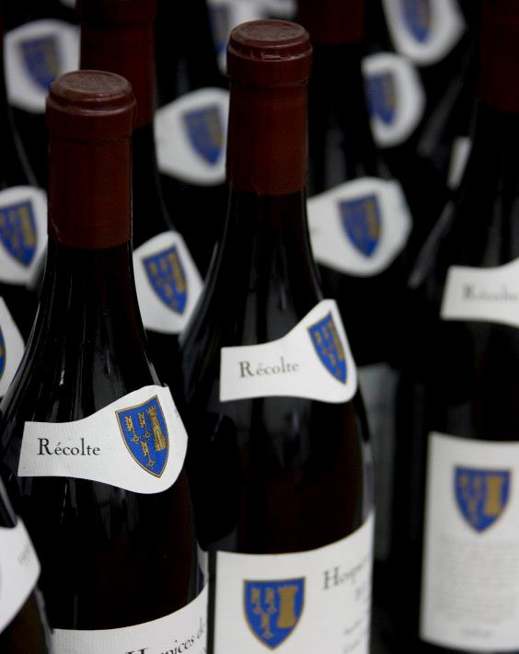
Our Investment Parameters
We only buy reputable and highly sought-after vintages of wines that have excelled themselves in that vintage and which have been properly stored.
All wines will have been highly rated by the consolidated opinion of globally renowned wine critics and the wines will already have an international reputation.
We are always looking for wines which are undervalued according to the Wine Price Ratio and Price Value Gap philosophy.
We won’t buy En-Primeur, split cases or any wines without fully documented provenance.
We intend to use all available data and our collective experience to invest in wines on an upward trend.

Slide 13
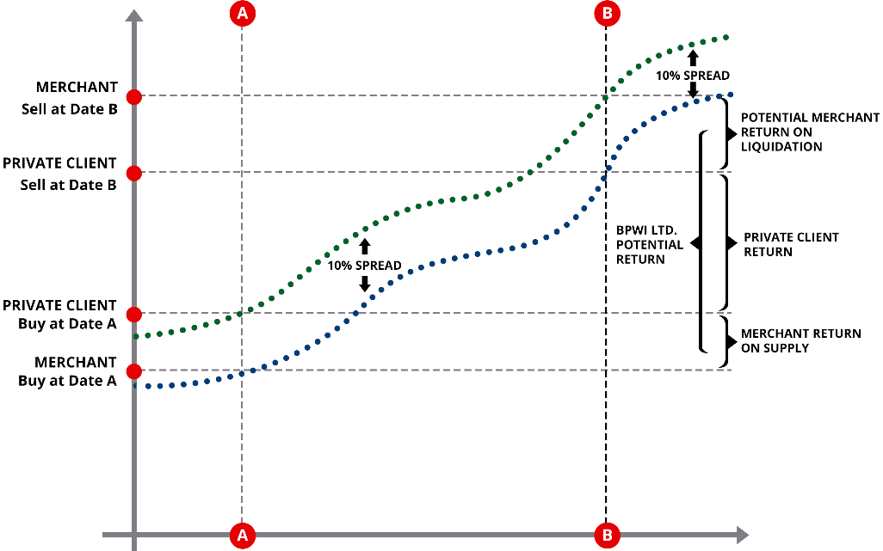
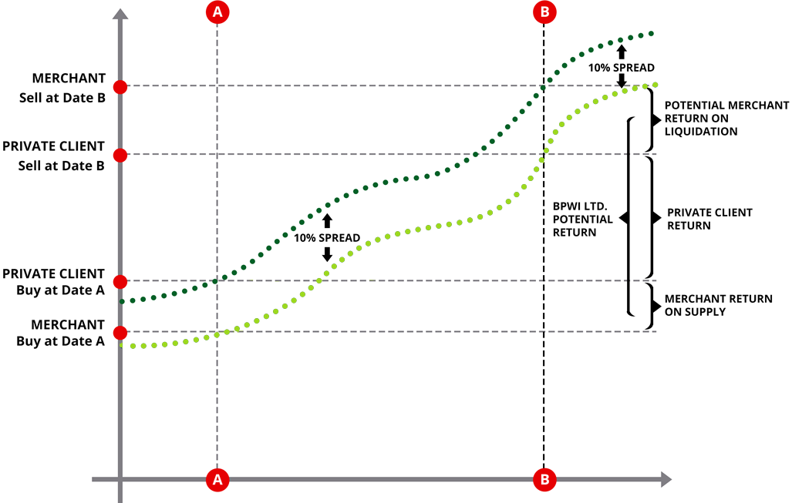
Enhanced Margins to Investors
Return On Investment – Private Client vs. Merchant
As members of London International Vintners Exchange (www.liv-ex.com) the Company will be able to buy large volumes of wine at inter-merchant prices (B2B prices) whilst remaining anonymous.
By purchasing at B2B rates the Company has the opportunity to internalise all or part of the average 10% merchant margin levied on both purchases and sales.
Trading with this enhanced margin is a key financial benefit that accrues in full to the shareholders.
PRICE
A
B
A
B
TIME

Slide 14
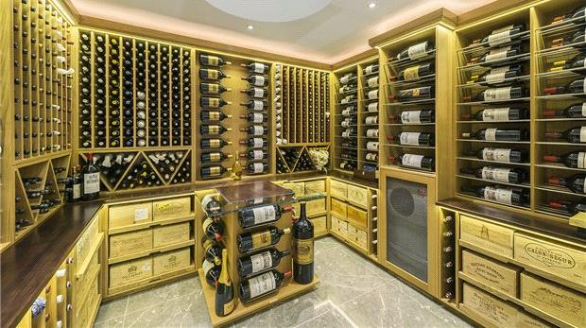
Our Proposal
Establish an LLP with capital of £ 5,000,000.00.
Recommended minimum participation of £100,000.00.
Implement a Partnership Agreement to protect the Invested Capital.
Liquidate the Partnership after 5 (or 7) years and distribute funds.
Appoint BPWI Ltd as Management and Investment Company.
Annual fees of 2.20% of the initial share capital.
12.5% of positive increase in the NAV on liquidation
Fees to be ‘paused’ if Net Asset Value drops below 95.00% of original Share Capital
  Re-instated when Net Asset Value goes above 96.00% of original Share Capital

Slide 15
How Do We Compare?
BUY & HOLD |  |  | ACTIVE MANAGEMENT
 | Wine Merchant |  | Cru Wines | Cult Wines | Bo & Peter
Number of Bottles Purchased | 5,000 |  | 5,000 | 5,000 | 5,395
Avg. Buying Price Per Bottle | £ 410.00 |  | £ 410.00 | £ 410.00 | £ 380.00
Invested Amount | £ 2,050,00.00 |  | £ 2,050,000.00 | £ 2,050,000.00 | £ 2,050,100.00
Joining Fee | 0% £ - |  | 1% £ 20,500.00 | 15% £ 307,500.00 | 0% £ -
Annual Fee for 5 Years | 0.00% £ - |  | 2.00% £205,000.00 | 0.00% £ - | 2.20% £ 225,511.00
Admin fees for 5 Years | 0.00% £ - |  | 0.00% £ - | 0.00% £ - | 0.20% £ 20,501.00
Storage & Insurance for 5 Years | 0.40% £41,000.00 |  | 0.40% £41,000.00 | 0.40% £41,000.00 | 0.40% £41,002.50
Total Cost of 5 Year Investment | £41,000.00 |  | £266,500.00 | £348,500.00 | £287,014.00
Number of Bottles Sold | 5,000 |  | 5,000 | 5,000 | 5,395
Avg. Selling Price Per Bottle | £ 600.00 |  | £ 600.00 | £ 600.00 | £ 650.00
Total Realistation from Investment | £ 3,000,000.00 |  | £ 3,000,000.00 | £ 3,000,000.00 | £ 3,506,750.00
Capital After 5 Years of Recurring Costs | £ 2,959,000.00 |  | £ 2,733,500.00 | £ 2,651,500.00 | £ 3,219,736.00
Profit Share to Managers | 0.00% £ - |  | 20.00% £190,000.00 | 0.00% £ - | 12.50% £ 146,204.50
PRE TAX Return to Investors | £ 909,000.00 |  | £ 493,500.00 | £ 601,500.00 | £ 1,203,431.50
Percentage Return over 5 Years | 44.34% |  | 24.07% | 29.34% | 49.2%
CAGR | 7.62% |  | 4.41% | 5.28% | 8.44%
‘Buy and Hold’ means that you must trust and rely entirely on your own, or your merchants judgement.
A collective portfolio of £2m + allows for broad diversification of content.
‘Buy & Hold’ decisions are most often not entirely independent as all Merchants seek to manage their own portfolio positions.
Other investment opportunities provide professional and independent advice, but result in lower returns as a result of higher costs.

Slide 16
Cost Comparison
Fee Structure Comparison | BPWI | Cru Wine | Cult Wine | UBS Fund 1 | UBS Fund 2 | UBS Fund 3
Entry Fee | 0.00% | 1.00% | 15.00% | 6.00% | 2.50% | 2.50%
Annual Management Fee | 2.20% | 2.00% | 0.00% | 0.00% | 0.00% | 0.00%
Annual Administration Fee | 0.20% | Fixed Fee | Fixed Fee | 1.08% | 1.04% | 2.12%
Annual Storage & Insurance Fee | 0.40% | 0.40% | 0.40% | 0.00% | 0.00% | 0.00%
Exit Fee / Conversion Charge | 0.00% | 0.00% | 0.00% | 3.00% | 2.50% | 2.50%
Profit Share | 12.50% | 20.00% | 0.00% | 0.00% | 0.00% | 0.00%
Performance Protection on Fees | YES | NO | NO | NO | NO | NO
Notes:
UBS Fund 1 is ISIN: LU1852199097, Sustainable Investing Balanced
UBS Fund 2 is ISIN: LU1918890887, Global Multi Income
UBS Fund 3 is ISIN: LU0678606244, Global Allocation

Slide 17
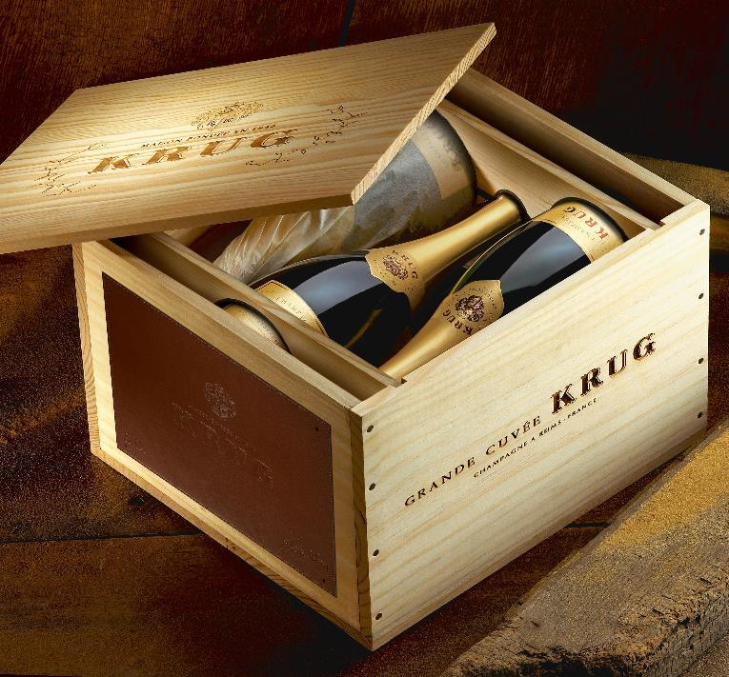
Deal Flow Benefits to Investors
Bespoke Wine Concierge Service
Access to deal flows at B2B Prices.
Access to feedback and information about any wine you may be interested in.
Purchase and Delivery services for wines that shareholders wish to purchase for their own consumption.
Preferential storage rates available for investors’ own reserves.

Slide 18
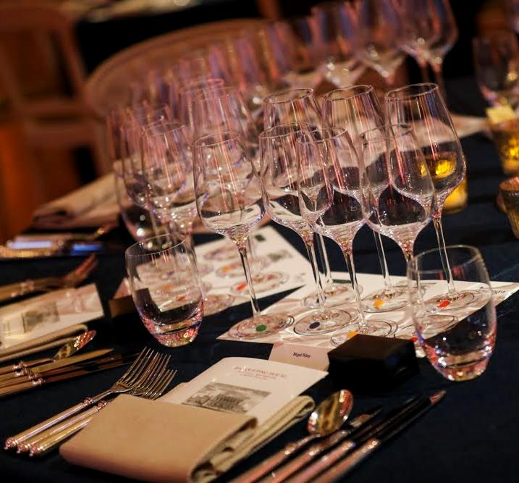
Event Benefits to Investors
Wine Themed Events
UK Dinners in premium locations in London and the Home Counties
  Vertical tastings, e.g. 6 vintages of Chateau Palmer
  Compare different wines, e.g. Puligny to Chassagne Montrachet
  Match food choices with relevant wines
  First Growth wine tastings
Annual Bordeaux dinner
Annual Burgundy dinner

Slide 19
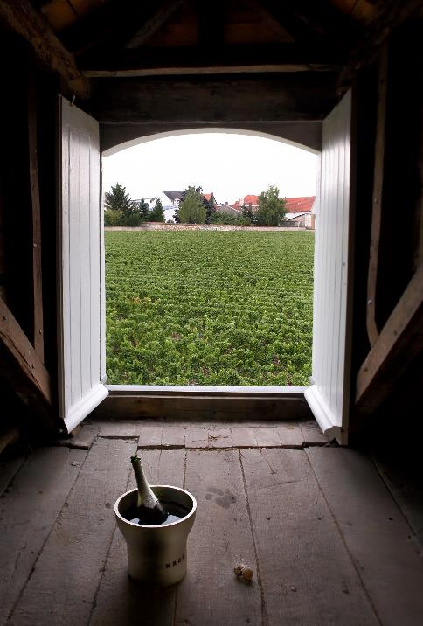
Travel Benefits to Investors
Visits to Vineyards
Visits to famous overseas Vineyards
Champagne – Krug
Bordeaux – Margaux & Yquem
Burgundy – De Vogue, Dujac, Bouchard Pere et Fils
Rhone – Guigal, Pegau
Napa Valley – Screaming Eagle, Opus One, Colgin
South Africa – Rupert & Rothschild, Kanonkop, Vergelegen (Stellenbosch)
Etc...

Slide 20

Administration and Management
Bank | Handelsbanken
Accountants | TBD
Legal | Field Parkes & Seymour
Storage/Custodian | London City Bond, Vinoteque
Additional photography courtesy of Pexels
Slide 1 “Green Plant Field Near House” by David Bartus
Slide 20 “Apple Wireless Keyboard” by Pixabay
Slide 21 “Pathway Under Clouds And Blue Sky” by David `

