Slide 1
Learn and engage with your favorite idol!

Slide 2
THE PROBLEM
Fans and the general public yearn to both directly learn from famous national experts and to have personal contact with them.
There is currently no platform that facilitates both learning and engaging.

Slide 3
THE SOLUTION
We develop an online platform through which users from all over can study online video courses from local celebrity instructors.
Users will be able to leave questions and comments and get personal video recordings of answers and feedback.

Slide 4
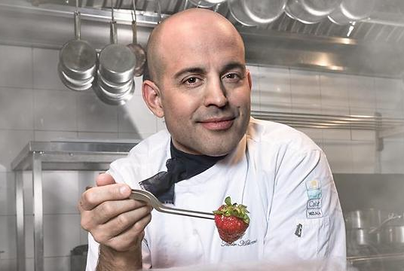
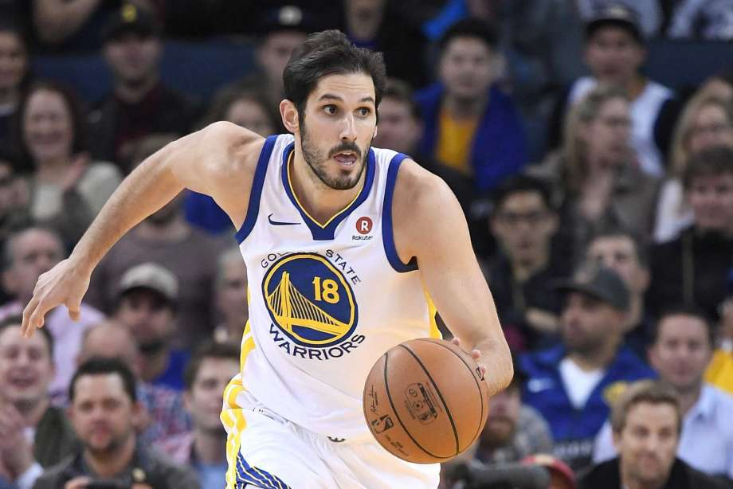
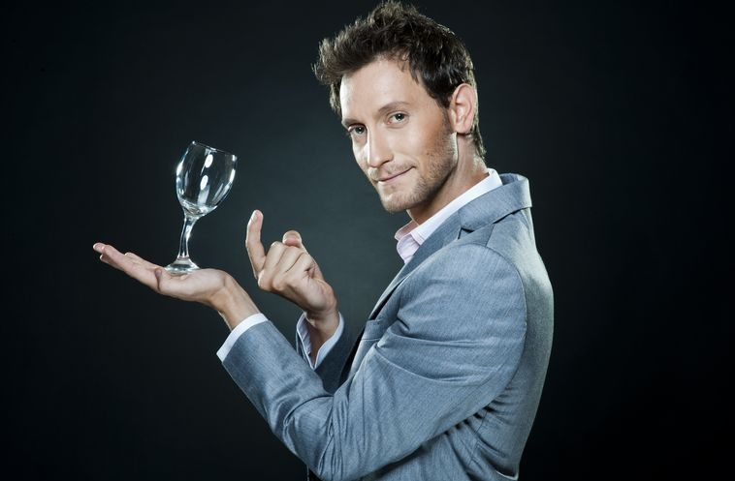
EXAMPLES OF EXPERTS
OF THE ISRAELI PLATFORM
Meir Adoni
Teaching Cooking
Omir Capassi
Teaching Basketball
Lior Suchard
Teaching Mentalism

Slide 5
BUSINESS MODEL
The
Masters
Video
Courses
Income
Sales of online courses, individually or with subscription, secondary income from sales of experts’ items, package deals available for simultaneous purchase of course and items.
Promotion
Production
Sales

Slide 6
MARKETING & SALES STRATEGY
1
Instructors must be big social media influencers.
4
2
Opening a call centre with strong sales representatives who will sell courses to hot leads over the phone and up sale current users.
Instructors must commit to constantly promote their courses on their channels.
3
Provide incentive to the experts to properly promote their courses with a revenue share model.

Slide 7
COMPETITORS
a
Masterclass.com
American based platform
Theepicschool.com
Spanish based platform

Slide 8
PROJECTIONS
Return of investment after
1.3 years
Profits at the end of year 5 of operation
$29 million
Growth engines
Opening the platform in a new country every year starting from year 3 with France.
Producing and adding 2-3 new courses every quarter on each platform

Slide 9
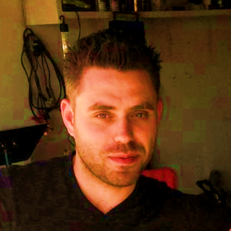
Owners and founders
Sixstar Coaching and Online Mentoring
Arik Lifshits
Founder and CEO
Experience in production, creative, marketing.
Yuval Regev
Co-Founder and COO
Experience in Sales management, affiliate management.
Supporting team
Firma Production and Creative
Over 10 years of experience in producing films and commercials.
Between their projects: Seat, Amdocs, Shufersal, Hisense, Dove, Corona, Burger Ranch, Lexus
The Israeli blockbuster ‘Maktub’

Slide 10
TIMELINE
Start
6 months
from raising capital
3 months
from launch
24 months from launch
5 years from launch
Preparation for pilot in Israel
Research
Recruiting experts.
Fund raising.
Launch platform in Israel
With 10 different courses available.
Expand the Platform
With 2-3 additional courses every quarter.
Launch platform in France
With 10 different courses available
Expand the Platform
Into Germany, Italy & England

Slide 11
RAISING
$700,000
$490,000
70%
$210,000
30%
Production of 10 different video courses of between 3-4 hours.
Developing technology
Legal department
Branding
Marketing

Slide 12
Strengths
Low risk investment
Most of the capital is spent on a one time production of courses. Returning the investment quickly only from selling to hard core fans is very likely.
Easy and inexpensive advertising as we rely mostly on our famous experts’ channels.
Weaknesses
Unprotected Content might be pirated.
(There is a solution)
S
W
T
O
Threats
Another better funded start up might enter the market.
MasterClass might enter the European market.
Opportunities
Enormous growth potential
Format is not known yet in non-English speaking countries.

