Slide 1



welcome to

Slide 2


THE TEAM 10 YEARS AGO
Mark Licciardo
MANAGING DIRECTOR

Slide 3



Slide 4

2007 – 2017
1 decade
120 months
520 weeks
3,650 days

Slide 5
2007 – 2017
87,600 hours
5,256,000 minutes
315,360,000 seconds

Slide 6
2007 – 2017
87,600 hours
5,256,000 minutes
315,360,000 seconds

Slide 7

TRUST OUR EXPERTS
Rodney Davidson
CORPORATE GOVERNANCE
CONSULTANT

Slide 8

TRUST OUR EXPERTS
Geraldine Delves
CORPORATE GOVERNANCE
ASSISTANT

Slide 9
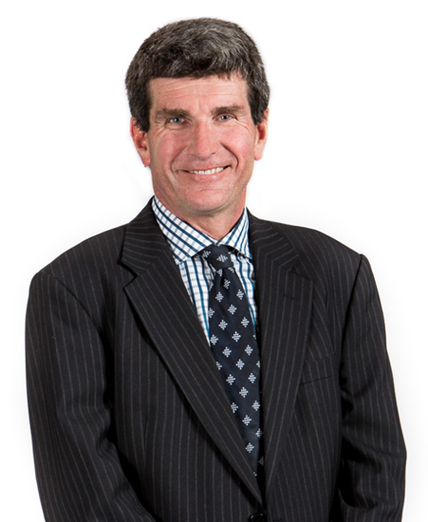
TRUST OUR EXPERTS
Chris Lobb
MANAGER, CORPORATE
GOVERNANCE

Slide 10

TRUST OUR EXPERTS
Kate Goland
CORPORATE GOVERNANCE
ADVISOR

Slide 11

TRUST OUR EXPERTS
David Nairn
CORPORATE GOVERNANCE
CONSULTANT

Slide 12

TRUST OUR EXPERTS
Belinda Cleminson
CORPORATE GOVERNANCE
ADVISOR

Slide 13

TRUST OUR EXPERTS
Adam Sutherland
CORPORATE GOVERNANCE
ASSISTANT

Slide 14

What a team!

Slide 15
What a team!

Slide 16
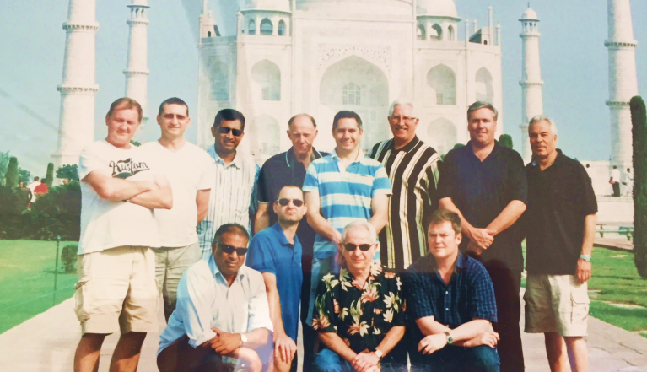
OUR FIRST CLIENT
India Equities Fund

Slide 17
OUR FIRST CLIENT
India Equities Fund

Slide 18


We are privileged to
work with

Slide 19
We are privileged to
work with

Slide 20
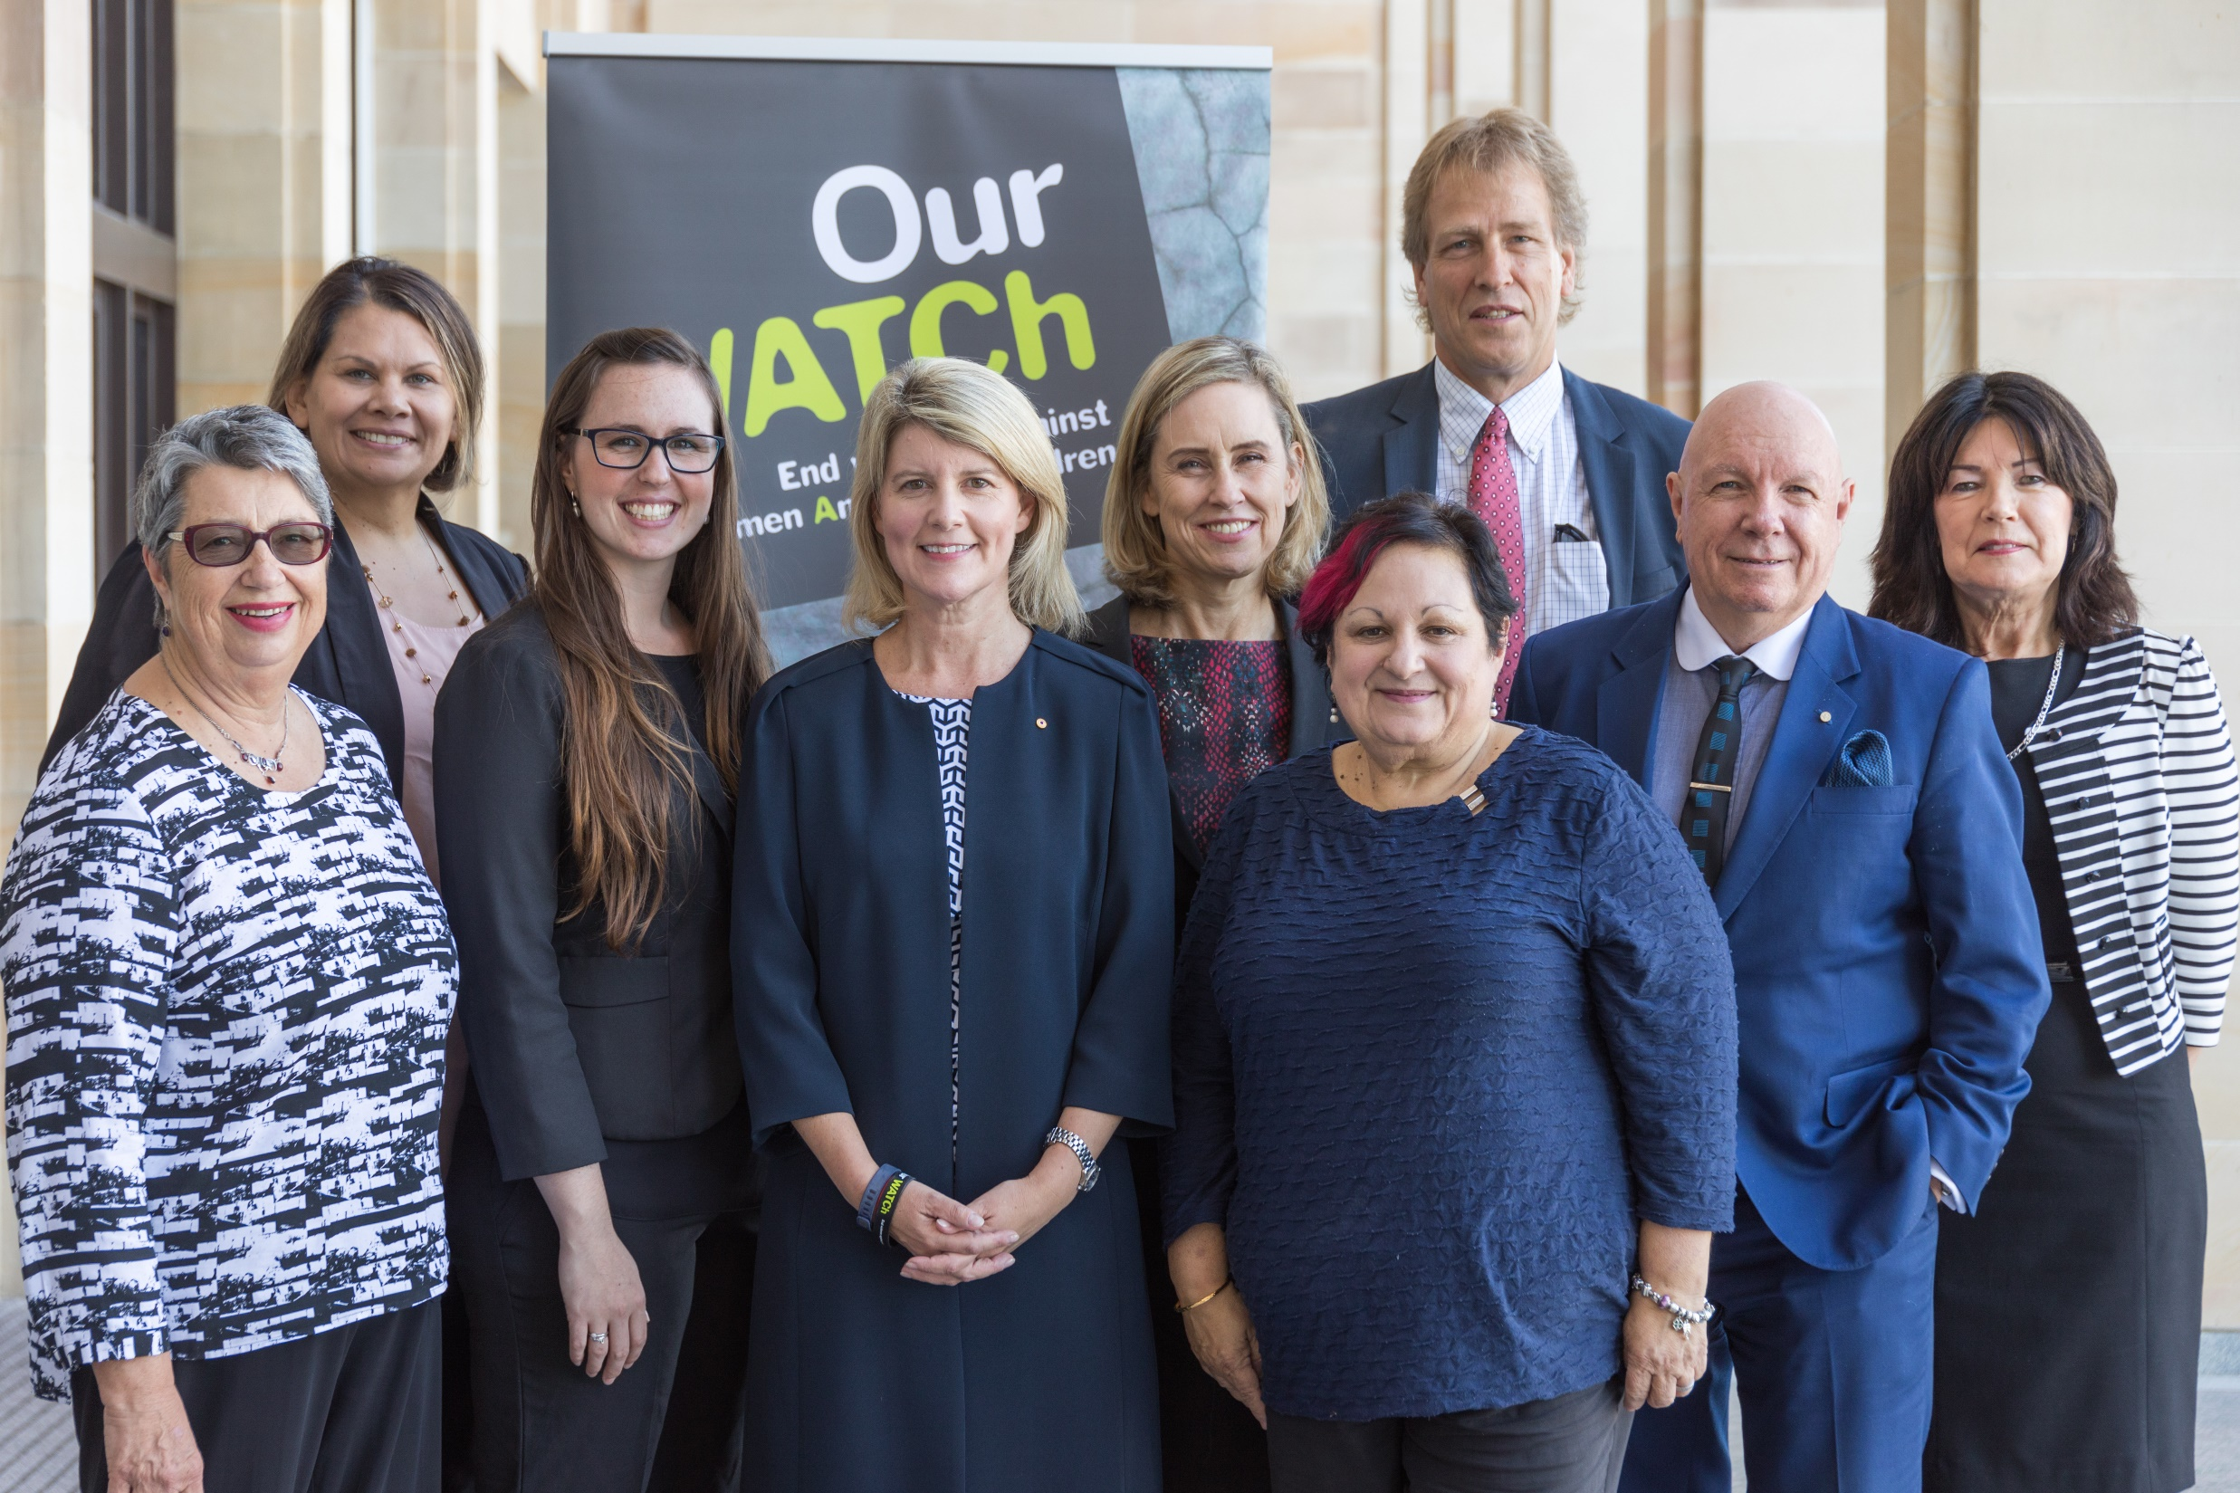

We are privileged to
work with

Slide 21
We are privileged to
work with

Slide 22


We are privileged to
work with

Slide 23
We are privileged to
work with

Slide 24


We are privileged to
work with

Slide 25
We are privileged to
work with

Slide 26


We are privileged to
work with

Slide 27
We are privileged to
work with

Slide 28


We are privileged to
work with

Slide 29
We are privileged to
work with

Slide 30


We are privileged to
work with

Slide 31
We are privileged to
work with

Slide 32


We are privileged to
work with

Slide 33
We are privileged to
work with

Slide 34
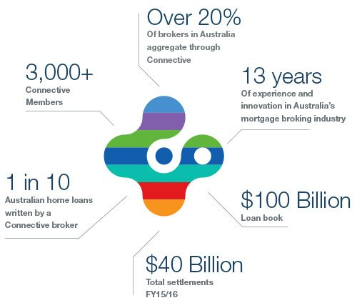

We are privileged to
work with

Slide 35
We are privileged to
work with

Slide 36


We are privileged to
work with

Slide 37
We are privileged to
work with

Slide 38














Mercantile Investment Company Limited
We are privileged to work with…

Slide 39
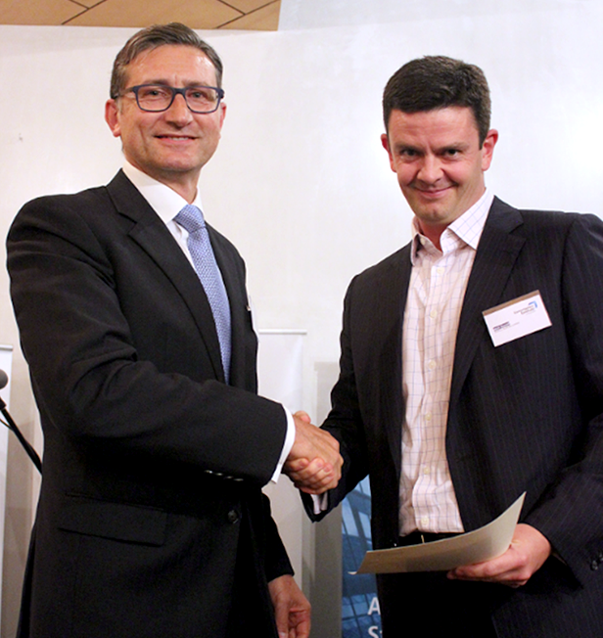


  Mertons is proud to sponsor the Annual
  Governance Institute of Australia Awards
We are proud to support

Slide 40
  Mertons is proud to sponsor the Annual
  Governance Institute of Australia Awards
We are proud to support

Slide 41


