Slide 1
welcome to

Slide 2
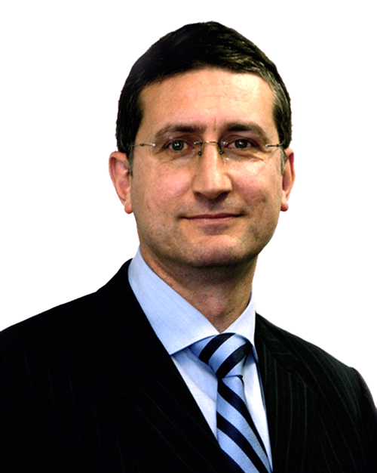
THE TEAM 10 YEARS AGO
Mark Licciardo
MANAGING DIRECTOR

Slide 4
2007 – 2017
1 decade
120 months
520 weeks
3,650 days

Slide 5
2007 – 2017
87,600 hours
5,256,000 minutes
315,360,000 seconds

Slide 6
2007 – 2017
87,600 hours
5,256,000 minutes
315,360,000 seconds

Slide 7
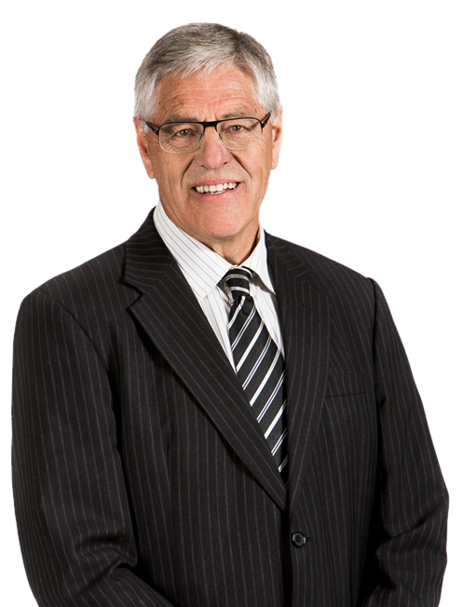
TRUST OUR EXPERTS
Rodney Davidson
CORPORATE GOVERNANCE
CONSULTANT

Slide 8
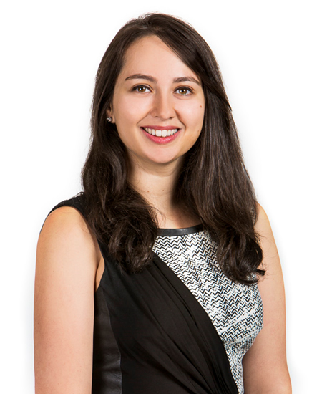
TRUST OUR EXPERTS
Kate Goland
CORPORATE GOVERNANCE
ADVISOR

Slide 9
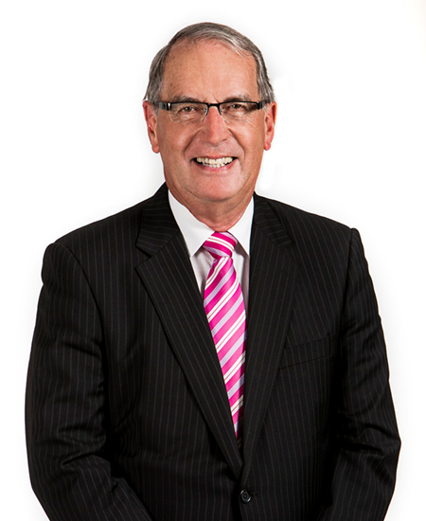
TRUST OUR EXPERTS
David Nairn
CORPORATE GOVERNANCE
CONSULTANT

Slide 10
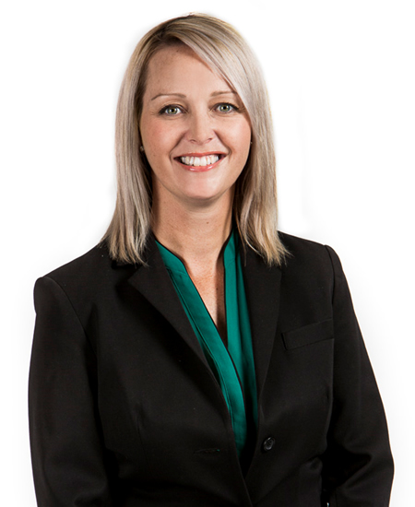
TRUST OUR EXPERTS
Belinda Cleminson
CORPORATE GOVERNANCE
ADVISOR

Slide 11
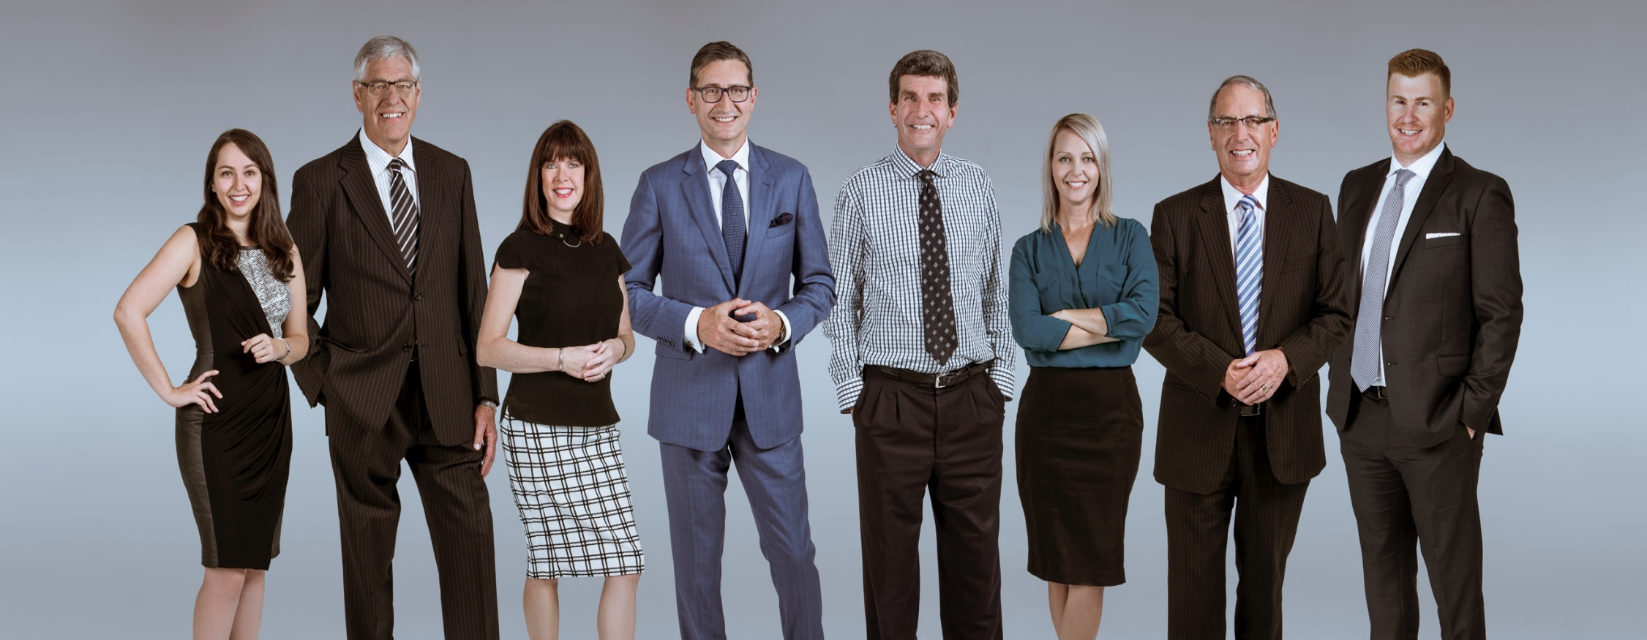
What a team!

Slide 12
What a team!

Slide 13
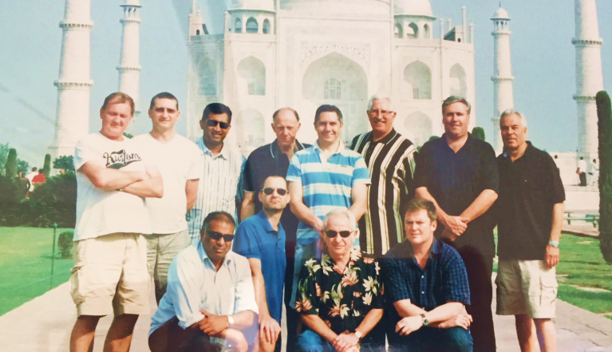
OUR FIRST CLIENT
India Equities Fund

Slide 14
OUR FIRST CLIENT
India Equities Fund

Slide 15
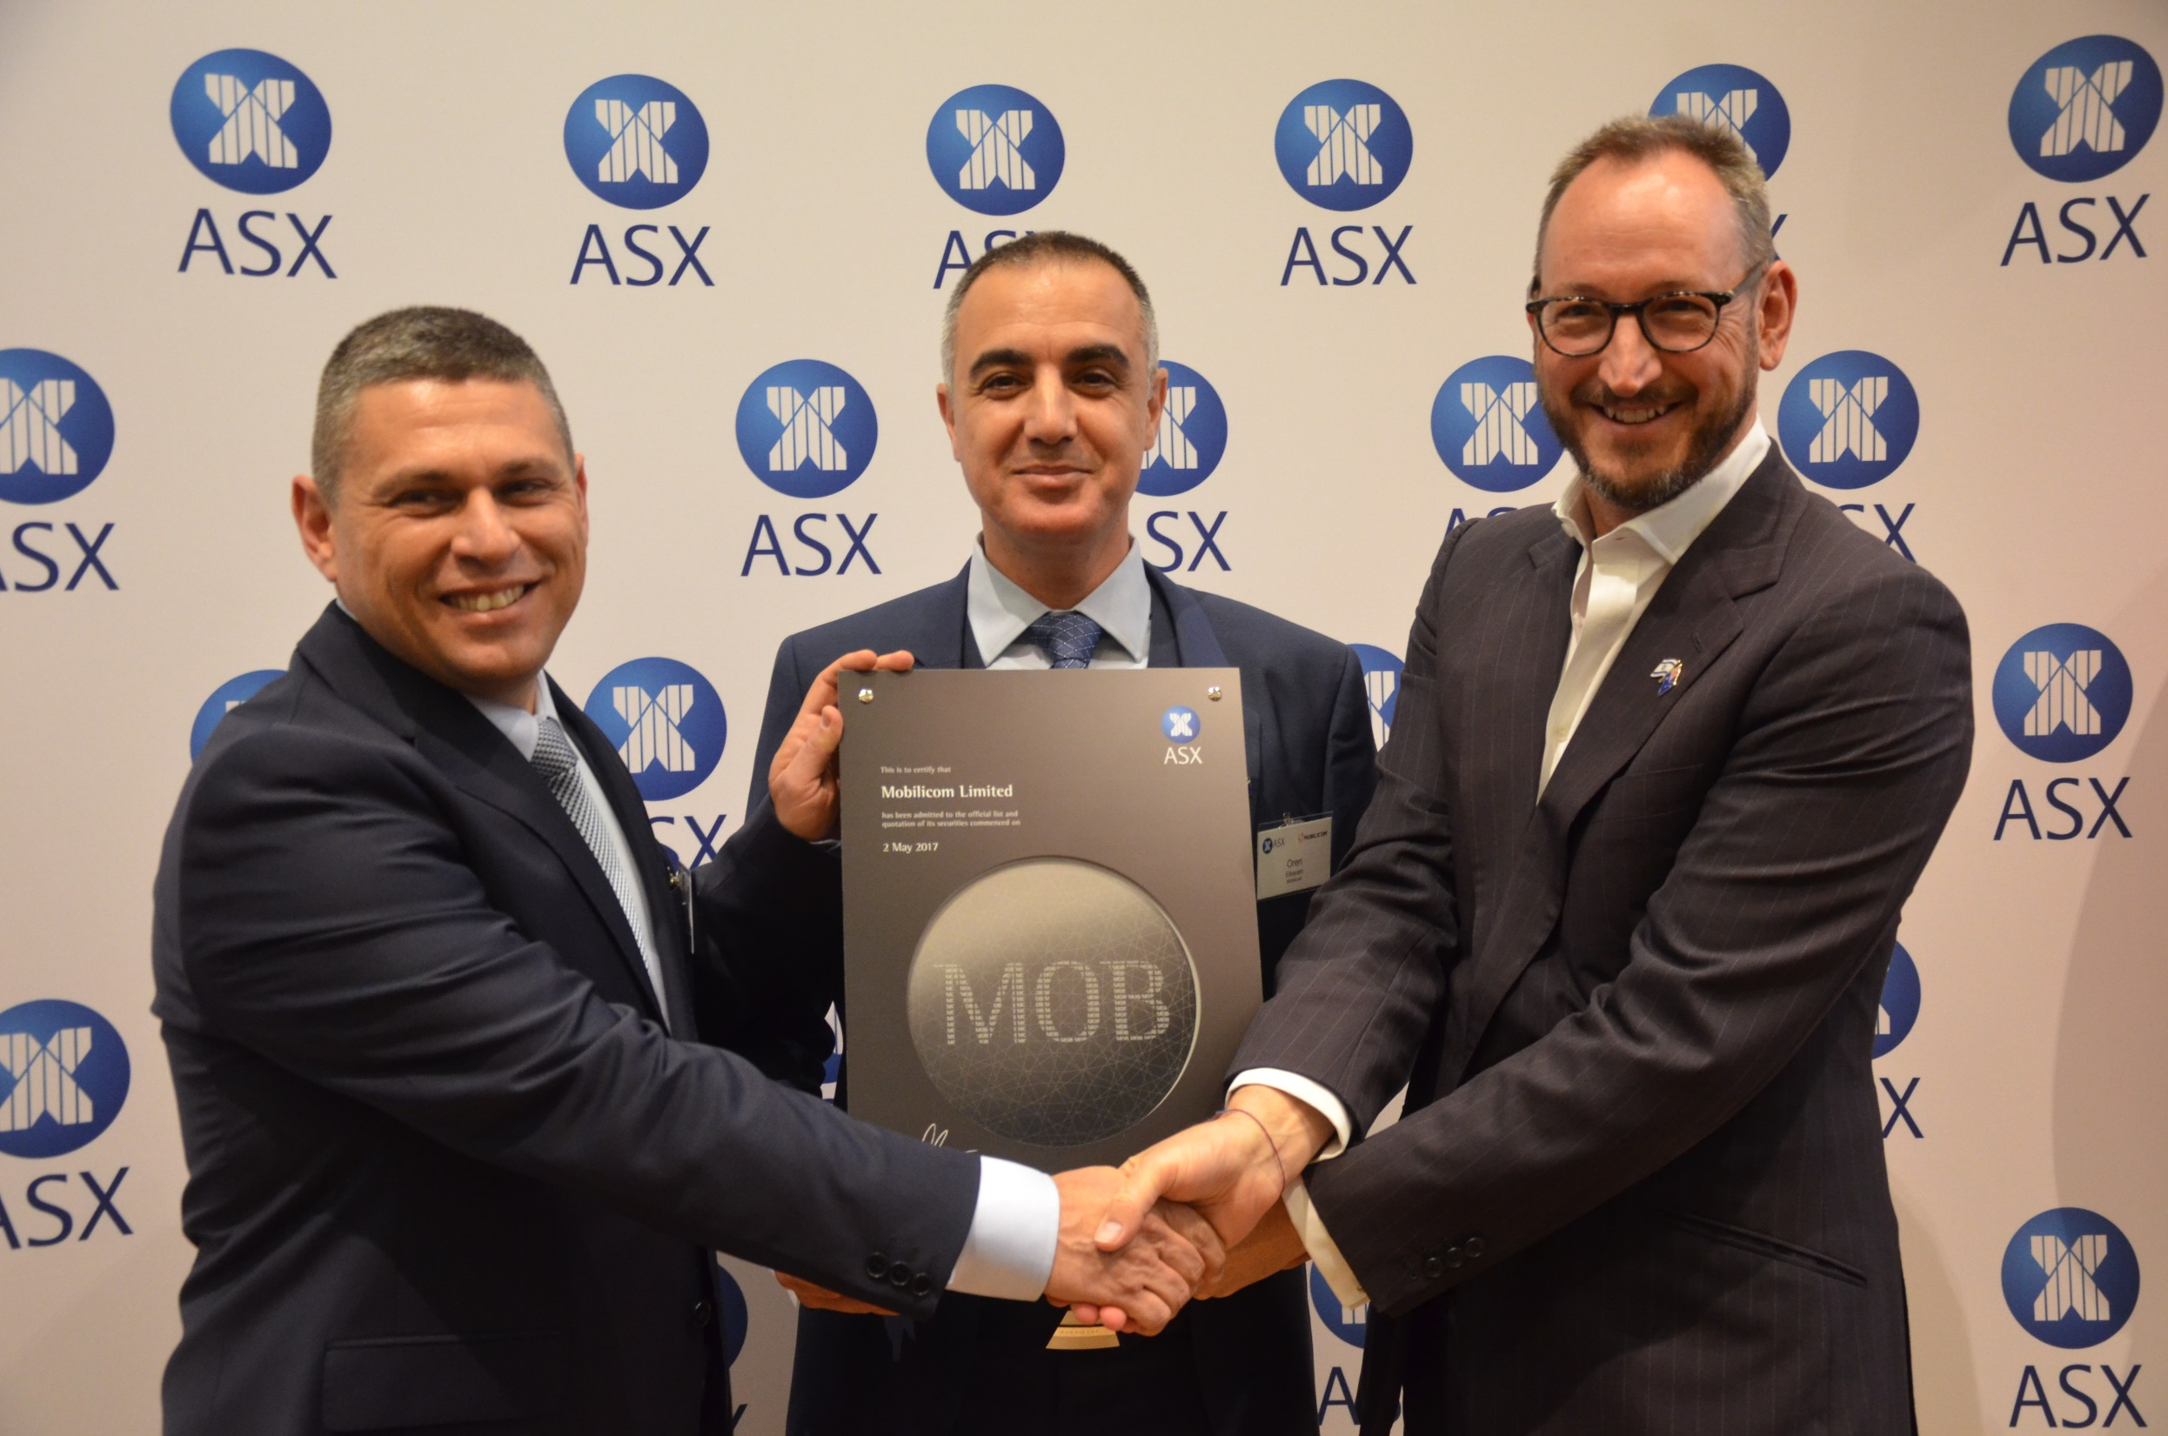
We are privileged to
work with

Slide 16
We are privileged to
work with

Slide 17
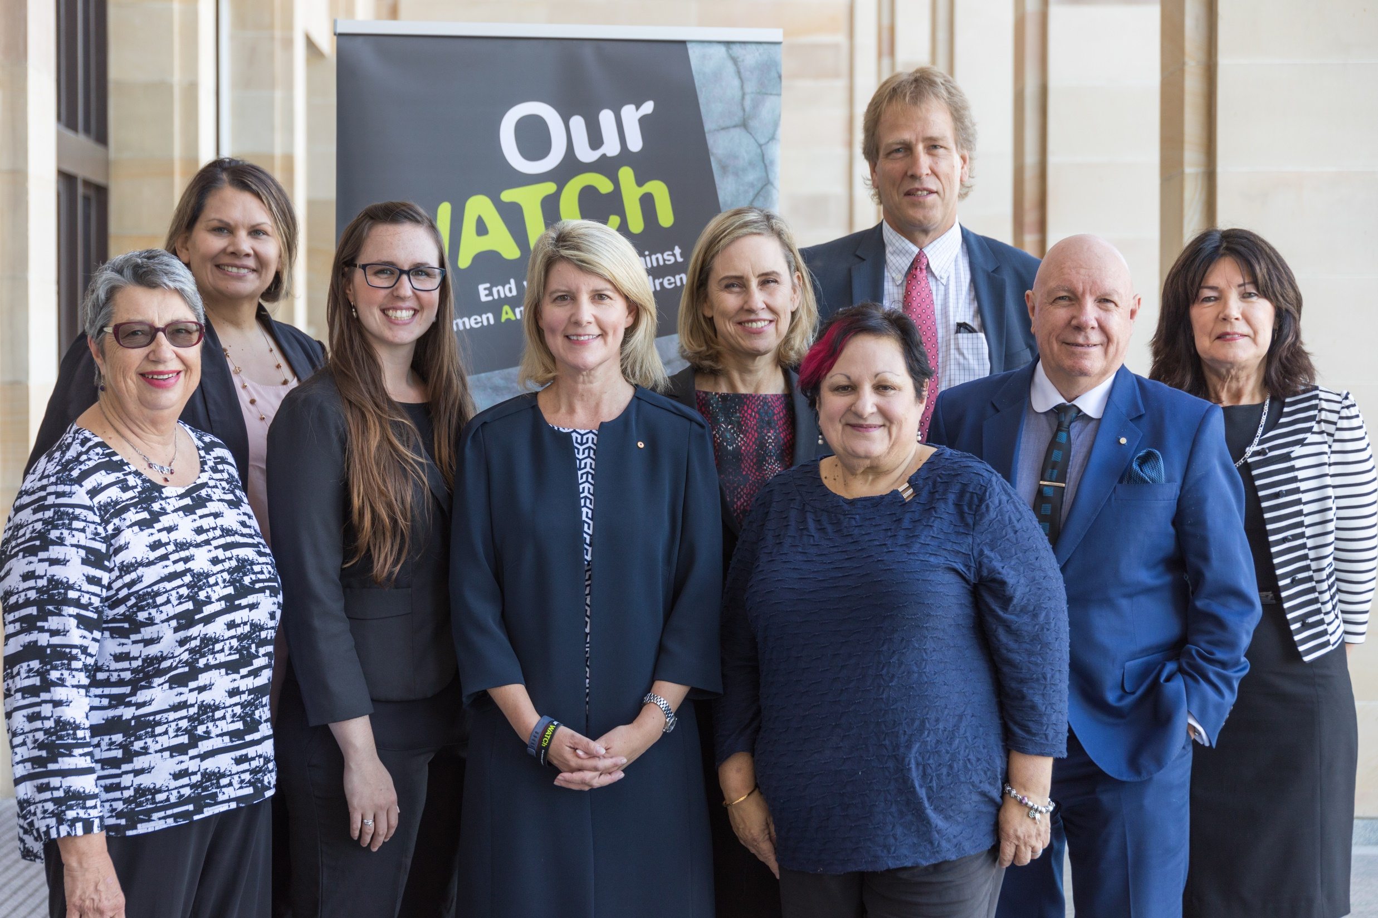
We are privileged to
work with

Slide 18
We are privileged to
work with

Slide 19
We are privileged to
work with

Slide 20
We are privileged to
work with

Slide 21
Mercantile Investment Company Limited
We are privileged to work with…

Slide 22
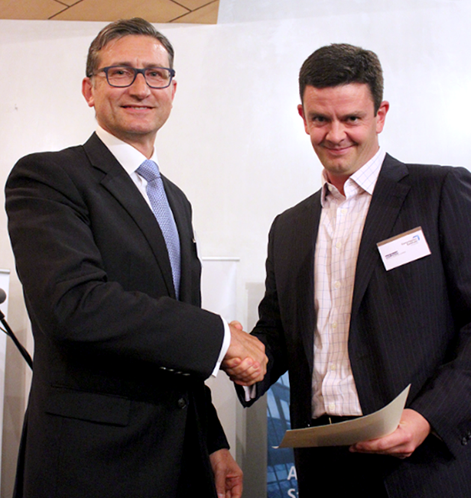
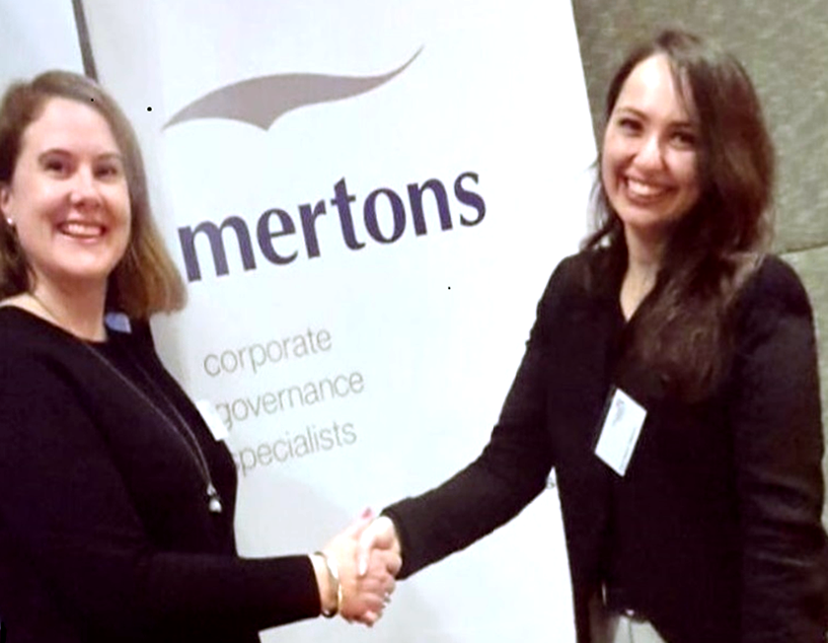
Mertons is proud to sponsor the Annual
Governance Institute of Australia Awards
We are proud to support

Slide 23
Mertons is proud to sponsor the Annual
Governance Institute of Australia Awards
We are proud to support

