Slide 1
Welcome to Mertons’
10th Anniversary Celebration!
Notes:
The slideshow is drafted on the corporate Powerpoint template
Set up slideshow to run slowly – giving enough time for people to see/read each slide
Continue in a loop

Slide 2
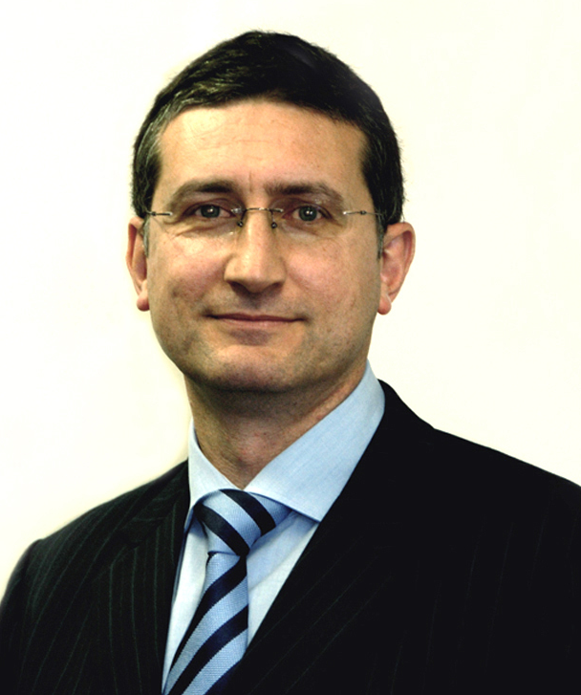
The ’team’ ten years ago…..
Mark Licciardo
Managing Director

Slide 3
2007 - 2017
1 decade
120 months
520 weeks
3,650 days
10 years
87,600 hours
5,256,000 minutes
315,360,000 seconds
Notes:
Wordart diagram with the central focus on 10 years?

Slide 4
Trust our experts
Rodney Davidson
Corporate Governance Consultant
Notes:
7 Individual shots of team coming onto screen with staff name on each (excluding Mark)
Finish with full team shot on last slide

Slide 5
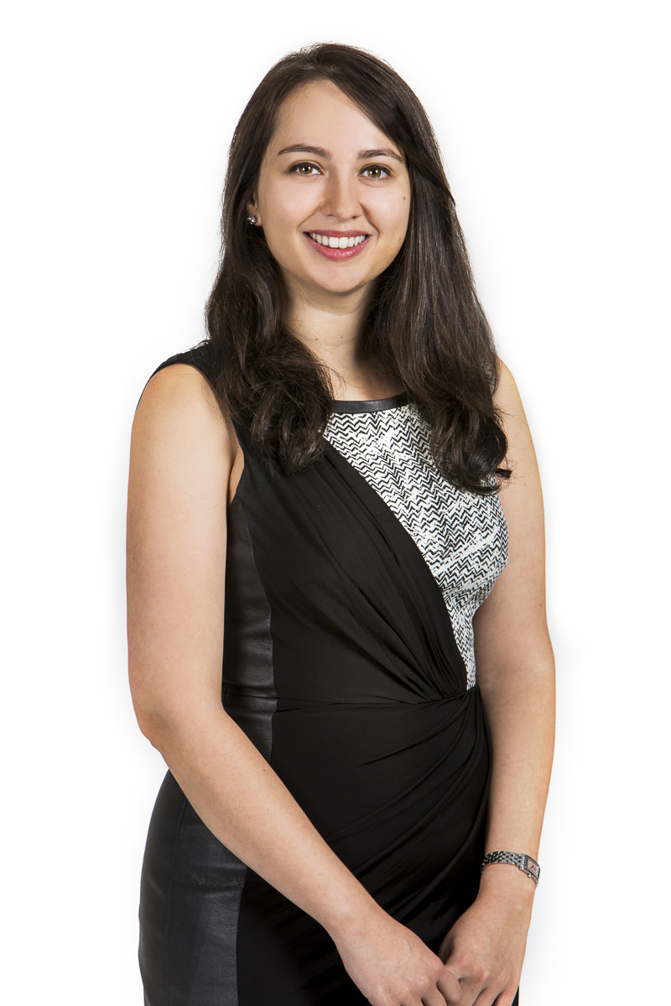
Trust our experts
Kate Goland
Corporate Governance Advisor
Notes:
7 Individual shots of team coming onto screen with staff name on each (excluding Mark)
Finish with full team shot on last slide

Slide 6
Trust our experts
David Nairn
Corporate Governance Consultant
Notes:
7 Individual shots of team coming onto screen with staff name on each (excluding Mark)
Finish with full team shot on last slide

Slide 7
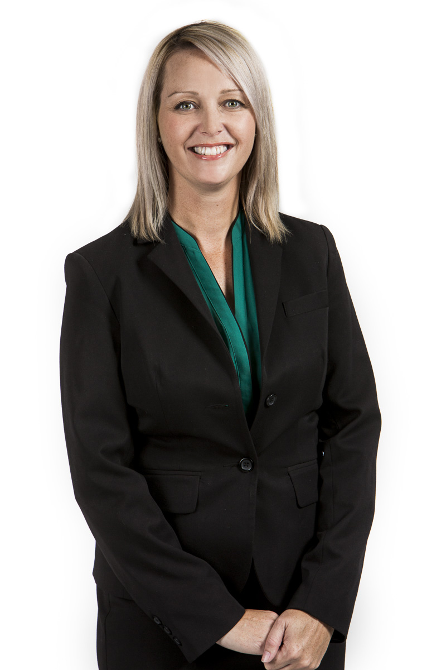
Trust our experts
Belinda Cleminson
Corporate Governance Advisor
Notes:
7 Individual shots of team coming onto screen with staff name on each (excluding Mark)
Finish with full team shot on last slide

Slide 8
What a team!
Notes:
7 Individual shots of team coming onto screen with staff name on each (excluding Mark)
Finish with full team shot

Slide 9
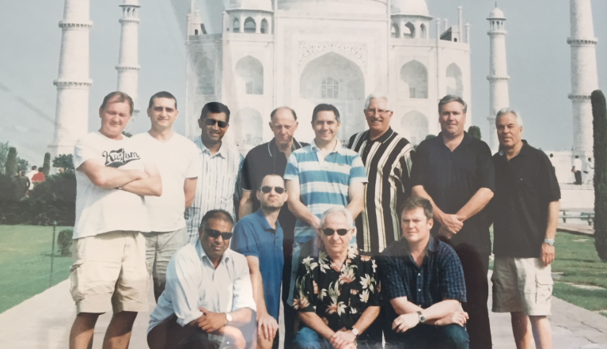
Our first client
India Equities
Fund
Notes:
Review each of the following slides and images for general appearance and format presentation
Not sure if they need effects? Maybe just a fade in??

Slide 10
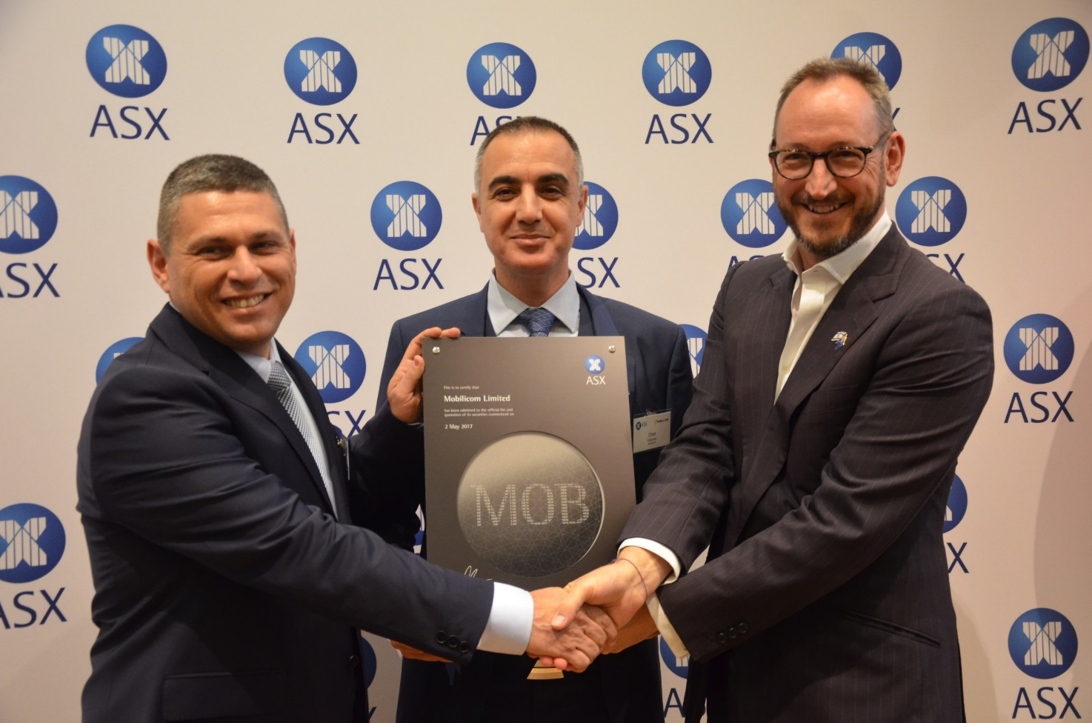
We are privileged to work with….

Slide 11
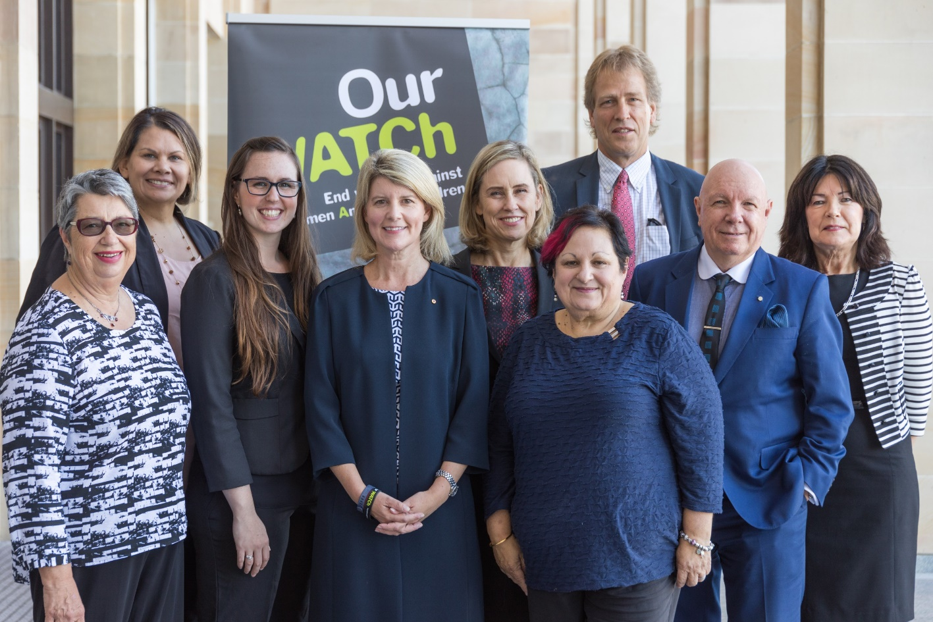
We are privileged to work with….

Slide 12
We are privileged to work with…
ENGLISH LANGUAGE

Slide 13
We are privileged to work with…

Slide 14
We are privileged to work with….
Mercantile Investment Company Limited
Notes:
Review slide for format and image of each logo – visually pleasing arrangement needed
1 slide with individual logos individually coming into view
Finish this slide with all logos showing

Slide 15
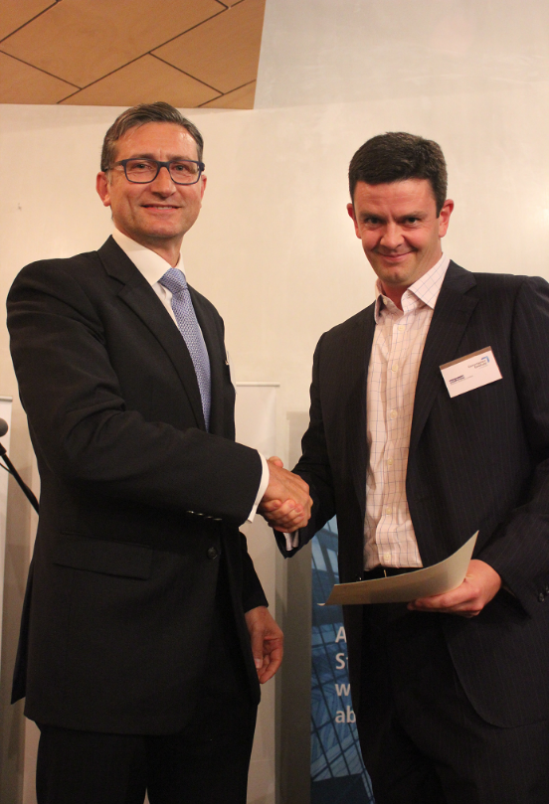
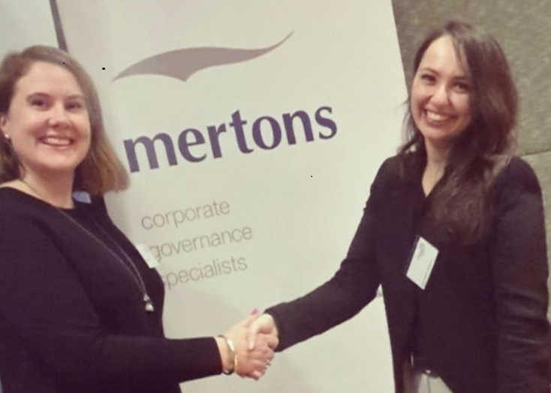
We are proud to support
Mertons’ is proud to
sponsor the Annual
Governance Institute
of Australia Awards

Slide 16
Notes:
Finish with something splashy?

