Slide 1
Medium’s Top Articles
2015
Top 100
Highlighted Passages

Slide 2
How I Crashed and Burned in YCombinator
“I don’t want to start another company until I find a problem that I care about. A problem that I eat, sleep and breathe. A problem worth solving.”
-@Charlie Guo
January

Slide 3
If I had to do it over, I would skip the MBA
“It’s only in mid-life that we finally realize, there was no need to hurry.”
-@Anjali Gupta
January

Slide 4
I’ve Written 100 Posts on Medium, Here’s What I’ve Learned
“If you’re a passive member of the community, you get little out of it. You consume and move on. If you’re active, you get rewarded. It’s strangely like real life.”
-@Paul Cantor
January

Slide 5
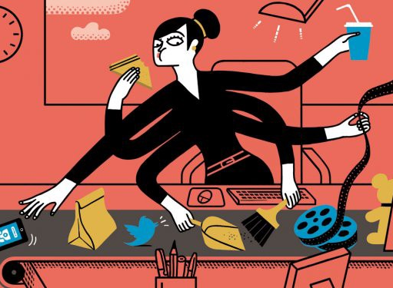
Age 40: Ain’t Nobody Got Time For That
“I let other people be responsible for how they choose to respond to things.”
-@Amanda Clayman
January

Slide 6
The purge: What happens when you unfollow everyone on the Internet
“We’re among the first generations expected to maintain connections with every single person we’ve ever met, thanks to the Internet. The weight of our swollen social networks can be super stressful, let alone a distraction from knowing who you want to focus your.”
-@Helena Price
February

Slide 7
What China Gets Right About Relationships
“They tend to say less and do more, showing their care through considerate actions instead of words. The wall between strangers is higher, perhaps, but once you’ve crossed that wall, everything is shared.”
-@Sam Massie
February

Slide 8
Why I Just Fucking Did It
“Another thing I also noticed recently about the idea porn is that if I sleep on an idea, I will find it as a totally bullshit idea as soon as I wake up the next morning.”
-@Ali Mese
February

Slide 9
The Age of the Introvert Entrepreneur
“We are in the glory days of the introverted entrepreneur. Because of technology, there are so many ways to build a company now, talk to people and make connections in the business world; all without leaving your desk.”
--@Gary Vaynerchuk
February

Slide 10
Unicorns vs. Horses
“The siren call for many entrepreneurs isn’t money, it’s freedom.”
-@Andrew Wilkinson
February

Slide 11
Being a People Pleaser is a Strength, Not a Weakness
“What is wrong with wanting to give? Being positive? Making sure everyone around you is happy? To me, these sound like the furthest things from a “weakness” and it blows my mind why people would want to label it as such.”
-@Gary Vaynerchuk
March

Slide 12
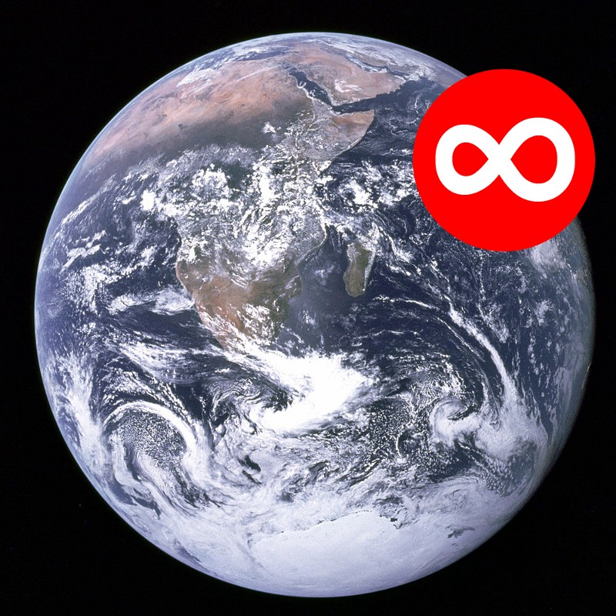
Notifications & Alerts
“I erased most of my TODO list since I really only need to stay alive and listen to people and everything else is a lie.”
-@Paul Ford
March

Slide 13
How To Keep Loving Someone
“Love is being acutely aware of how quickly someone could ruin you.”
-@Jamie Varon
September

Slide 14
The Death of the Death of Books
“What if books, unlike various physical forms of music or movies, are the medium that weathers the digital onslaught?”
-@M.G. Siegler
September

