Slide 1
Hobart Showground Redevelopment
Stakeholder Consultations 2012
www.hobartshowground.com.AU

Slide 2
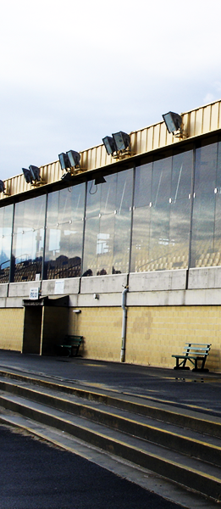
Our Background
The Past
The Royal Agricultural Society purchased the showground site in 1904.
Various developments have occurred on the site since.
Major pavilions – now occupied by Topform & Market.
Main Grandstand and Arena complex have become redundant after Racing occupancy.
Show pavilions – adhoc, with no master plan overseeing their development.
The Present
Today we have a site that still suffers the occupancy of Racing and the impost of aged buildings and infrastructure that must be tackled to ensure the future viability of the Society, the Showground and the Royal Hobart Show.
Main Grandstand

Slide 3
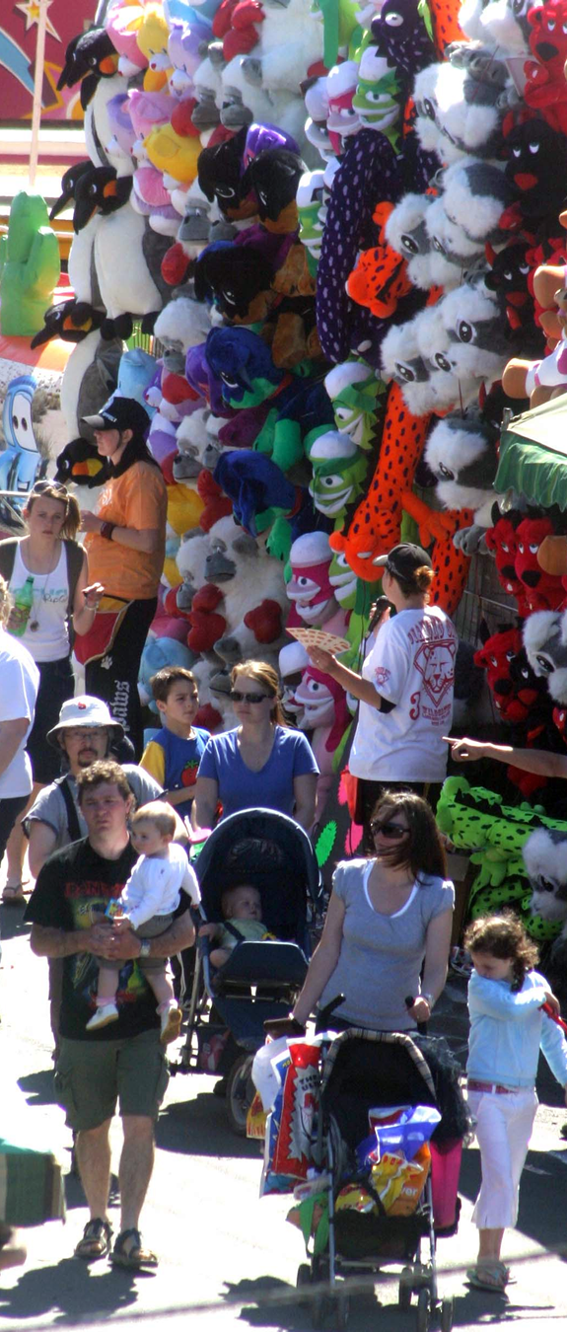
Our Assets
The Hobart Showground is
Strategically located in Hobart
A large piece of relatively undeveloped land
Reasonably level ground
Has freehold ownership by the Royal Agricultural Society
A multipurpose site capable of hosting a wide variety of events
Incredible amount of interest in what we do
The Public
Local Council
Government
Developers
Hobart Show
Sideshow Alley

Slide 4
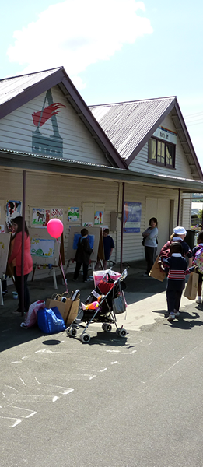
Redevelopment
The answer to the future?
Discussion on the future direction of the Showground has raged unceasingly for many years.
Cost implications of maintaining a privately owned and funded place of public assembly will drive the Society into bankruptcy without a change in direction.
The Society is asset rich but cash flow poor
The Royal Hobart Show currently takes place onsite
Our challenge is to employ our assets; the ground, buildings, people, income better for the future
Whatever Building this is

Slide 5
Redevelopment – Decision Structure
RAST Board
Appoints the Redevelopment Committee
Redevelopment Committee
Works with architects and receives input from Staff and other parties
Concept Plan
Plans are originated considering RHS needs, third party usage, revenue potential
Redevelopment Committee is guided by Board
Decisions are understood and supported by stakeholders

Slide 6
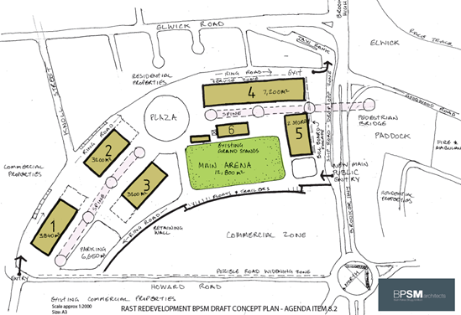
Redevelopment BPSM Draft Concept Plan

Slide 7
Royal Hobart Show Usage
Overview
3 Levels
Ring Road, parking and access/exit
Open Areas Arena, Plaza, green areas
Retain 2 buildings
5 new buildings
Plaza
Carnival Space
Central Spine
Services and shelter
Hatched Areas
Indicate outdoor areas which are undercover
Brooker Overpass
Public drop off via Brooker frontage

Slide 8
Royal Hobart Show Usage
Building 1
Showcase & SB (Carnival adjacent)
Building 2
Animal Nursery
Building 3
Arts & Crafts (Woodchopping adjacent)
Building 4
Main Livestock (Access to arena)
Building 5
Admin (upper level)
Companion Animals (lower level)
Building 6
Grandstand
Building 7
Old Grandstand

Slide 9
Non-Show usage 350 days per year
Building 1
Market Precinct
Building 2
Companion Animal Shows
Building 3
Exhibition Building
Building 4
Indoor Recreation
Retail Space
Building 5
Admin upper level, tenancies
Building 6
Grandstand
Building 7
Old Grandstand
Brooker Highway
Public drop off via Brooker frontage
Plaza
Motor Homes

Slide 10
The Commercial Zone
Advantages
Designated area fronting Howard Road and Brooker Highway
Separate access/exit from that area
Bulky Goods usage
3 potential commercial operators in the area
Leasehold Developments by third parties on 25 year leases

