Slide 1
Case
Studies

Slide 2
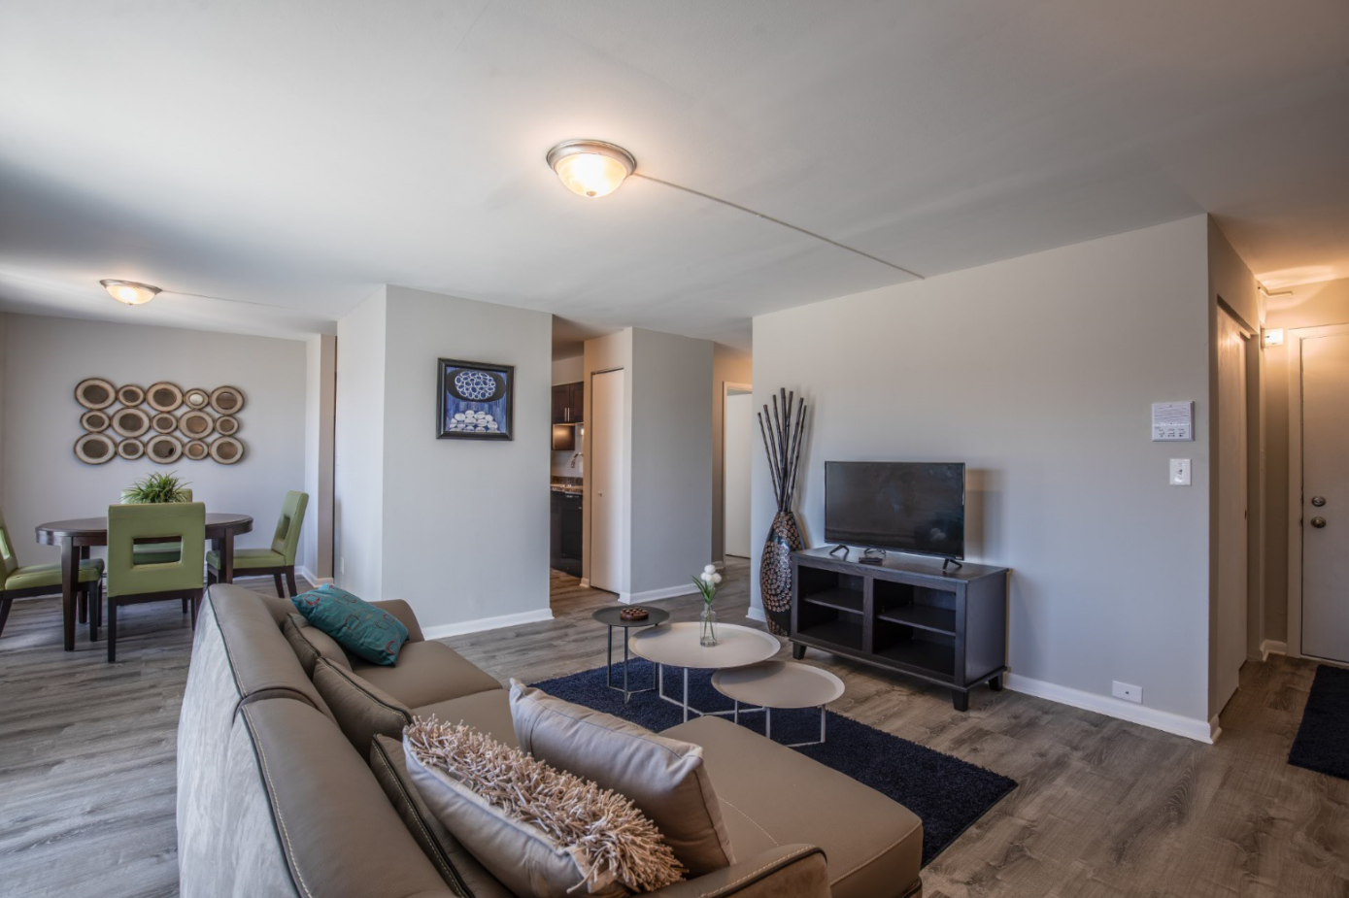
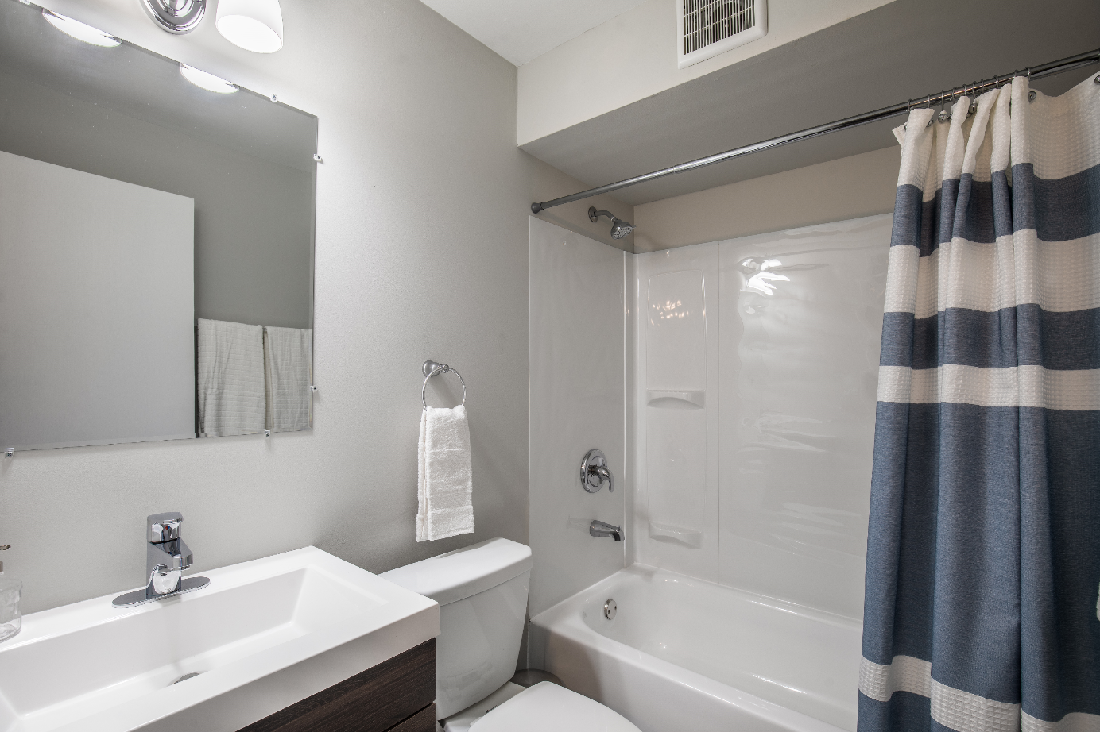
Haven hobart
Address | 353 Niagra Lane Hobart, IN 46345
Year Built | 1977
Unit Count | 300
Year Purchased | November 2015
Purchase Price | $29,400,000
Renovation Budget | $8,489,211
Acquired a stabilized 300-unit garden-style apartment complex that was operating below its potential. Tricap is creating value through the repositioning of the asset for its highest and best use. A physical renovation, both exterior and unit interiors, and improved day-to-day property management will raise the quality of the property resulting in higher rents and other income. All renovations are expected to be completed within the first two years of ownership.
31% projected increase in rent
81% projected NOI growth (in-place at time of purchase to stabilization in Year 3)

Slide 3
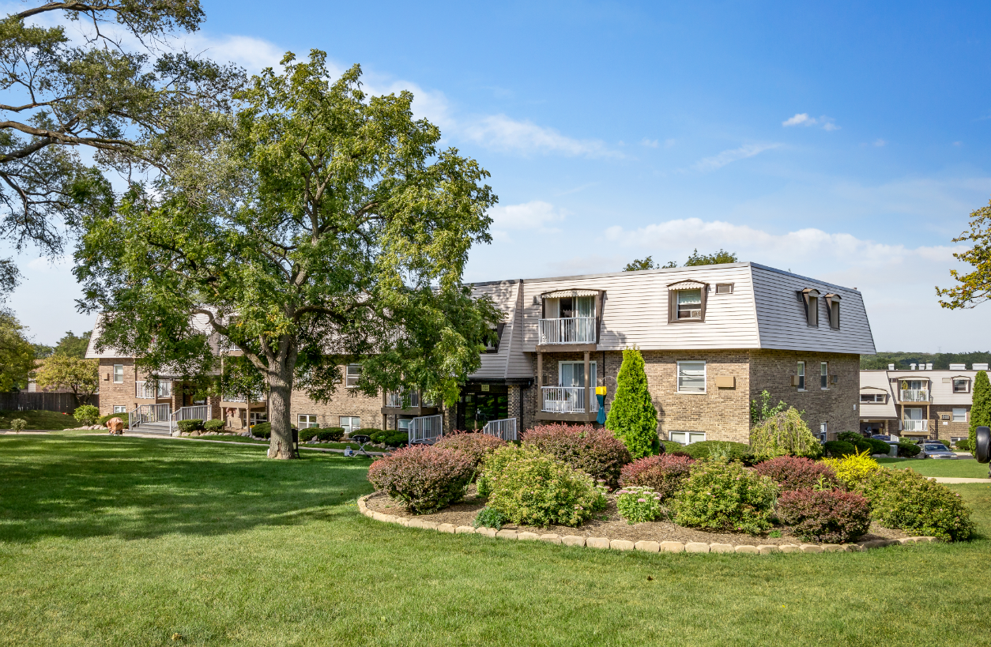
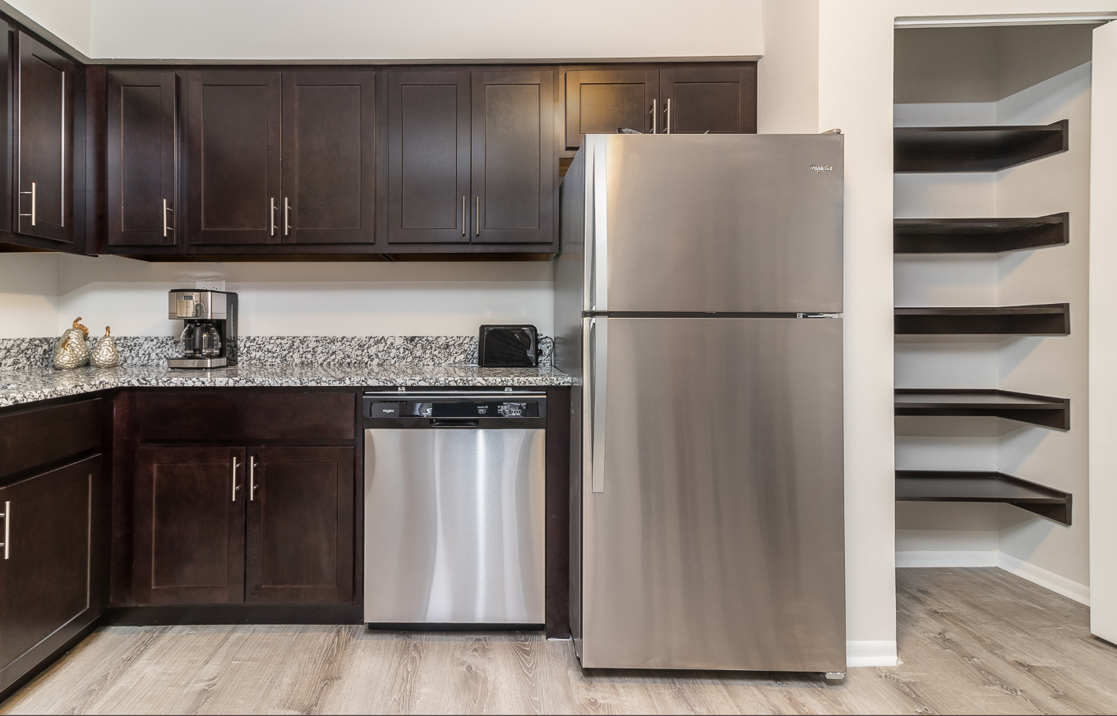
Haven Woodridge
Address | 910 Route 73 Woolbridge, IL 60271
Year Built | 1983
Unit Count | 222
Year Purchased | November 2019
Purchase Price | $12,250,000
Renovation Budget | $2,300,000
Acquired from a long time family owner who had done a meticulous job maintain the structure of the assets. Tricap implemented an interior renovation and exterior curb appeal program in order to capitalize on rental upside already present in the submarket.
7.5x increase in other income by implementing a resident utility billing program. Grew from $350 per unit per year to $2,815.

Slide 4
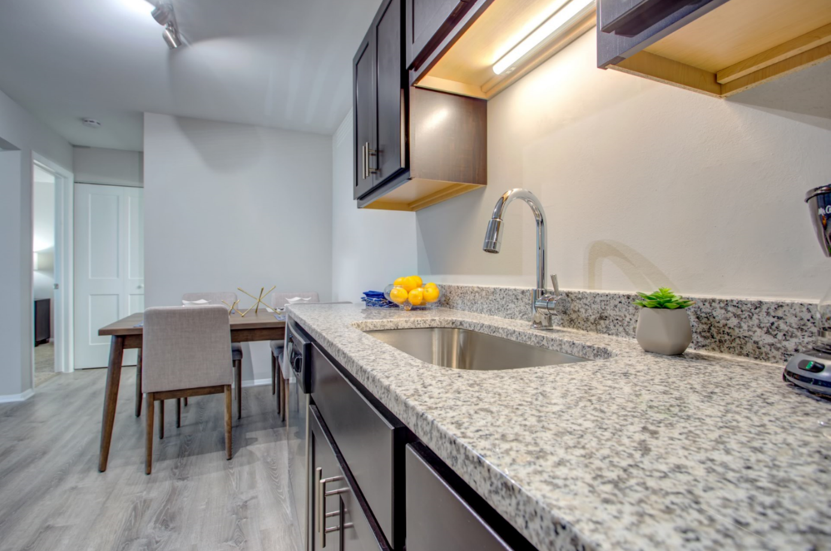
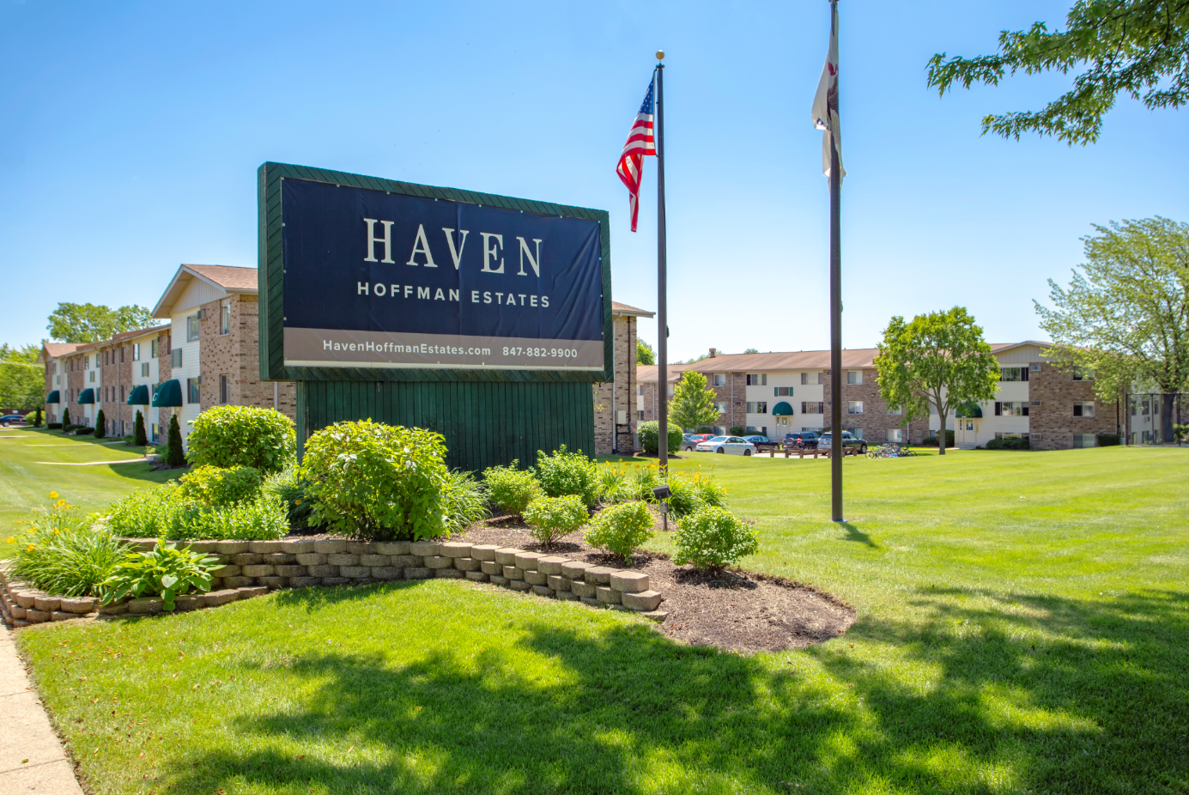
Haven Hoffman estates
Address | 725 Bride Circus Estate, IL 60169
Year Built | 1978
Unit Count | 750
Year Purchased | April 2018
Purchase Price | $18,250,000
Renovation Budget | $5,832,120
Acquired a stabilized 750-unit garden-style apartment complex located in an excellent location, just 30 miles Northwest of Chicago. The property is undergoing a significant renovation, including kitchen and bathroom upgrades and common area enhancements.
32% projected increase in rent
54% projected NOI growth (in-place at time of purchase to stabilization in Year 3)

Slide 5
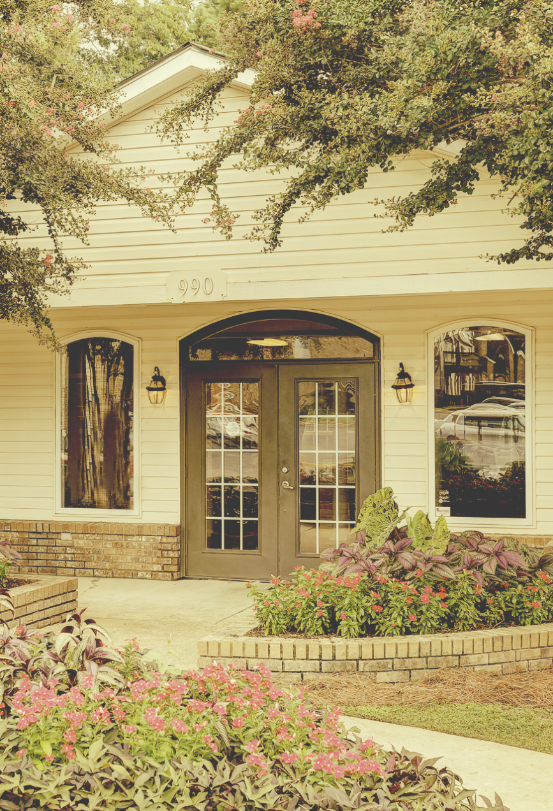
Tricap Residential Group
171 N. Aberdeen, Suite 400
Chicago, IL 6060
TricapRes.com

