Slide 1
our experience
Why Tricap
Leadership
Investment Strategy
Investment Track Record
Owned & Managed Properties

Slide 2
HELPING PEOPLE LIVE BETTER LIVES
WHO WE ARE
We are a team of men and women with a relentless dedication to exceptional service and incredible value for our residents.
WHAT SETS US APART
Our company at its core is a real estate execution firm. We are finding opportunities, we are creating a vision for where we want to take that opportunity, and we are driving the execution of the deal.
The experience

Slide 3
LEADERSHIP
OUR TALENTED TEAM OF REAL ESTATE PROFESSIONALS HAVE AN UNCANNY ABILITY TO ANTICIPATE AND IDENTIFY OPPORTUNITIES IN DIVERSE MARKETS.
Bryan Pritchard Founder / President
As Founder and CEO of Tricap, Bryan Pritchard enjoys taking on difficult projects that challenge his teammates and encourage growth. Under Bryan’s direction, Tricap owns and operates thousands of apartments in communities throughout the Midwest and has completed redevelopment projects ranging from neighborhood walk-ups to major high-rise renovations.
A graduate of the University of Michigan with a B.S. in Mechanical Engineering, Bryan founded Tricap in 2007 as a redeveloper of multi-family properties. The company achieved quick success by repositioning properties through a combination of renovation, enhanced property management and lease-up. Over the years, Bryan built Tricap into a multifaceted organization that develops, manages and leases thousands of apartments. Specializing in “value add” renovations, Tricap also has extensive experience and expertise in new construction.
Bringing an “owner’s perspective” to Tricap and personifying the company’s approach to the real estate business, Bryan values innovation and cohesiveness as a way to bring success to each of his company’s projects. Tricap only operates properties the company owns, utilizing the best available digital tools to assist both the Tricap management team and apartment residents.
“The secret of success is to understand the point of view of others.” — Henry Ford
The experience

Slide 4
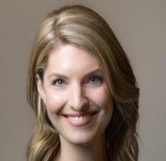
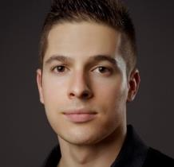
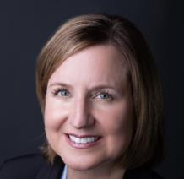
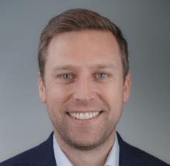
Senior leadership team
INTEGRITY, TRUST, AND HARD WORK PUSH OUR DEDICATED TEAM AHEAD, OUR GOALS AND COMMITMENT HOLD US TOGETHER.
Cassandra Durham INTEGRATOR
Cassandra oversees the people, systems, and process for Tricap. Her keen sense of people allows her to keep a pulse on the heartbeat of the company. Cassie’s prior experience is in managing ultra-high net worth Family Office services with a focus on Real Estate and Property Management.
Joe Palomino Director of Acquisition and Development
Joe oversees all aspects of the acquisition pipeline and value add strategies for each property in the Tricap portfolio. Joe’s organized and process-oriented approach allows him to vet new opportunities and effectively execute the business plan for each property acquisition.
Suzanne Hopson Director of Property Management
A property management veteran, Suzanne began her career in 1989, as an on-site professional leasing specialist. She has held several positions throughout her career including Senior Regional Manager, Business Developer, Lease-Up Director, and Director of Marketing and Training.
Max Keate Director of Finance
As the Director of Finance, Max oversees all aspects of accounting, investment reporting, and cash management. Prior to joining Tricap, Max was a Finance Manager at Heitman in the North American Private Equity Group. His main duties included investor reporting and preparing valuations of real estate and debt. Max received his bachelors degree from Indiana University (Bloomington) with majors in Finance and Accounting. He is a CFA charterholder as well as a CPA.
The experience

Slide 5
Tricap Proven Investment Process
YEARS OF EXPERIENCE HAVE SCULPTED AN INVESTMENT PROCESS THAT IS SIMPLE, YET EFFECTIVE, FOR OUR INVESTORS AND INVESTMENTS.
Deal Funnel
Filter hundreds to find one that works.
Transaction Process
Transaction process 3–6 MO
close
exit
assess many deals
value-add process
Renovate
6–18 mo
Stabilize
2–10 yrs
make offers
Narrow to
1 deal
Investor process
review
sign & fund
Roi
quarterly (until exit)
Transaction Process
3–6
mo
Evaluate
Detailed physical and financial due diligence.
Capitalize
Source debt and equity investments.
Execute
Close the deal and execute the business plan.
6–18
mo
Value-Add Process
Our vertically integrated value enhancements include renovations, leasing, and streamlined operations.
Renovate
Upgrades to interior units, common areas, and amenities.
Lease
Professional sales & marketing drives increased revenue.
Optimize
Experienced management and system integrations.
2–10
yrs
Investor Process
Conservative underwriting and transparent business plans are the cornerstone of our investments.
Simple Investor Process
(30–60 days)
close
ROI
(2–10 yrs)
1
Notice of Investment Opportunity
2
Review Investment & Legal Docs
3
Execute Docs & Fund Investment
2
1
Quarterly Updates & Distributions
3
Exit Investment
4
The experience
The experience
Tricap Residential Group | TricapRes.com
5

Slide 6
OUR OPPORTUNITY FUNNEL
We evaluate hundreds of deals to find the best opportunity for long-term value creation.
ASSESSMENT AND UNDERWRITING
Great investments start with strong underwriting. We do our homework to determine which opportunities are worth pursuing.
Financial Due Diligence
Assess market rents
Verify property expenses
Analyze risk factors
Physical Inspections
Prepare renovation budgets
Project long-term physical needs
Engage professional engineers
Capitalization
Procure lender term sheets
Project equity returns
OFFER AND NEGOTIATE
Smart underwriting leads to competitive offers. We may not win every deal, but we are confident in our analysis.
Disciplined Offers
Maintain fiscal responsibility
Conservative execution timelines
Efficient Execution
No games
We hold ourselves and the seller responsible
EXECUTE THE DEAL
Verify assumptions
Capitalize the investment
Execute the business plan
A disciplined acquisition process is the foundation of a well-executed business plan.
The experience

Slide 7
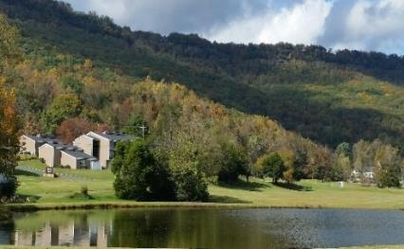
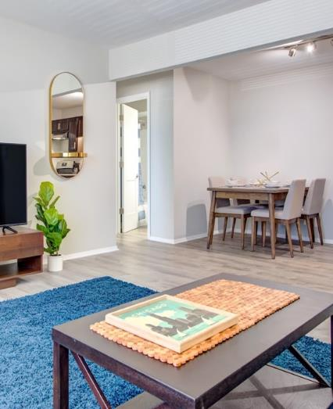
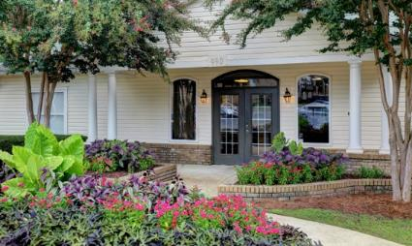
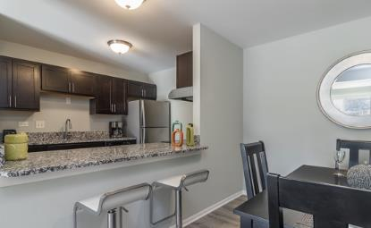
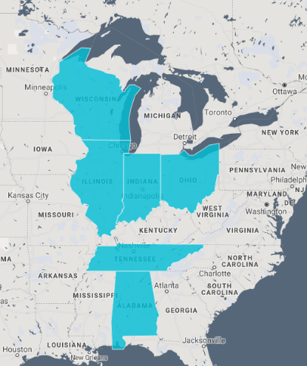
OUR PROPERTIES
We DEDICATE OURSELVES TO YOUR RESIDENTS AND COMMUNITY BY CONSISTENTLY PROVIDING INCREDIBLE CUSTOMER SERVICE, TREMENDOUS VALUE, AND A COMFORTABLE LIVING ENVIRONMENT.
2394
6
15
Total Units Managed
States Covered
Managed Communities
Property Name | No. of Units | Property Name | No. of Units
Hampshire Park | 186 | Southside Flats | 40
Ravenswood Gardens | 151 | Haven Woodridge | 122
Residences of Sawmill Park | 120 | Haven Crystal Lake | 80
Everett Hyde Park | 98 | Haven St. Charles | 71
5454 S. Everett | 32 | Haven Hobart | 300
Worthington Woods | 96 | Haven Franklin Park | 128
Hermitage Garden | 73 | Haven Hoffman Estates | 550
Links at Reads Lake | 66 | Element Hoover | 323
Total Units Under Management: |  |  | 2,436
The experience

