Slide 1



Investment
Track
Record
  DECEMBER 2019

Slide 2
TRICAP INVESTMENT TRACK RECORD
INVESTMENT TRACK RECORD
Footnotes 1. Recapitalized

Slide 3
Acquisition business plan 2020
Current Pipeline
DEAL FLOW 2019
CURRENT PIPELINE
Pre-Screen
785 Deals
Pre-Screen
12 Deals
Underwrote
90
Proceed to Underwrite
90
LOI
7
Under Contract
2
LOI
1
Closed
4
Under
Contact
1

Slide 4
Acquisition business plan 2020
2019 Deal Flow
2020 Projections
Deal Criteria:
Stabilized garden-style apartment communities that are operating below their potential as a result of poor management or a lack of capital.
B- and C-quality apartments that can be improved to B+ assets through renovation and repositioning. B+ properties have the interior finishes of a Class A property but the age of the property is greater than 30 years and lacks the top amenities.
$10M+ purchase price
100+ units
Downside protection: post renovation rents +/- 30% discount to new construction
Workforce housing: post renovation rents +/-25% 3-mile area median income
Pre-Screen
189
Pre-Screen
1,500 Deals
Underwrote
12
Underwrite
25
LOI
412 Deals
LOI
912 Deals
Contract
8
Contract
15
 |  | ACQUISITION TARGETS
Year | 2019 | 2020 | 2021 | 2022 | 2023
Units Acquired | 2,005 | 2,400 | 2,800 | 3,100 | 3,300
Units Sold |  | 395 | 142
Year End Portfolio | 3,436 | 4,441 | 6,099 | 8199 | 10,499
Annual Equity Investment | 52,050,000 | 66,000,000 | 82,000,000 | 94,000,000 | 102,000,000
TOTAL AUM | $350,000,000 | $490,000,000 | $670,000,000 | $925,000,000 | $1,620,000,000
Target Market Considerations:
population growth
low unemployment
job growth
favorable demographics
Investment Return Metrics:
IRR: 13%-16%
Equity Multiple: +2.0x
Y3 (stabilization year) yield on total cost: +7.0%
Average annual cash-on-cash return of +9%

Slide 5
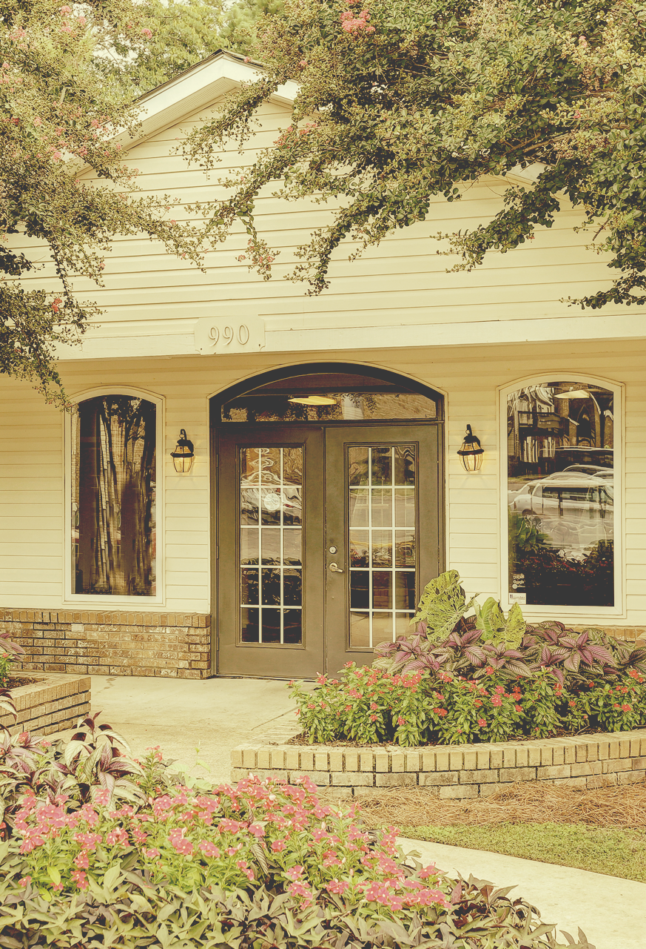

Tricap Residential Group
171 N. Aberdeen, Suite 400
Chicago, IL 6060
TricapRes.com

