Slide 1
Storage options for electrical energy

Slide 2
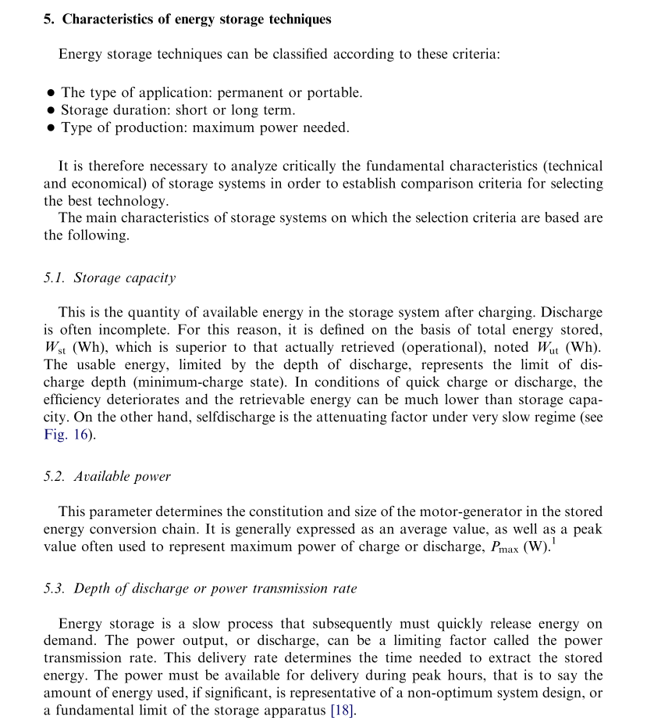

Slide 3
Electric Energy
First, electricity is consumed at the same time as it is generated. The proper amount of electricity must always be provided to meet the varying demand.
The second characteristic is that the places where electricity is generated are usually located far from the locations where it is consumed1. Generators and consumers are connected through power grids and form a power system.
Therefore it is helpful to store energy for later use.
Energy can be stored by using various technologies:

Slide 4
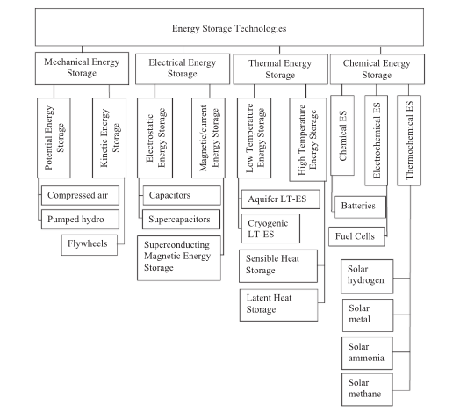
Energy Storage Technologies
Mechanical Energy
Electrical Energy
Thermal Energy
Chemical Energy

Slide 5
Mechanical Energy
Technology Type
Open-loop Pumped Hydro Storage
(Time Shift)
Rated Power in kW
3,003,000
Duration at Rated Power
10:18.00
The Bath County Pumped Storage Station is a pumped storage hydroelectric power plant, which is described as the “largest battery in the world”, with a generation capacity of 3,003 MW[3] The station is located in the northern corner of Bath County, Virginia, on the southeast side of the Eastern Continental Divide, which forms this section of the border between Virginia and West Virginia. The station consists of two reservoirs separated by about 1,260 feet (380 m) in elevation. It is the largest pumped-storage power station in the world
Construction on the power station, with an original capacity of 2,100 megawatts (2,800,000 hp), began in March 1977 and was completed in December 1985 at a cost of $1.6 billion, Voith-Siemens upgraded the six turbines between 2004 and 2009, increasing power generation to 500.5 MW and pumping power to 480 megawatts (640,000 hp) for each turbine.

Slide 6
Electrical Energy Storage
Supercaps are great for fast discharging AND fast charging. Cyclelife is the most important part for storage!
Ultracapacitors also last far longer, aren’t as temperature-sensitive (they’ve been used in F1 racing, after all), and don’t lose capacity as they age.
Graphene Supercapacitor
Maxwell’s entire line of ultracapacitor products.
The super caps shining point is C rate (or power). so if you hand pick the app where you need a high C rate at low ambients it might work to do a Cap/ battery Hybrid.
They really don’t work in Tesla situation though where they have a huge battery so C rate is not that Critical and cycle life is not critical.
Mazda führ I-Eloop-System ein, mit dem die beim Bremsen entstehende Energie in einem Kondensator gespeichert

Slide 7
Thermal Energy
Cryogenic energy storage
Cryogenic energy storage (CES) is the use of low temperature (cryogenic) liquids such as liquid air or liquid nitrogen as energy storage.
HISTORY
A liquid air powered car called Liquid Air was built between 1899 and 1902 but it couldn't at the time compete in terms of efficiency with other engines More recently, a liquid nitrogen vehicle was built. Peter Dearman, a garage inventor in Hertfordshire, UK who had initially developed a liquid air powered car, then put the technology to use as grid energy storage.
Grid energy storage (Process)
When it is cheaper (usually at night), electricity is used to cool air from the atmosphere to -195 °C using the Claude Cycle to the point where it liquefies. The liquid air, which takes up one-thousandth of the volume of the gas, can be kept for a long time in a large vacuum flask at atmospheric pressure. At times of high demand for electricity, the liquid air is pumped at high pressure into a heat exchanger, which acts as a boiler. Air from the atmosphere at ambient temperature, or hot water from an industrial heat source, is used to heat the liquid and turn it back into a gas. The massive increase in volume and pressure from this is used to drive a turbine to generate electricity
Pilot plant
A 300 kW, 2.5MWh storage capacity pilot cryogenic energy system developed by researchers at the University of Leeds and Highview Power Storage, that uses liquid air (with the CO2 and water removed as they would turn solid at the storage temperature) as the energy store, and low-grade waste heat to boost the thermal re-expansion of the air, has been operating at a 80MW biomass power station in Slough, UK, since 2010. The efficiency is less than 15% because of low efficiency hardware components used, but the engineers are targeting an efficiency of about 60 percent for the next generation of CES based on operation experiences of this system.
The system is based on proven technology, used safely in many industrial processes, and does not require any particularly rare elements or expensive components to manufacture. Dr Tim Fox, the head of Energy at the IMechE says "it uses standard industrial components...., it will last for decades, and it can be fixed with a spanner."

Slide 8
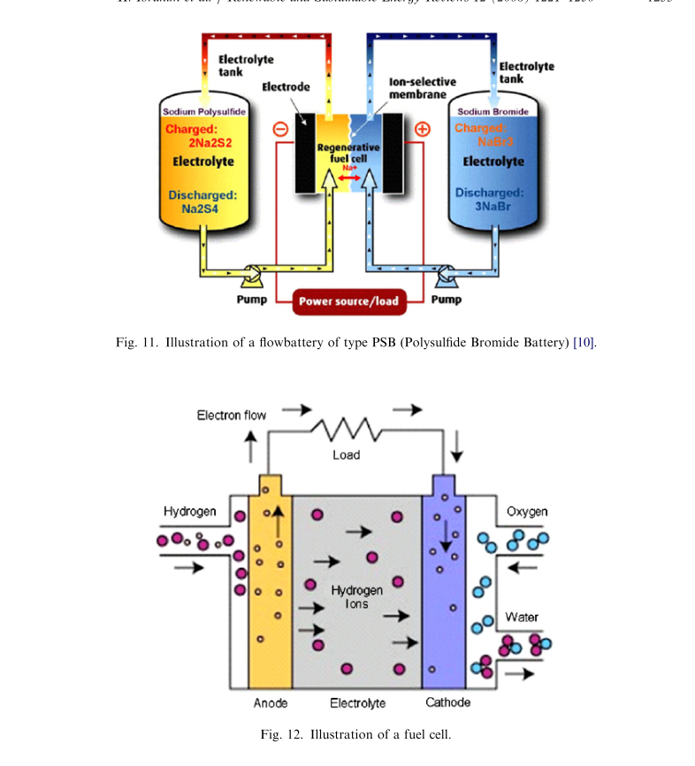
Chemical Energy: Fuel Cell
A fuel cell is a device that converts the chemical energy from a fuel into electricity through a chemical reaction of positively charged hydrogen ions with oxygen or another oxidizing agent. Fuel cells are different from batteries in that they require a continuous source of fuel and oxygen or air to sustain the chemical reaction, whereas in a battery the chemicals present in the battery react with each other to generate an electromotive force. Fuel cells can produce electricity continuously for as long as these inputs are supplied.
fuel cells for use in cars will never be commercially viable because of the inefficiency of producing, transporting and storing hydrogen and the flammability of the gas

Slide 9
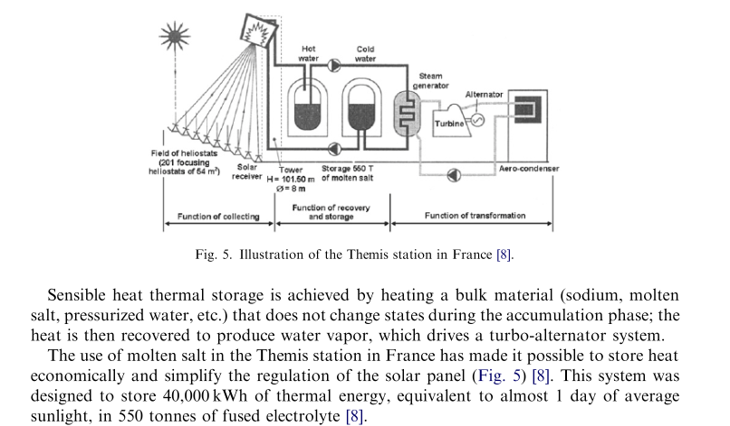
Sensible Heat Thermal storage

Slide 10
Worldwide installed storage capacity
http://large.stanford.edu/courses/2012/ph240/doshay1/docs/EPRI.pdf - 2010

Slide 11
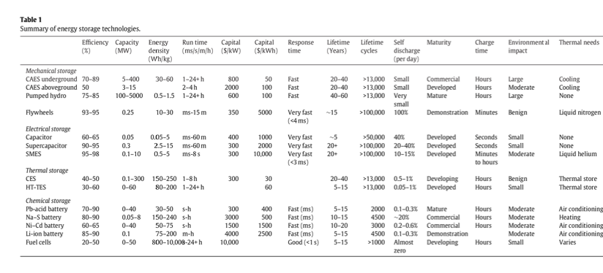
Comparison of energy storage technologies
NOTE: SHALL BE LIKE THIS (x/y axis flipped):
Mechanical Storage
Electrical storage ….
 | CAES underground | CAES aboveground | Pumped Hydro | …
Efficiency %
Capacity (MW)
Energy Density (wh/kg)
…
Notes:
The task here is to convert this image to a “real”, editable table. I know this is pain, but it is needed.

Slide 12
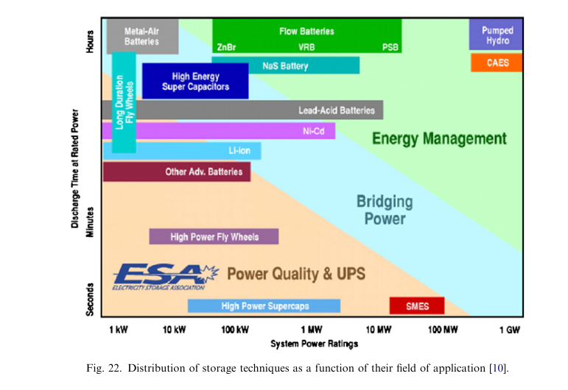

Slide 13
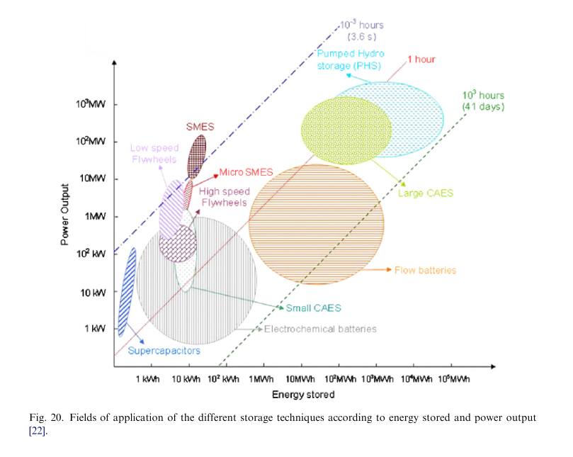
Fields of application

Slide 14
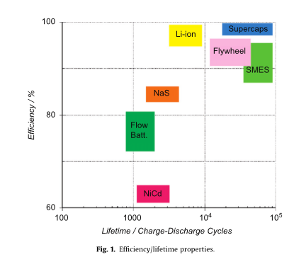
Efficency / Lifetime properties of storage technologies

Slide 15
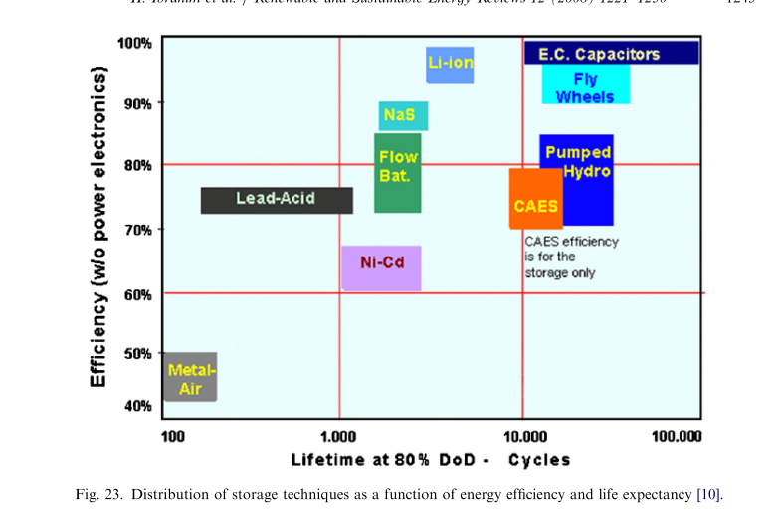

Slide 16
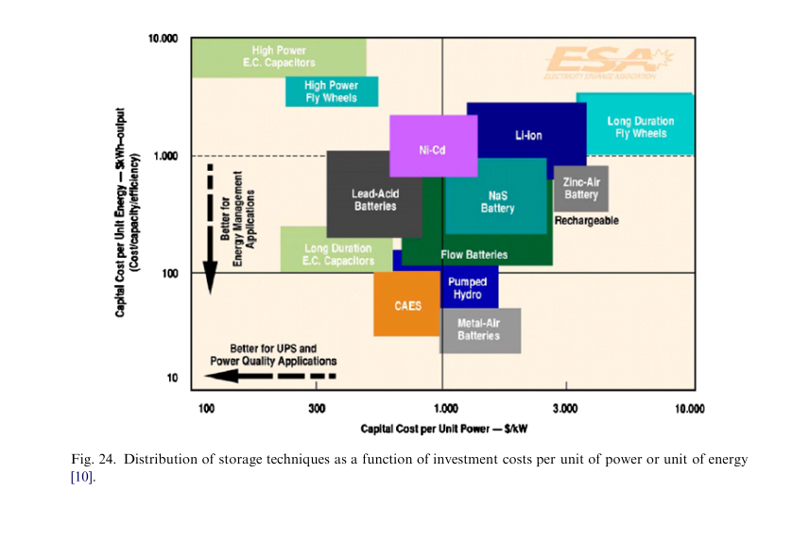

Slide 17
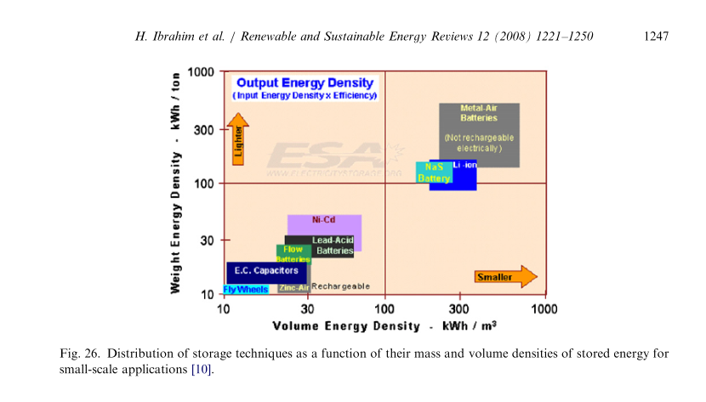

Slide 18
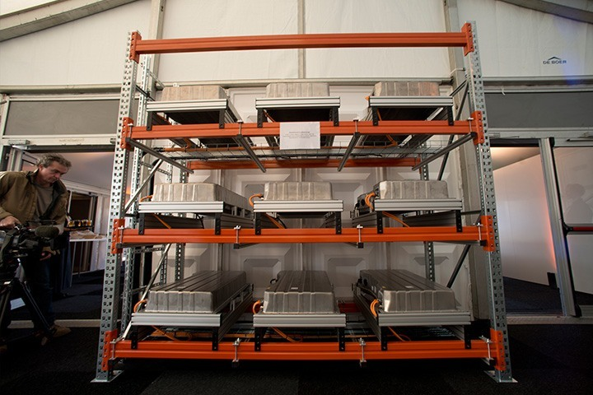
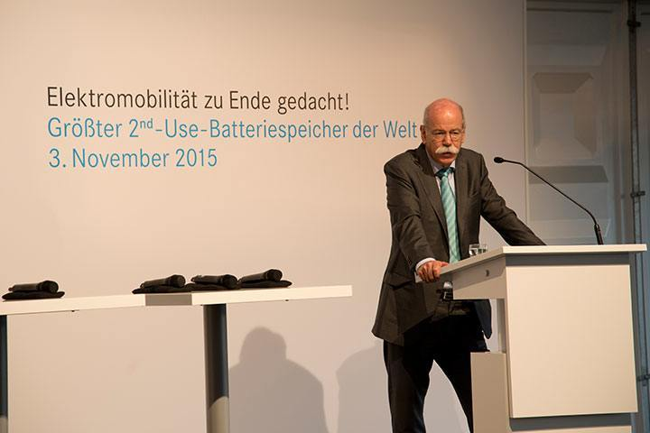
World's largest 2nd-use battery storage unit set to connect to the grid
13-megawatt battery storage unit to connect to the grid in early 2016
Levelling out fluctuations in the power grid as an active contribution towards the energy revolution
The world's largest 2nd-use battery storage unit will soon go into operation in the Westphalian town of Lünen and marketed in the German electricity balancing sector.
A special feature of this venture is the use of second-life battery systems from electric vehicles. In Lünen, systems from the second generation of smart electric drive vehicles are being incorporated into a stationary storage unit with a total capacity of 13 MWh. The process demonstrably improves the environmental performance of electric vehicles, thereby helping to make e-mobility more economically efficient.

