Slide 1
Wine Investment Proposal
BPWI Ltd.
London
December - 2019

Slide 2
Who are we?
Peter Lunzer
Peter is the founder of Lunzer Wine Group with over 30 years experience in the wine sector.
Peter formulated the Price Step Theory and subsequently developed the Wine Price Ratio which is a data driven process to analyse investing opportunities in the fine wine market.
Working with globally distinguished companies Peter sees the consumption patterns of wines through the corporate events that he hosts and in turn this knowledge guides investment decisions based on what is in demand and also what is tasting good.
Bo Ekberg
Bo is an experienced entrepreneur and business executive with a particular passion for start-ups that seek to disrupt existing industries in a way that benefits the consumer.
In 2011 he co-founded Task360. It became the UK’s leading iOS based crowdsourcing platform for information collection and completion of temporary tasks. It was sold to Private Equity investors in 2017.
He now acts as a Consultant and trusted Board level Advisor to businesses of various sizes across multiple industries.
Leveraging his strong financial background and passion for wine he currently sits on the Advisory Board of Bordeaux based Chateau Meaume.

Slide 3
What are we actually proposing
Our vision is to provide transparent and attractive financial returns from investments into fine wine, combined with access to the pleasures of the fine wine world.
BPWI Ltd. Proposal
An invitation for you to become an integral part of the world of fine wine and to achieve attractive financial returns as a shareholder in a Private Limited Company that invests in wine.
As a shareholder you will benefit directly from our combined depth of knowledge of, and access to the inside track of the wine industry.
Share Capital will be exclusively invested in a tradeable portfolio of wines which is wholly owned by the Company.
The Company can invest completely independently compared to a merchant managing their portfolio positions
Our buying expertise and transparent approach to the world of fine wine will also give you exceptional access to personal deal flows outside the remit of the Company
As a shareholder you can also enjoy bespoke arranged events both in the UK and internationally; e.g. at world renowned vineyards

Slide 4
The Fine Wine Market
Dominated by Bordeaux, Burgundy and Champagne
Rhone, Italy, USA and Australia emerging with some interesting wines
Global Fine Wine Inventory stable at +/- £7.0 bio
+/- £1.5 bio traded every year; equal to roughly 20% of available inventory
London dominates global trading (+/-80%), followed by Hong Kong (+/-15%)
Roughly 400 Fine Wine Merchants globally (Liv-Ex members), with the Top 6 representing +/- 25% of turnover:
BI Fine Wine & Spirits Merchant
Farr Vintners
Berry Brothers & Rudd
Corney & Barrow
Justerini & Brooks
Vinum Fine Wines

Slide 5
Fine Wine versus other Assets
‘Alternatives’, including Wine, are increasing in popularity due to low interest rates
Wine as an investment is becoming better understood and provides diversification to a portfolio
Trading exchanges provide increasing liquidity and - importantly - transparency
Wine is an‘inexpensive’ luxury compared to yachts, jets and cars
Wealthy consumers tend not to turn their backs on fine wines
Fine wine is produced in finite quantities
When the economies are strong, the availability of the most sought-after wines can decrease rapidly

Slide 6
Recent Market Trends
Market Trends
From 2003 to 2011 it was normal to see returns of 10% p.a. net of all fees (from sympathetically priced investment vehicles)
Regime change in China in 2012 coincided with many investors losing money on 2009 and 2010 En-Primeur purchases after they had become physical. The entire wine market reacted when Chinese buyers tried to exit their positions.
Wine prices declined steadily for 3 years until 2015
As has happened before historically, when wines become too affordable the market reacts. From 2015 to 2018 wines gently rose in price.
Global currency volatility and US-China are just two contributors to investor uncertainty since 2018
Growing global awareness of the fine wine market puts upwards pricing pressure of finite inventories

Slide 7
Market Potential
Market Opportunities
The market has plateaued for a few years and we anticipate that owning a portfolio before prices move again will be potentially beneficial.
Chinese buyers are growing in numbers year on year and supply is unlikely to keep pace with their growing demand let alone the traditional European demand for great wines.
The wine import taxes in India have held back collectors for many years. If the government were to soften their approach then we believe it would cause a significant increase in prices due to new demand
Market Risks
Repeat of price slump of the 2009 Bordeaux vintage which happened in 2012.
Polarised ownership of wine - should wine funds become mainstream then they will move the market if investors all redeem at the same time.
Trade wars threatening the free movement of Fine Wines.

Slide 8
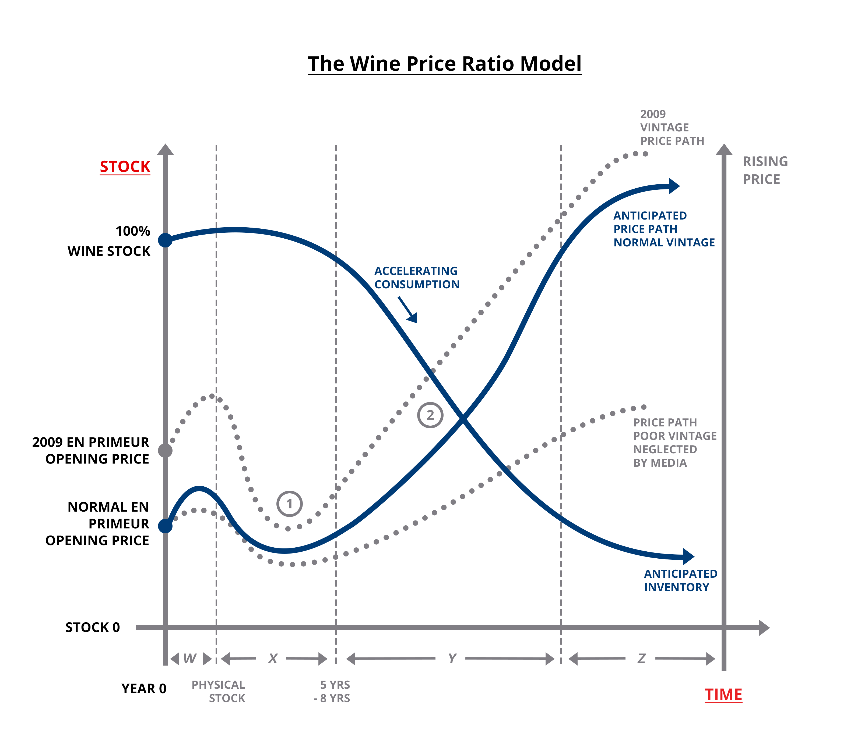
The Wine Price Ratio Model
Production Volumes and Product Quality are driven almost entirely by the weather
Pricing for a vintage at launch is driven by Product Quality and Points awarded by Critics. However, at marker ① wines are often neglected and become less expensive
Pricing over time is driven by diminishing supply against constant or growing demand
Pricing tends to accelerate when a wine hits its peak consumption window driven by increased consumption and demand, illustrated at marker ②

Slide 9
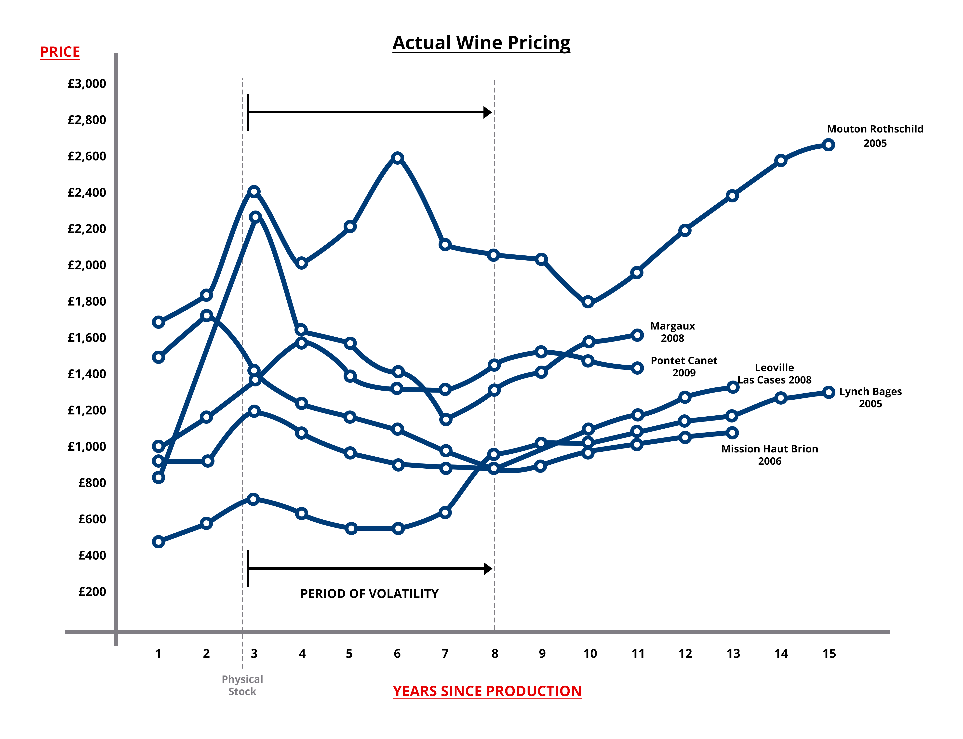
Fine Wine Pricing Examples
Actual pricing echoes our Wine Price Ratio Model, as each wine moves from its En-Primeur price
Prices do frequently rise after En Primeur, and sometimes until just after the wines are bottled
We see that after bottling, wine prices can become volatile until the wine is old enough to be consumed

Slide 10
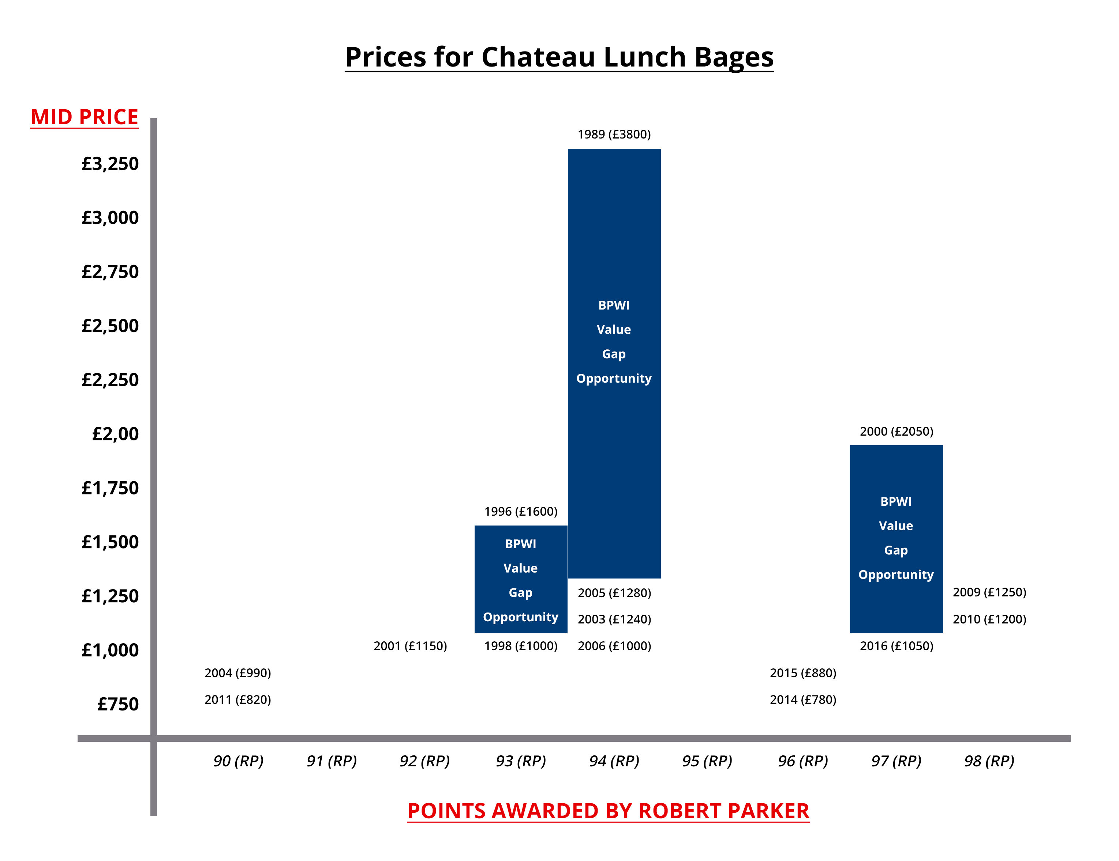
Identifying Value Opportunities
Buying Opportunities exist for a wine with comparable critic points across vintages – with younger vintages presenting value opportunities
The advent of Liv-Ex (and other exchanges) allows Member Companies to make transparent and data driven trading decisions

Slide 11
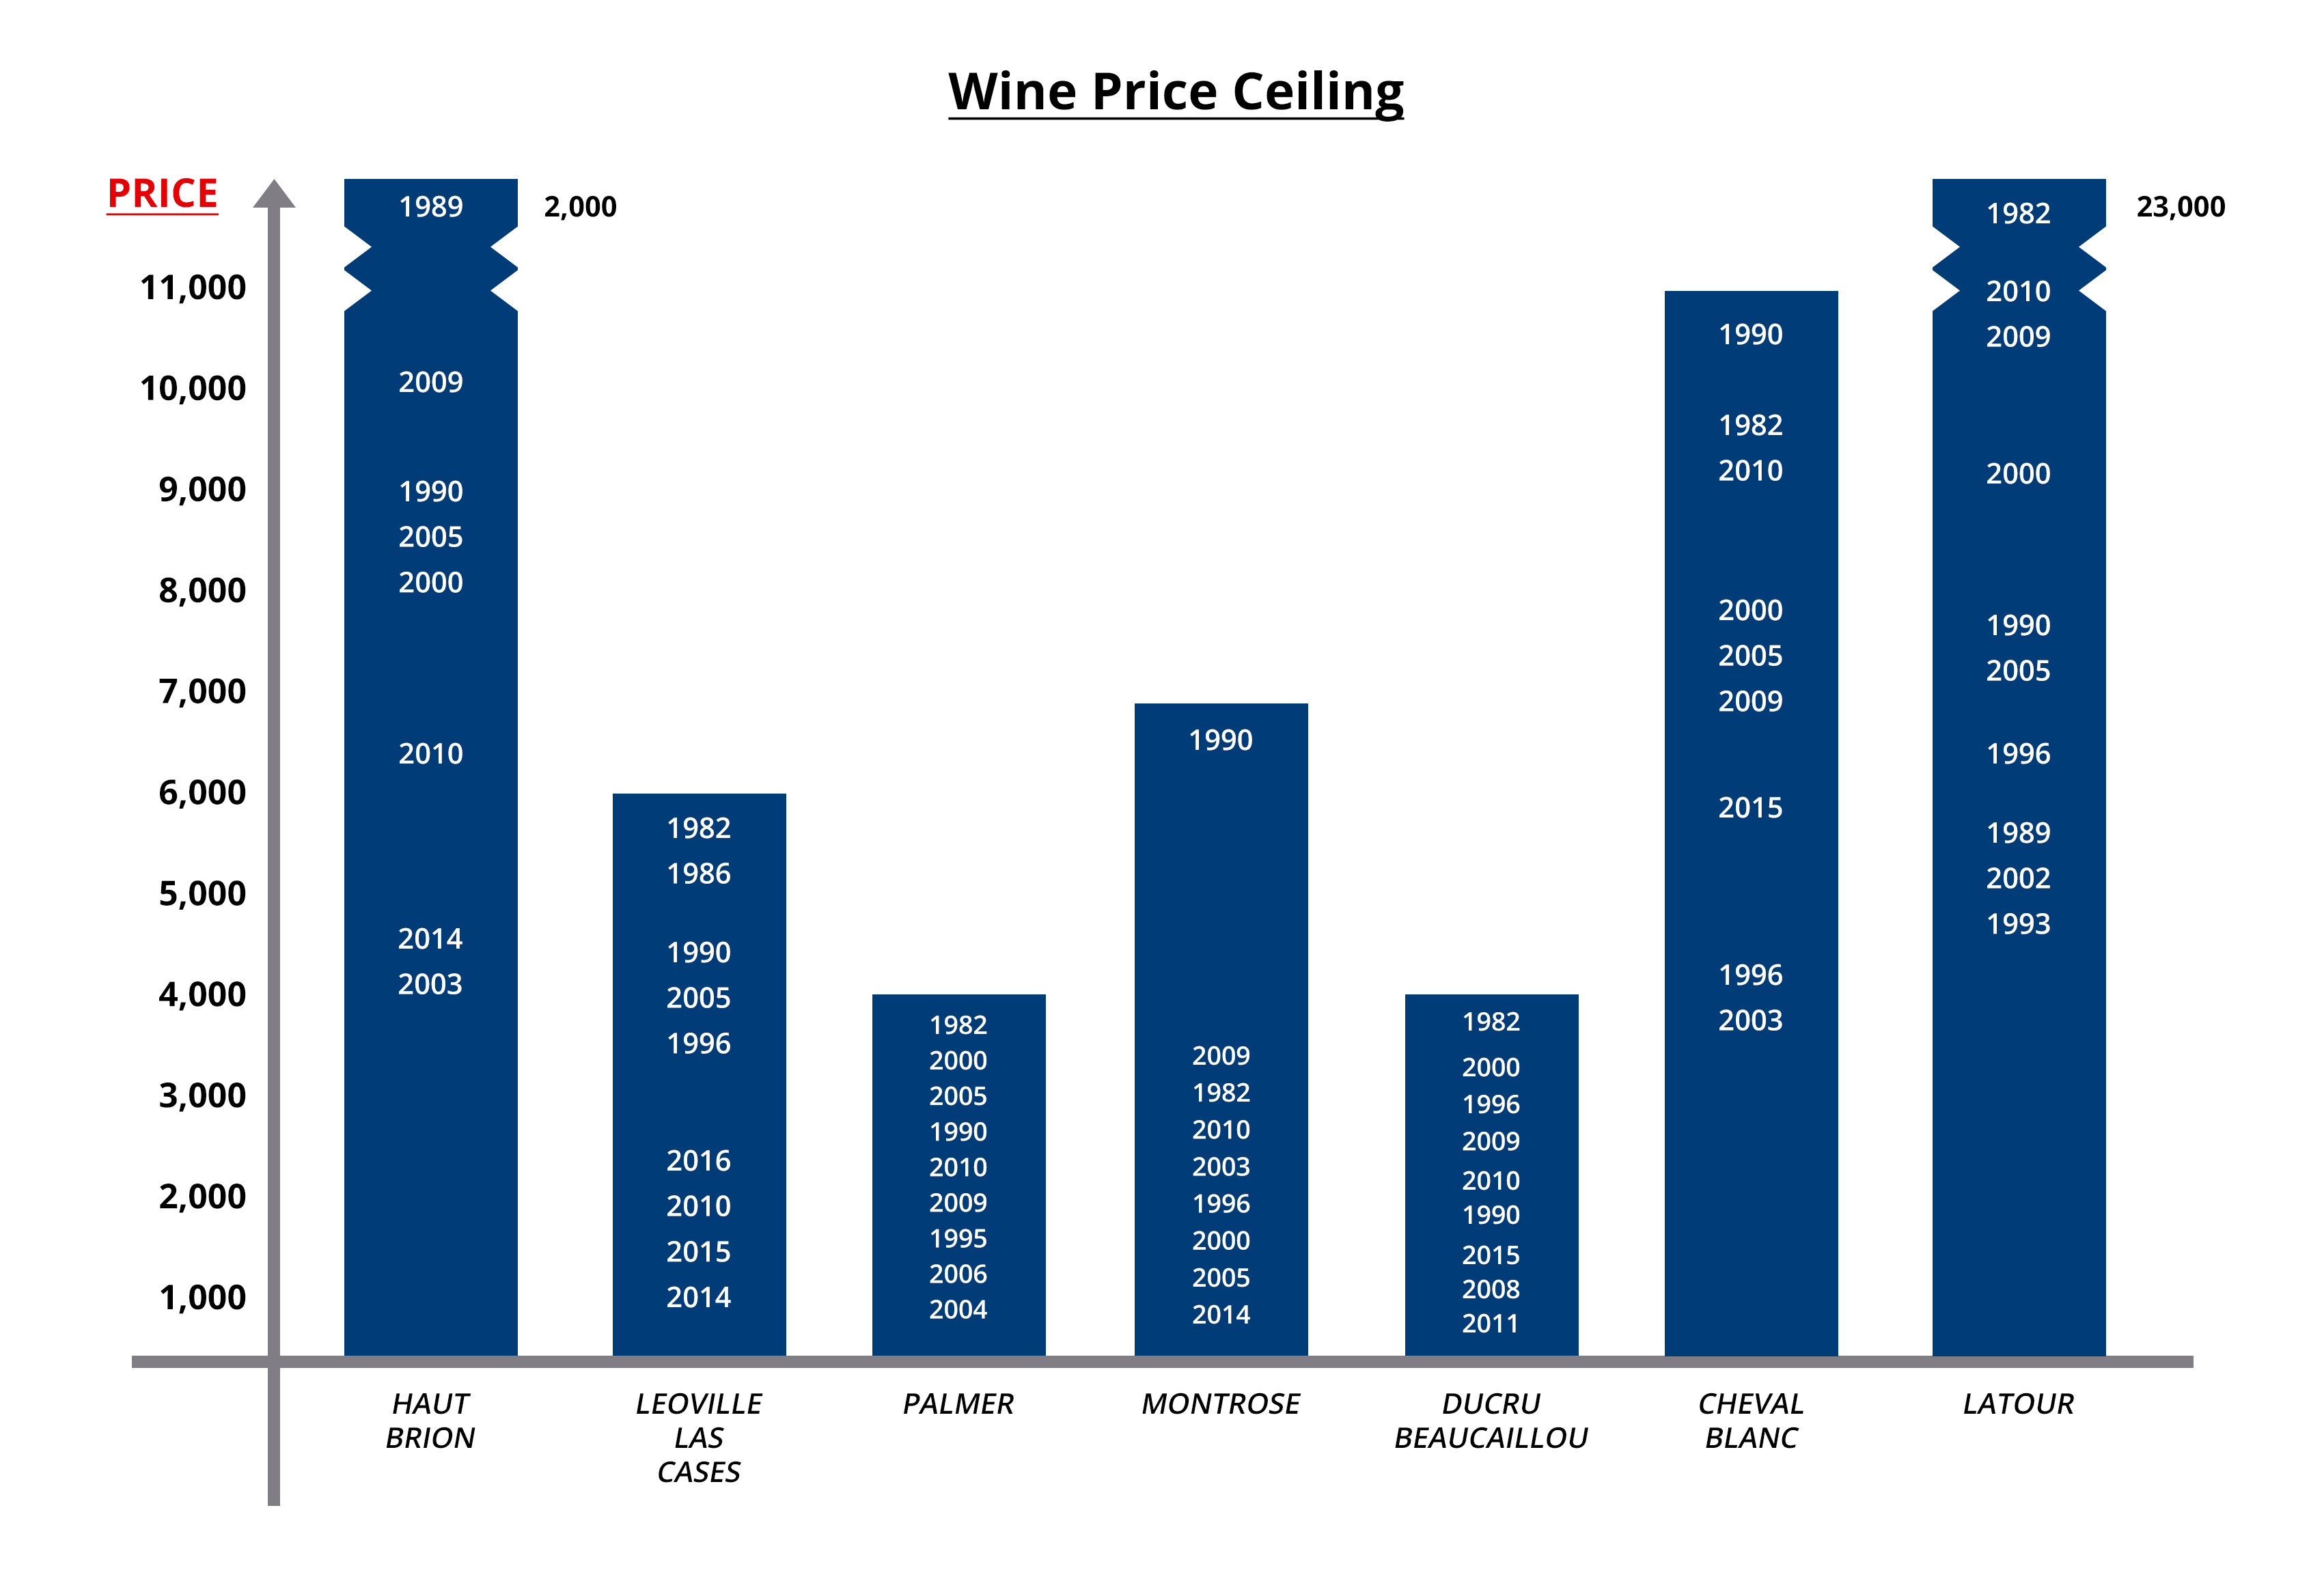
Identifying Value Opportunities
For a particular wine, a ‘glass ceiling’ exists for how expensive it can or may become
Understanding this provides valuable guidance on timing to sell and/or the remaining opportunity when buying
Cross referencing wine critic scores, Value Gaps and ‘Price Ceilings’ provide valuable data driven support in making investment decisions

Slide 12
Our Investment Parameters
We only buy reputable and highly sought-after vintages of wines that have excelled themselves in that vintage and which have been properly stored
All wines will have been highly rated by the consolidated opinion of globally renowned wine critics and the wines will already have an international reputation
We are always looking for wines which are undervalued according to the Wine Price Ratio and Price Value Gap philosophy
We won’t buy En-Primeur, split cases or any wines without fully documented provenance
We intend to use all available data and our collective experience to invest in wines on an upward trend

Slide 13
Our Proposal
Establish a Private Limited Company with share capital of 5,000,000 ordinary shares (par value of £1.00)
Recommended minimum shareholder subscription of £100,000.00
Implement a Shareholders Agreement to protect the invested Share Capital
Liquidate the Company after 5 (or 7 ) years and distribute funds to shareholders
Appoint Bo Ekberg and Peter Lunzer as Directors
Appoint up to 3 additional Directors / Board Members to oversee the Company
Appoint BPWI Ltd as Management and Investment Company
Annual fees of 2.20% of the initial share capital
12.5% of positive increase in the NAV on liquidation
Fees to be ‘paused’ if Net Asset Value drops below 95.00% of original Share Capital
Re-instated when Net Asset Value goes above 96.00% of original Share Capital

Slide 14
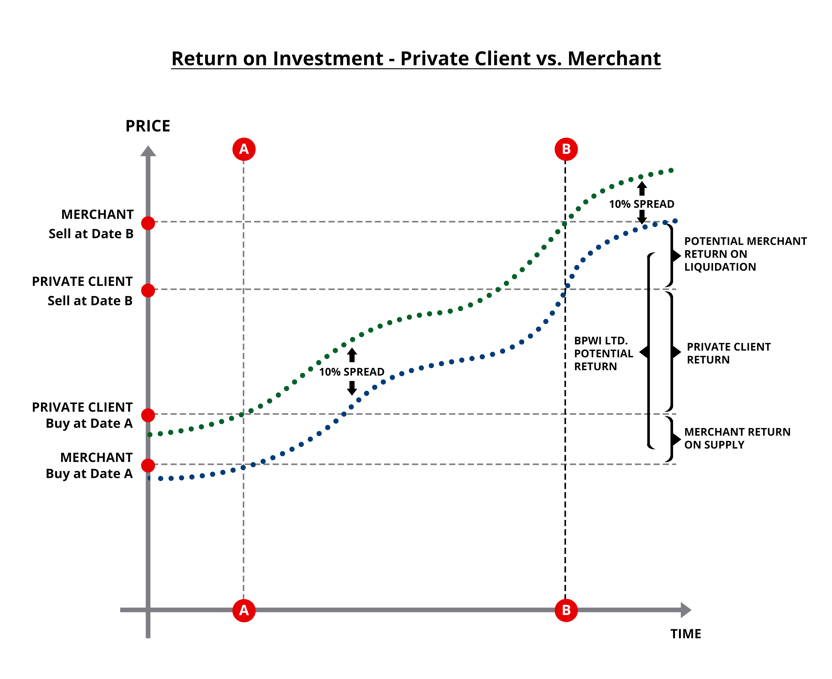
Enhanced Margins to Investors
As members of London International Vintners Exchange (www.liv-ex.com) the Company will be able to buy large volumes of wine at inter-merchant prices (B2B prices) whilst remaining anonymous
By purchasing at B2B rates the Company has the opportunity to internalise all or part of the average 10% merchant margin levied on both purchases and sales
Trading with this enhanced margin is a key financial benefit that accrues in full to the shareholders

Slide 15
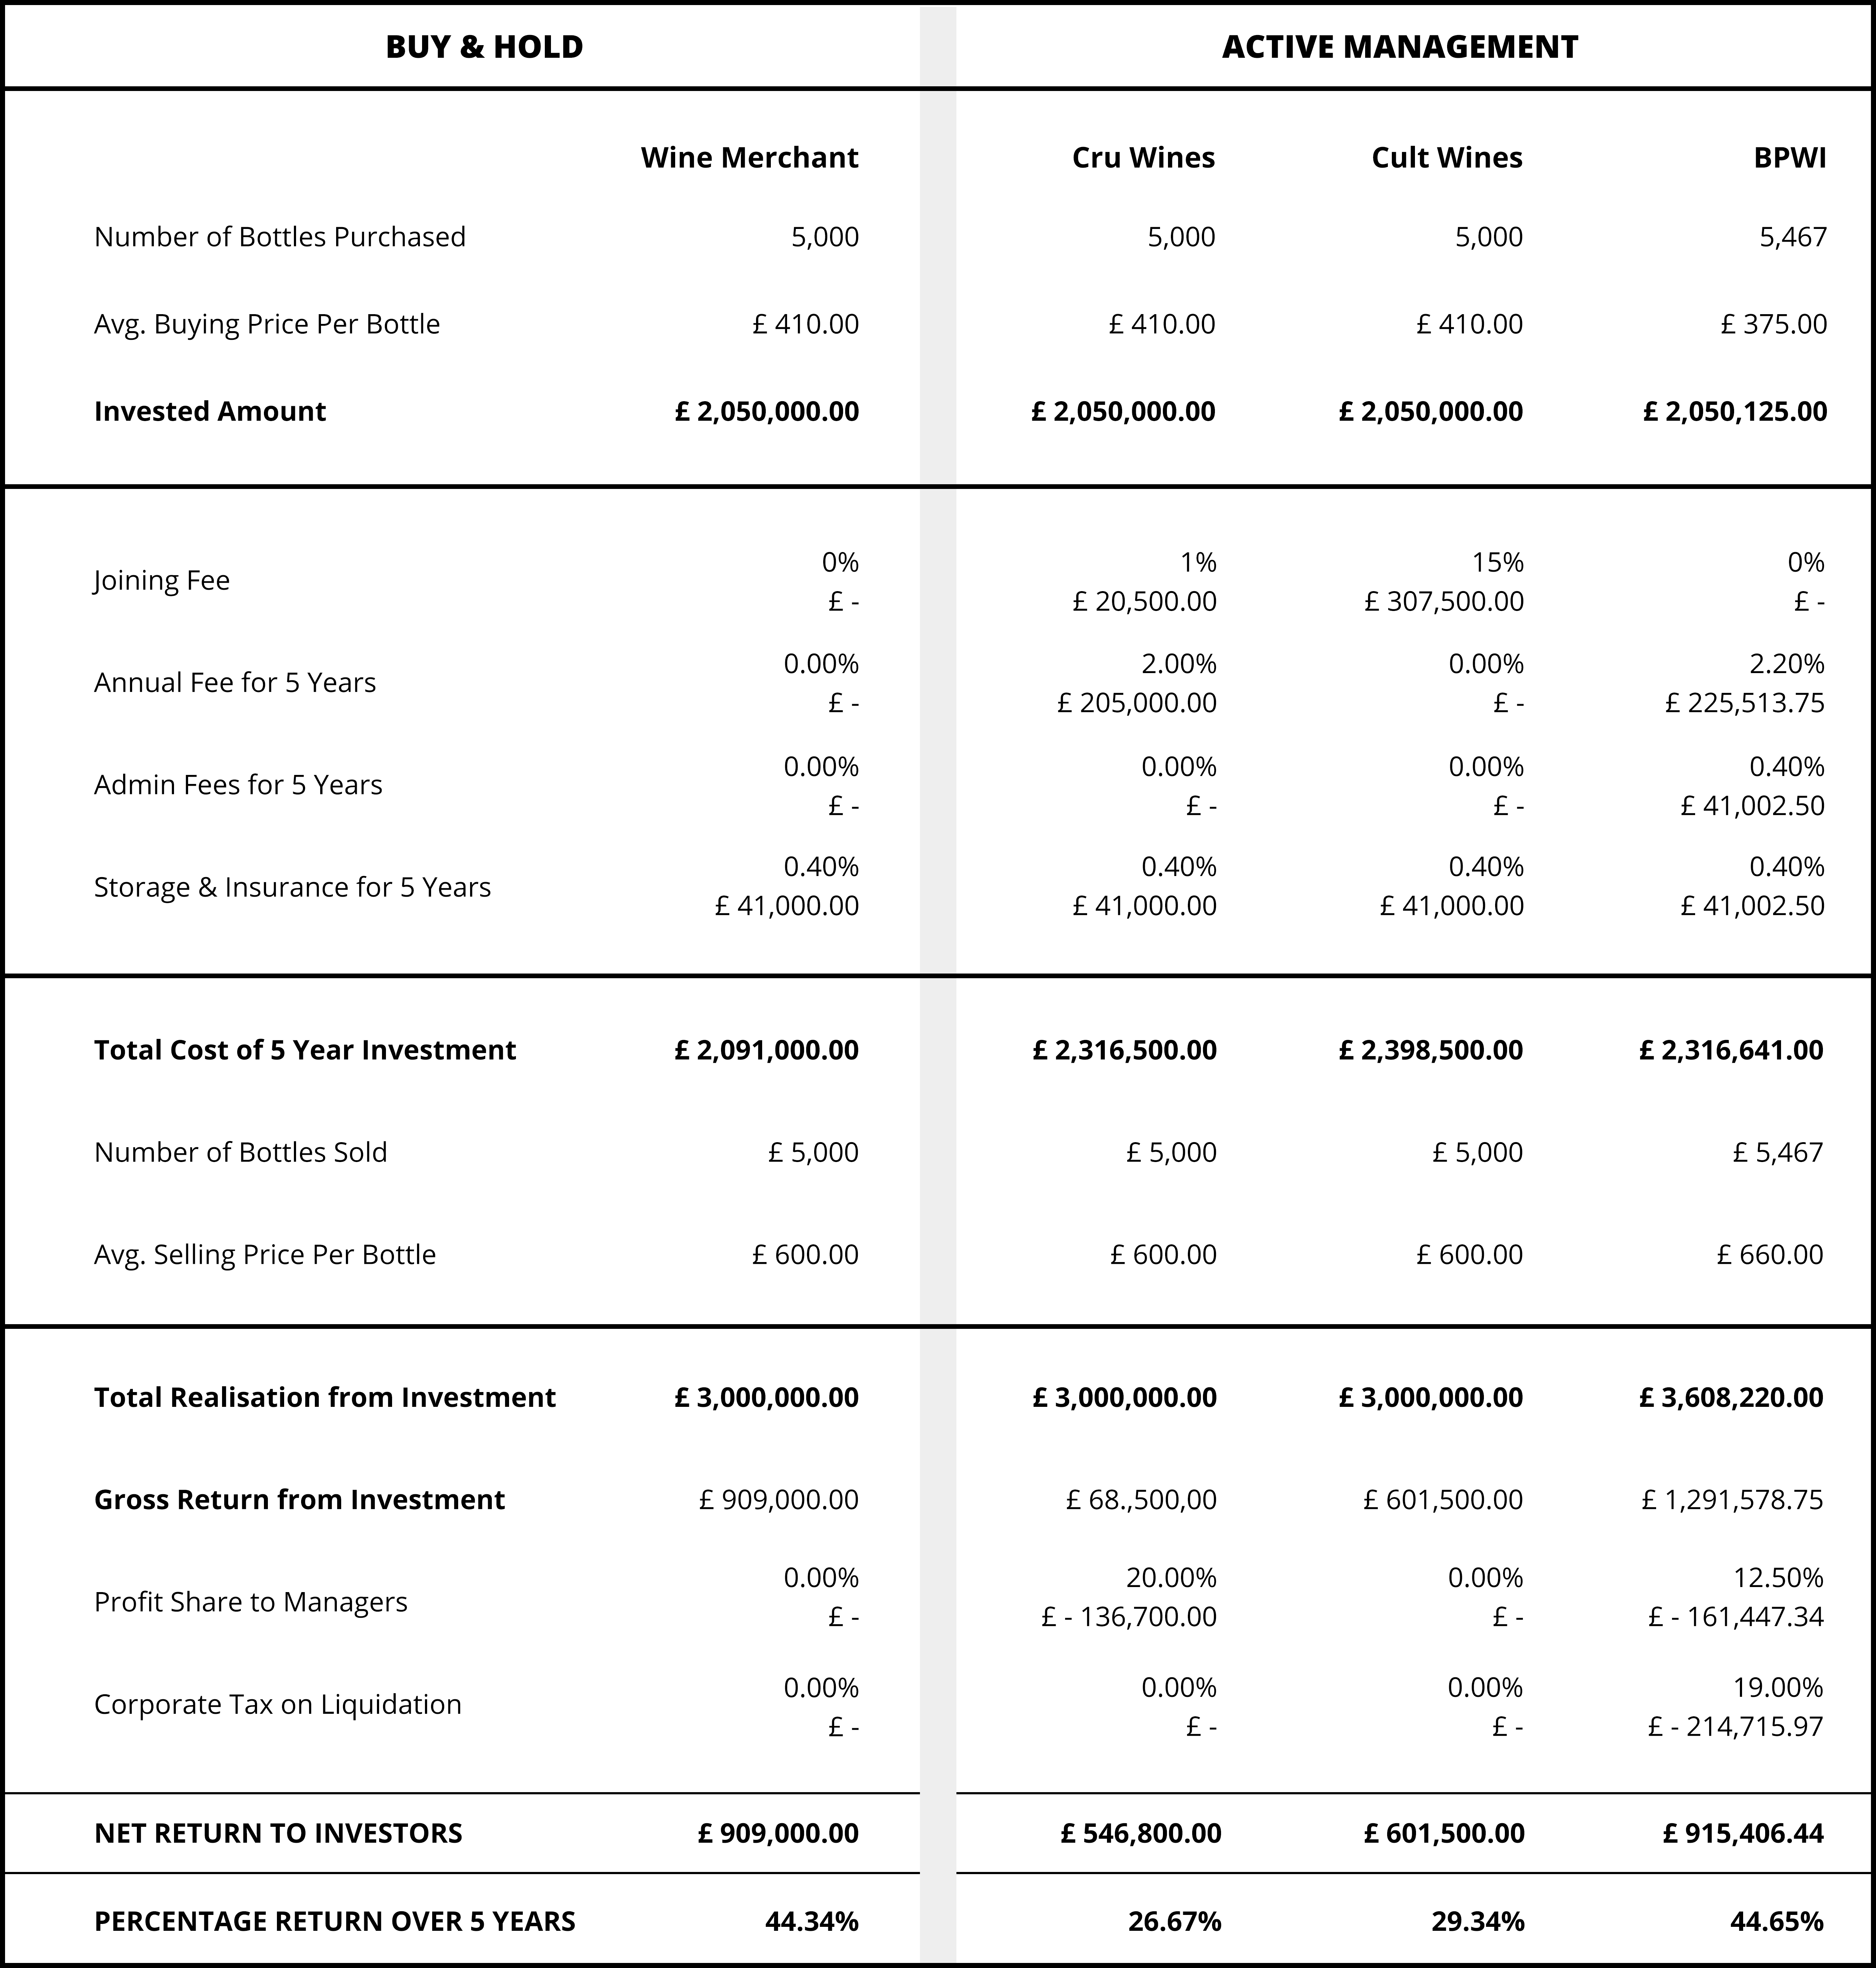
How do we compare?
Buy and hold means that you trust your own, or your merchants judgement
Etc

Slide 16
Benefits to Investors
Bespoke Wine Concierge Service
Access to deal flows at B2B Prices
Access to feedback and information about any wine you may be interested in
Purchase and Delivery services for wines that shareholders wish to purchase for their own consumption

Slide 17
Benefits to Investors
Wine Themed Events
UK Dinners in premium locations in London and the Home Counties
Vertical tastings, e.g. 6 vintages of Chateau Palmer
Compare different wines, e.g. Puligny to Chassagne
Match food choices with relevant wines
First Growth wine tastings

Slide 18
Benefits to Investors
Visits to Vineyards
Visits to famous overseas Vineyards
Champagne – Krug
Bordeaux – Margaux & Yquem
Burgundy – De Vogue
Rhone – Guigal
Napa Valley – Screaming Eagle, Opus One
South Africa – Rupert & Rothschild, Kanonkop, Vergelegen (Stellenbosch)
Etc. ….

Slide 19
Thank You
Back Up Slides to Follow

Slide 20
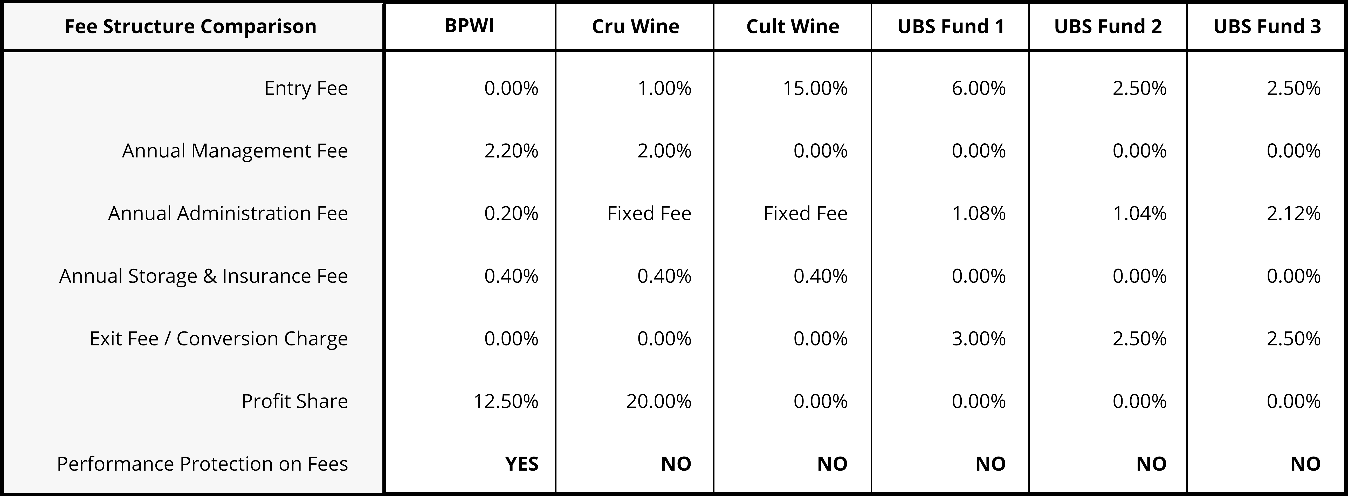
Cost Comparison
Notes:
UBS Fund 1 is ISIN: LU1852199097, Sustainable Investing Balanced
UBS Fund 2 is ISIN: LU1918890887, Global Multi Income
UBS Fund 3 is ISIN: LU0678606244, Global Allocation

Slide 21
Flow Chart of Company Activity

Slide 22
Administration and Management
Bank: Handelsbanken
Accountants: IFM Praxis
Legal: Field Parkes & Seymour
Storage/Custodian: London City Bond, Vinoteque

