Slide 1
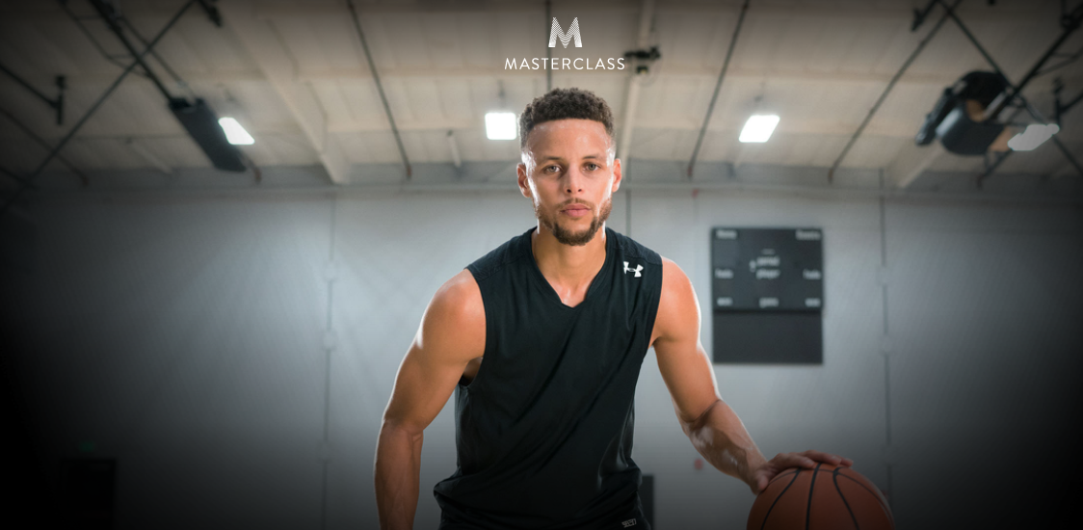
(Temporary name and logo)
Learn and engage with your favorite master
Our online platform which will be available on a website and a mobile application will allow users to view professional online courses taught by famous top-notch experts in a wide range of fields and to engage with their instructors.

Slide 2
Who doesn’t want to engage with their favorite masters and learn from them?
How does your favorite chef layout his kitchen?
What does the most successful businessman consider to be crucial stages when starting a company?
How does your singing idol recommends to warm the throat before singing?
How should you move on the court if you want to play like your favorite basketball player?
Where should you shop for clothing if you want to look like your fashion icon?
Fans and the general public yearn to both directly learn from famous national experts and to have personal contact with them.
There is currently no platform that facilitates both learning and engaging.
Notes:
Easily change photo. Please click on the small icon in the center of the holder and choose an image on your computer.
When you added the image send it to back (Right click on the image > Send to Back).

Slide 3
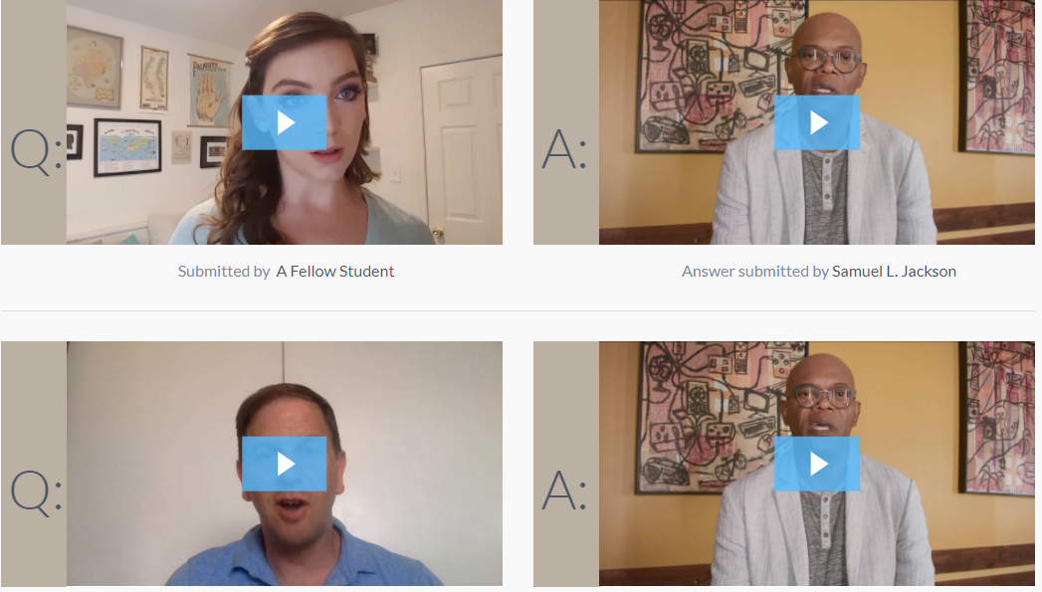
The Masters
We develop an online platform through which users from all over can study online video courses from local celebrity instructors.
Users will be able to engage with their masters through the platform live at specific office hours set by every instructor.
Users will be able to leave questions and comments and get personal video recordings of answers and feedback.

Slide 4
Examples of experts for the Israeli platform
Teaching
entrepreneurship
Shay Aggasi
Teaching
football
Eran Zehavi
Lior
Suchard
Teaching
Mentalism
Omri
Casspi
Teaching
basketball
Teaching
cooking
Meir
Adoni
Teaching
fashion
Neta
Alchimister

Slide 5
Business model
Picking top-notch experts with big social media influence to be instructors.
Rev share model with the experts to provide a good incentive for promoting the product on their channels.
Producing 10 high quality video courses with different experts and launching platform.
Producing 2-3 additional courses each quarter.
The Masters
Production
Providing high quality promotion materials to the experts to post and share on their social networks and media channels.
Promotion
Video courses
High value levelled courses compatible for beginners, intermediate and advanced students.
Income
Selling courses individually per expert or with subscription
Selling experts’ items and kits for the courses.
Selling package deals for simultaneous purchases of courses and kits
Selling gift cards for experts’ fans
Opening a call centre with high quality sales people who will sell the courses directly to new clients, up sale existing users and promote gift cards and packages.
Sales

Slide 6
Marketing and sales strategy
Instructors must be big social media influencers.
Instructors must commit to constantly promote their courses on their channels.
Provide incentive to the experts to properly promote
their courses with a revenue share model.
Target the experts hugest fans in marketing campaigns.
Producing a big launching event with all the famous instructors and media for quick advertising breakthrough
Opening a call centre with strong sales representatives who will sell courses to hot leads over the phone and up sale current users.

Slide 7
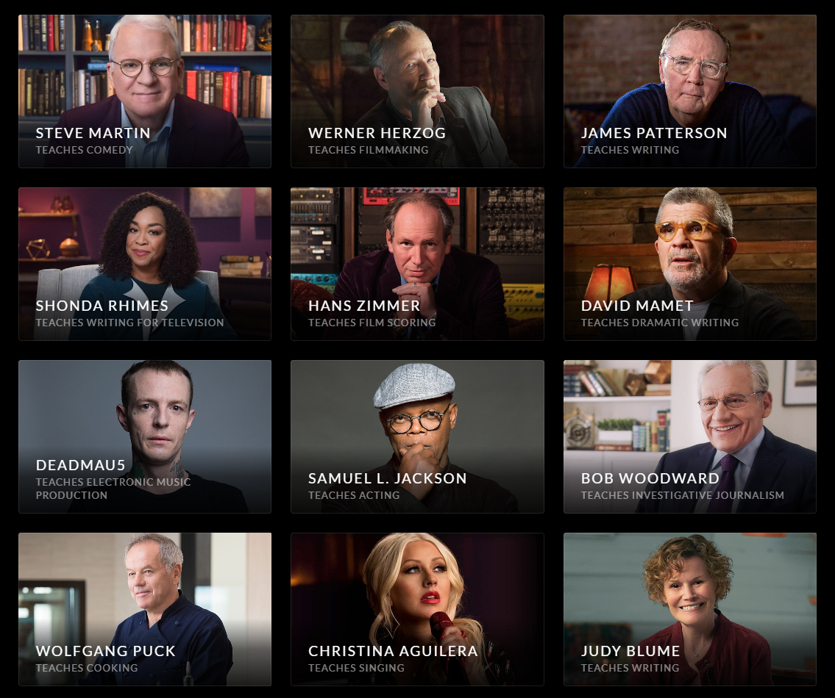
Competition
Masterclass.com
American based platform
6Y
Founded in 2012
30K
Sold over 30,000 courses in their first 3 months of operation.
$56.4
Raised $56.4 million in 4 rounds

Slide 8
Theepicschool.com
Spanish based platform.
Six courses available so far.

Slide 9
TEAM
Arik Lifshits
Founder and CEO
Experience in production, creative, marketing.
Owner and founder of international online mentoring and coaching company ‘Sixstar coaching’
Yuval Regev
Co-Founder and COO
Experience in Sales management, affiliate management.
Owner and founder of international online mentoring and coaching company ‘Sixstar coaching’
Firma production and creative
Over 10 years of experience in producing films and commercials.
Between their projects: Seat, Amdocs, Shufersal, Hisense, Dove, Corona, Burger Ranch, Lexus
The Israeli blockbuster ‘Maktub’
Supporting team:

Slide 10
PROJECTIONS:
Return of investment after:
1.3 years
Profits at the end of year 5 of operation:
$29 million
Growth engines
Opening the platform in a new country every year starting from year 3 with France.
Producing and adding 2-3 new courses every quarter on each platform

Slide 11
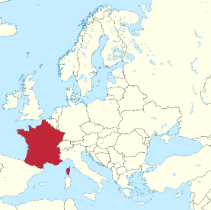
Road Map
6 months from raising capital
Launch platform in Israel
With 10 different courses available.
Preparation for pilot in Israel.
Research.
Recruiting experts.
Fund raising.
3 months from launch
Launch platform in France
With 10 different courses available
Expend the platform with 2-3 additional courses every quarter.
24 months from launch

Slide 12
Low risk investment because most of the capital is spent on a one time production of courses. Returning the investment quickly only from selling to hard core fans is very likely.
Strengths
Weaknesses
S
Easy and inexpensive advertising as we rely mostly on our famous experts’ channels.
W
Unprotected – content might be pirated.
(There is a solution)
T
O
Another better funded start up might enter the market.
MasterClass might enter the European market.
Enormous growth potential.
Format is not known yet in non-English speaking countries.
Threats
Opportunities

Slide 13
RAISING
$700,000
$490,000
70%
$210,000
30%
Production of 10 different video courses of between 3-4 hours.
Developing technology.
Legal department.
Branding.
Marketing.

Slide 14
ARIK LIFSHITS
Hamishna 8, Tel Aviv
+972-52-362-0251
Ariklifa3@gmail.com

