Slide 1

An introduction to SIA
2019

Slide 2
An introduction to SIA
Strategic Infrastructure Advisory (SIA) is a boutique infrastructure advisory firm that assists develop, procure, finance and operate transport, energy, water and social infrastructure projects. We bridge the gap between investors and market participants to develop, identify and transact quality projects.
New approach to changing markets
Balanced commercial and technical solutions
Long term partnerships that drive value
  Energy, Transport, Water and Urban Infrastructure markets are changing rapidly with new technology, business models and regulation all having a major impact on project design, delivery and investment risk.
  We play at the forefront of these markets and can bring considered and alternate approaches to project development, finance and transactions.
  Our team works with investors, consultants, developers and government and understand the broader issues and risks with infrastructure development and finance.
  We are specialists in our focus sectors and have worked across most major infrastructure projects in Australia.
We focus on delivering value and building strong client relationships. This suits a smaller number of clients who have a longer term focus.
This partnership approach brings substantial benefits to both parties and enables us to deliver significantly more than a typical engagement.
2

Slide 3
Our service offering
SIA brings together a range of technical and commercial service offerings to meet the needs of our clients. We provide flexible engagements that are tailored to outcomes
Project Development &
Management
Concept generation
Prefeasibility concept studies
Project management
Commercial & Technical
due diligence
Commercial and technical transaction due diligence
Sourcing and coordination of specialist advisors
Investment Decision making
Business cases
Economic analysis
Financial analysis
Cost competitiveness
Commercial advisory
Strategic advisory
Commercial structuring
Sourcing debt and equity
Climate Risk Services
Portfolio and asset review
GHG and emission reporting
Carbon, energy and emission reduction strategies
Climate Change risk and adaptation plans
Market & Technology Review
Australian, regional and global market and technology reviews
Industry benchmarking
Compliance & Risk Services
Policy & Regulation advisory
Compliance risk review
Project or portfolio risk assessment
Government Advisory
Grant applications
Unsolicited bids
Commercial interface

Slide 4
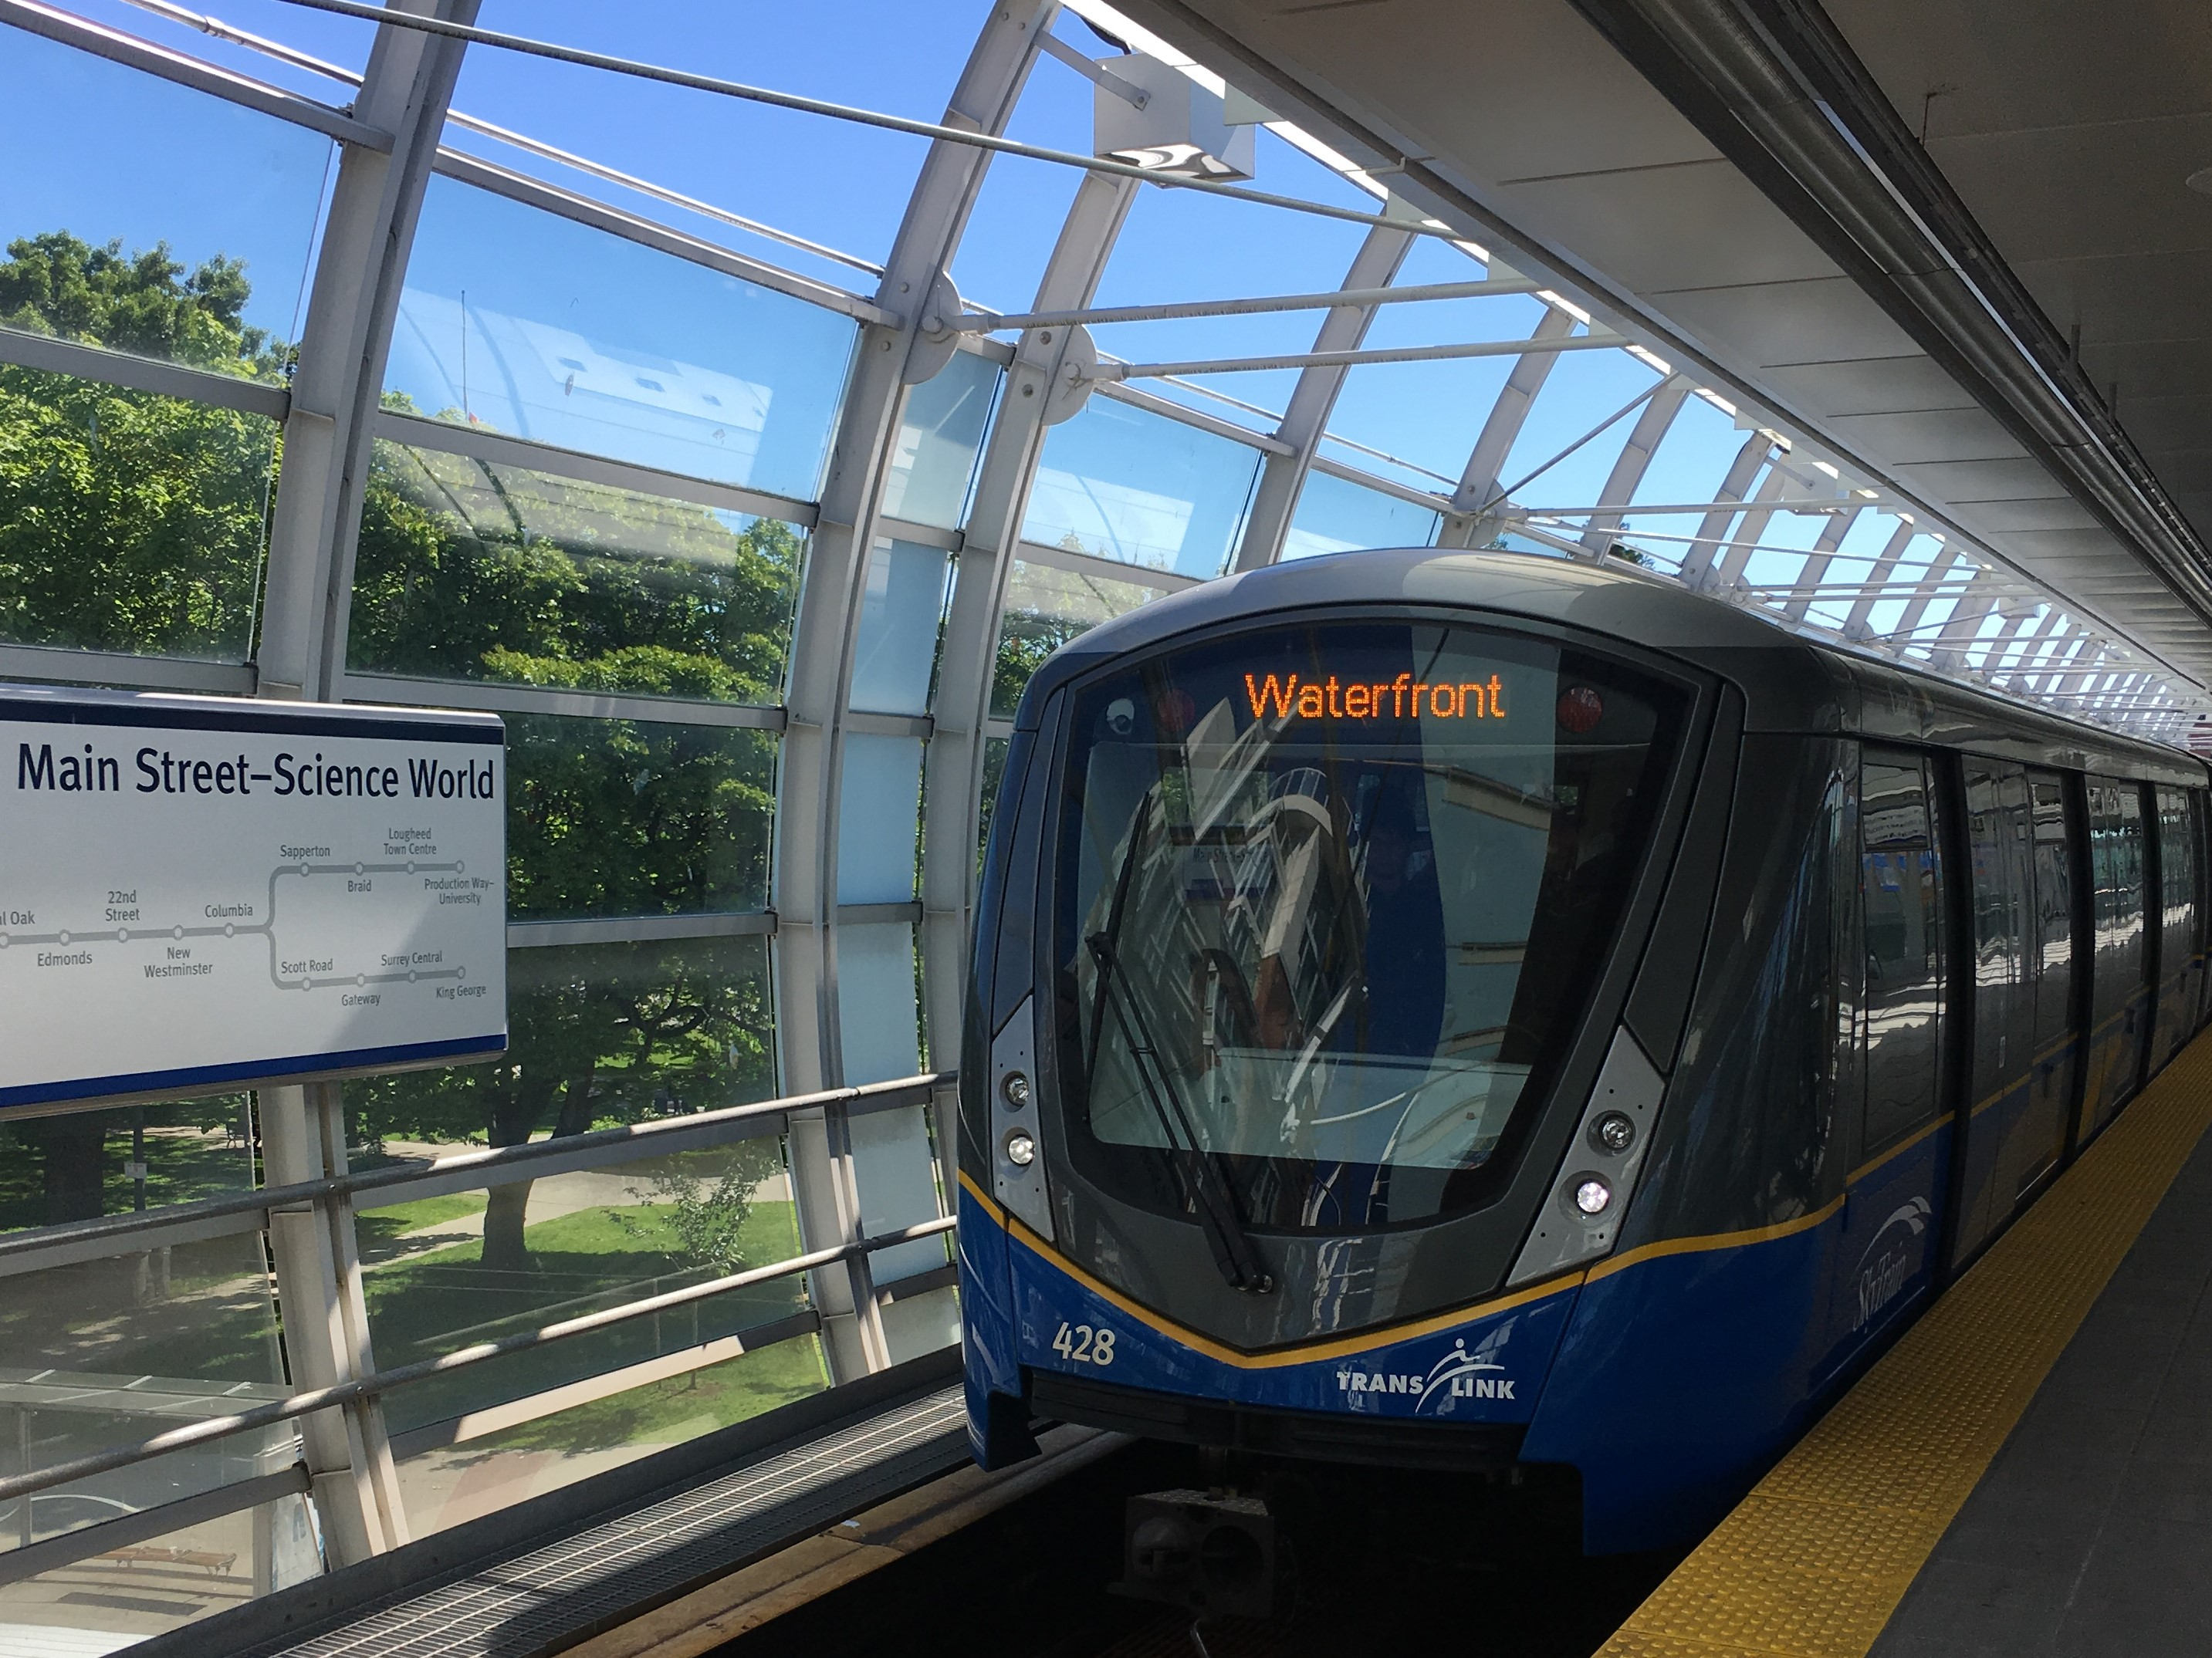
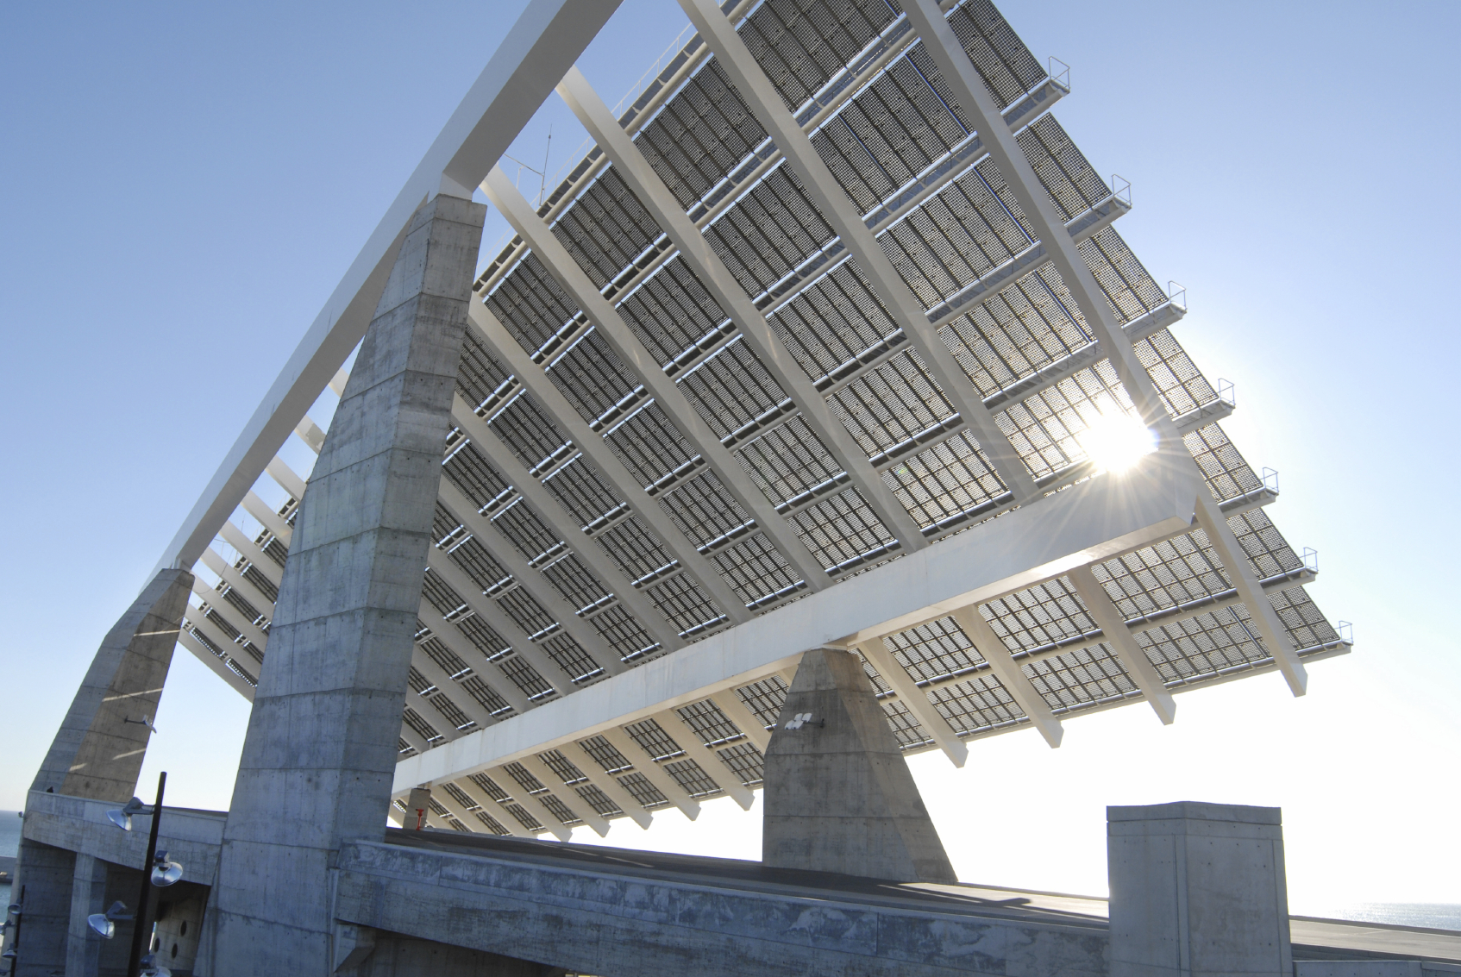
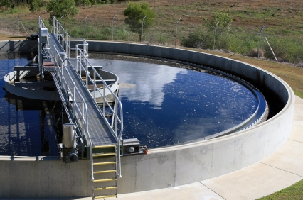
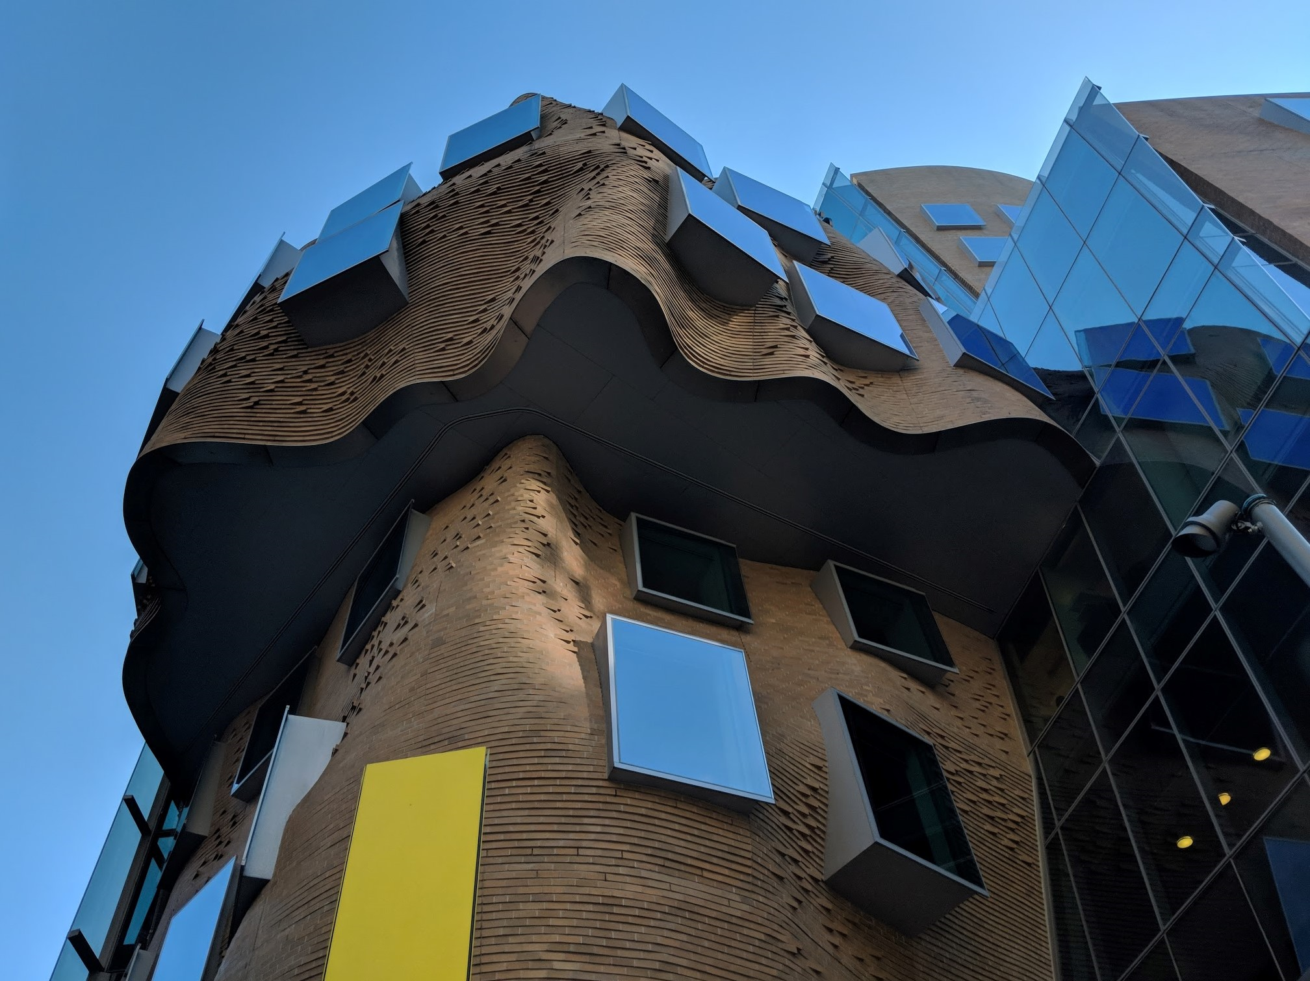
Our sector expertise
SIA has significant depth of experience in the transport, energy, water and integrated infrastructure sectors. This includes meeting client's investment needs within each market segment.
Transport
Our team have extensive experience in road, rail, port, aviation, logistics and public transport and have played a leading role in delivered some of Australia’s major transport infrastructure projects. We are sought out by government and investors to support the feasibility, development and delivery of strategic transport projects.
SIA are leading new approaches to technology and project delivery in the transport sector including transport interchanges, rail technology, EV and congestion management.
Energy
SIA have one of the most experienced energy team’s in the market who work across all forms of technology and projects. This includes development, finance, delivery, policy & regulation as well as operation improvement. We are also specialists in storage technology and carbon management.
SIA are assisting investors with technology due diligence, project development and regulatory risk in the energy sector. This includes some of Australia's leading storage and generation projects.
Water
We have developed and delivered some of Australia’s most innovative and leading water projects and continue to play a strategic role supporting government, water authorities, engineering & technology companies in each phase of the delivery of water assets.
SIA are working with government and the private sector on major water infrastructure projects to address long term water security issues.
Integrated Infrastructure
Innovative models for social infrastructure delivery are reshaping the market and the convergence of infrastructure in cities is leading to a redesign of our built environment. At SIA we deliver health, education, and social/recreation facilities play an integrated role developing leading precinct concepts.
SIA are working with leading urban design firms on establishing innovative approaches to integrated infrastructure and precincts.
4

Slide 5
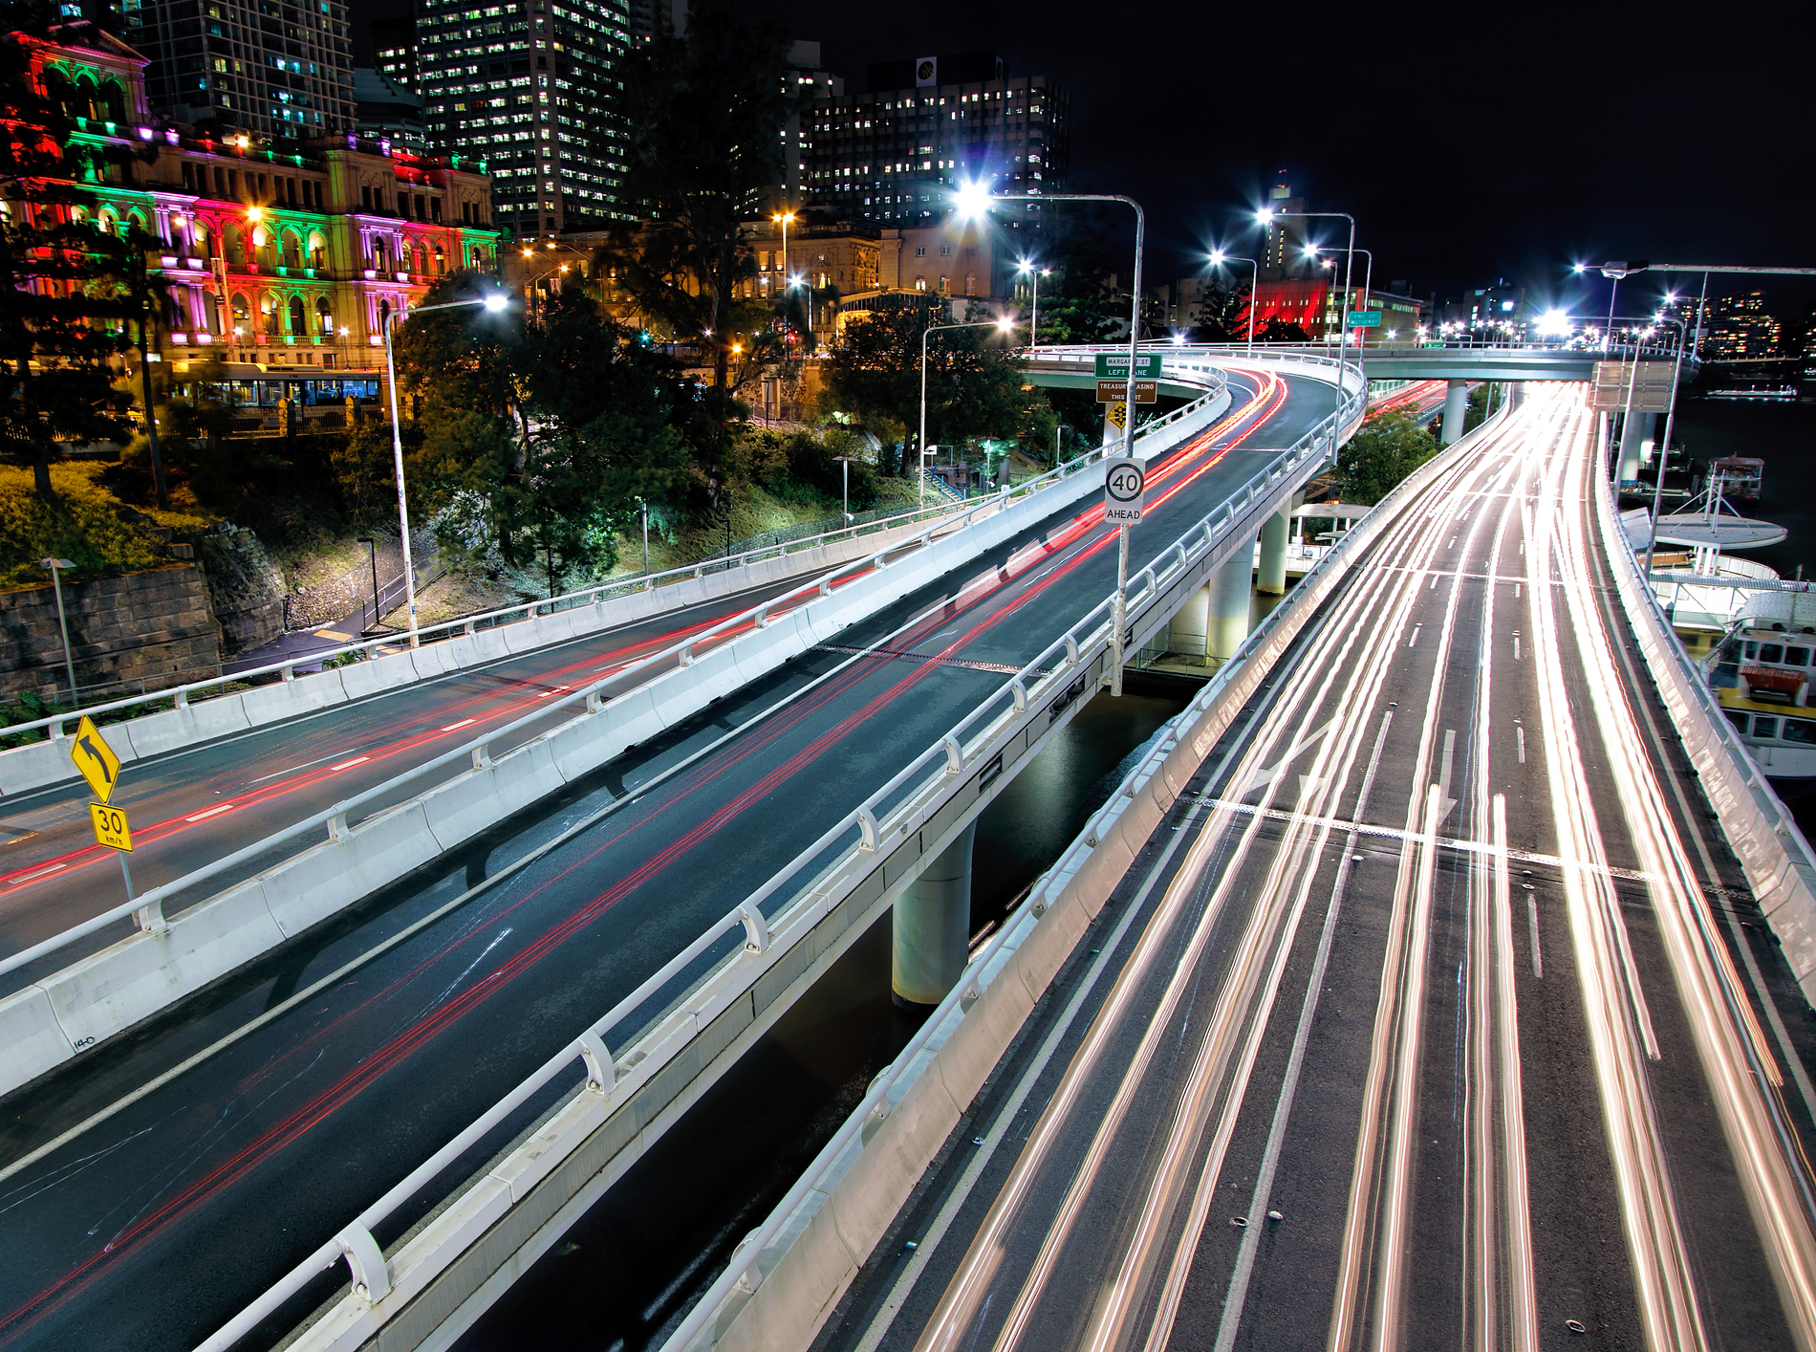
Transport experience
Project | Client | Description
Western Sydney Airport | Commonwealth Govt | Business Case and Economic Evaluation
North West Rail Link | Transport for NSW | Business Case, Economic Evaluation and Independent Sustainability Certifier
Sydney Metro | Transport for NSW | Funding Analysis
Westconnex | NSW Govt | Economic and Financial Advisory
New Zealand National Highway | NZ Govt | Valuation and Asset Management
Climate Risk Framework | Australian Super & IFM | Climate Risk review Brisbane Airport, Perth Airport, Port Botany, Port Kembla & M5
Westlink M7 | Rothesay | Due Diligence
Hobart Light Rail | Tasmanian Govt | Funding & Delivery Analysis
5

Slide 6

Energy experience
Project | Client | Description
Alinta Energy Acquisition | Chow Tai Fook | Identified and analysed a range of acquisition targets which led to the management and delivery of the acquisition of Alinta energy.
Ausgrid Transaction | Australian Super & IFM | Technical due diligence for the $16bn asset sale
Cultana Pumped Hydro Project | Energy Australia | Project development and sourcing finance
Wind Farm Development | Confidential | Feasibility and development of wind farms in Queensland & Tasmania
Biogas to Grid | ACTEWAGL | Feasibility and project development
Gas powered Microgrid | Siemens | Connection and Regulatory due diligence
Battery manufacturing facility | ICG | Commercial and technical due diligence
Renewable technology grants | ARENA | Commercial and technical due diligence for PV, CSP, battery storage, geothermal & biomass projects
6

Slide 7
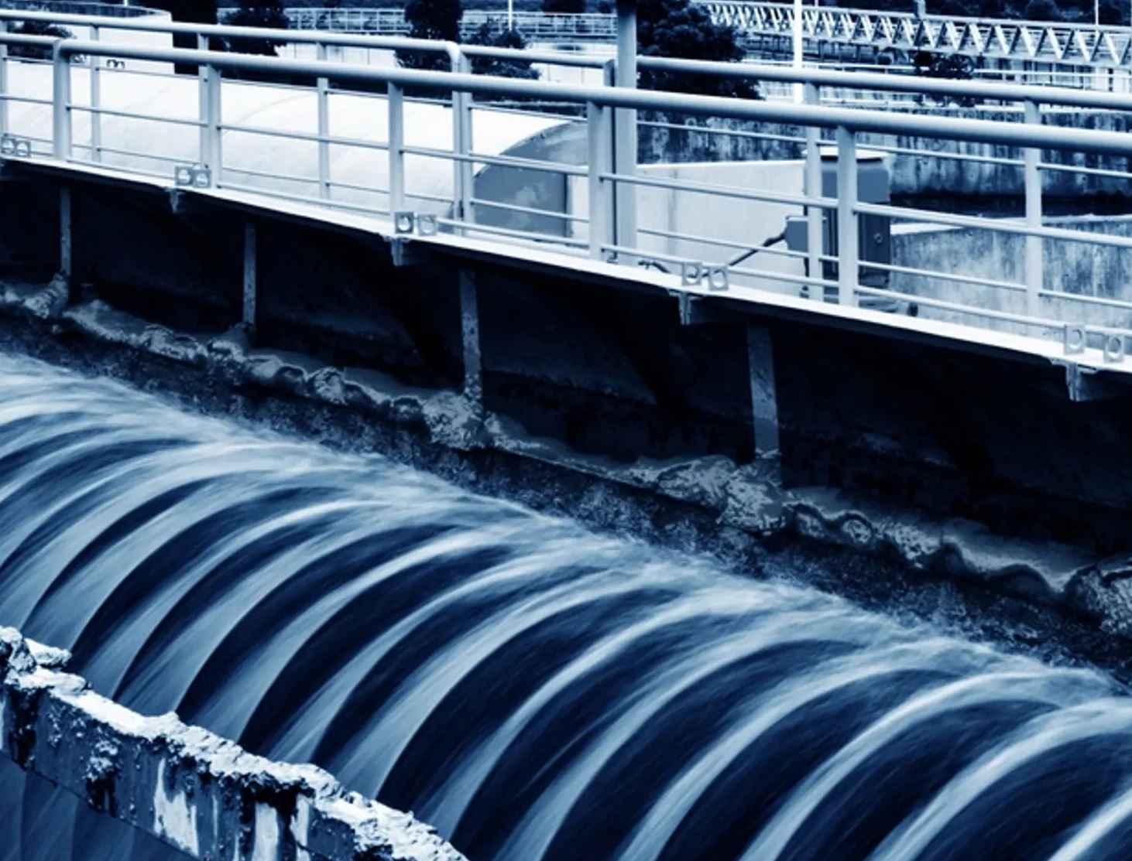
Water experience
Project | Client | Description
North South Interconnector | SA Water | Economic and financial analysis
NSW Drought Protection Program | Water NSW | Business case
Barwon Water Biosolids Drying Plant | Barwon Water/ Plenary Group | Project development
Government Water Asset Sale | Malaysian Government | Financial analysis
Mine Site Water Treatment Assets | BHP Mitsubishi Alliance | Project management & turnkey delivery
Asset Resilience Infrastructure Review | Infrastructure Australia | Review and development of asset resilience strategies for Australian water infrastructure
Climate Risk Assessment | Tenix | Climate risk and adaptation strategy for the development of the Proserpine and Cannonvale WTP
Unsolicited Proposal | Confidential | Water supply asset NSW
7

Slide 8
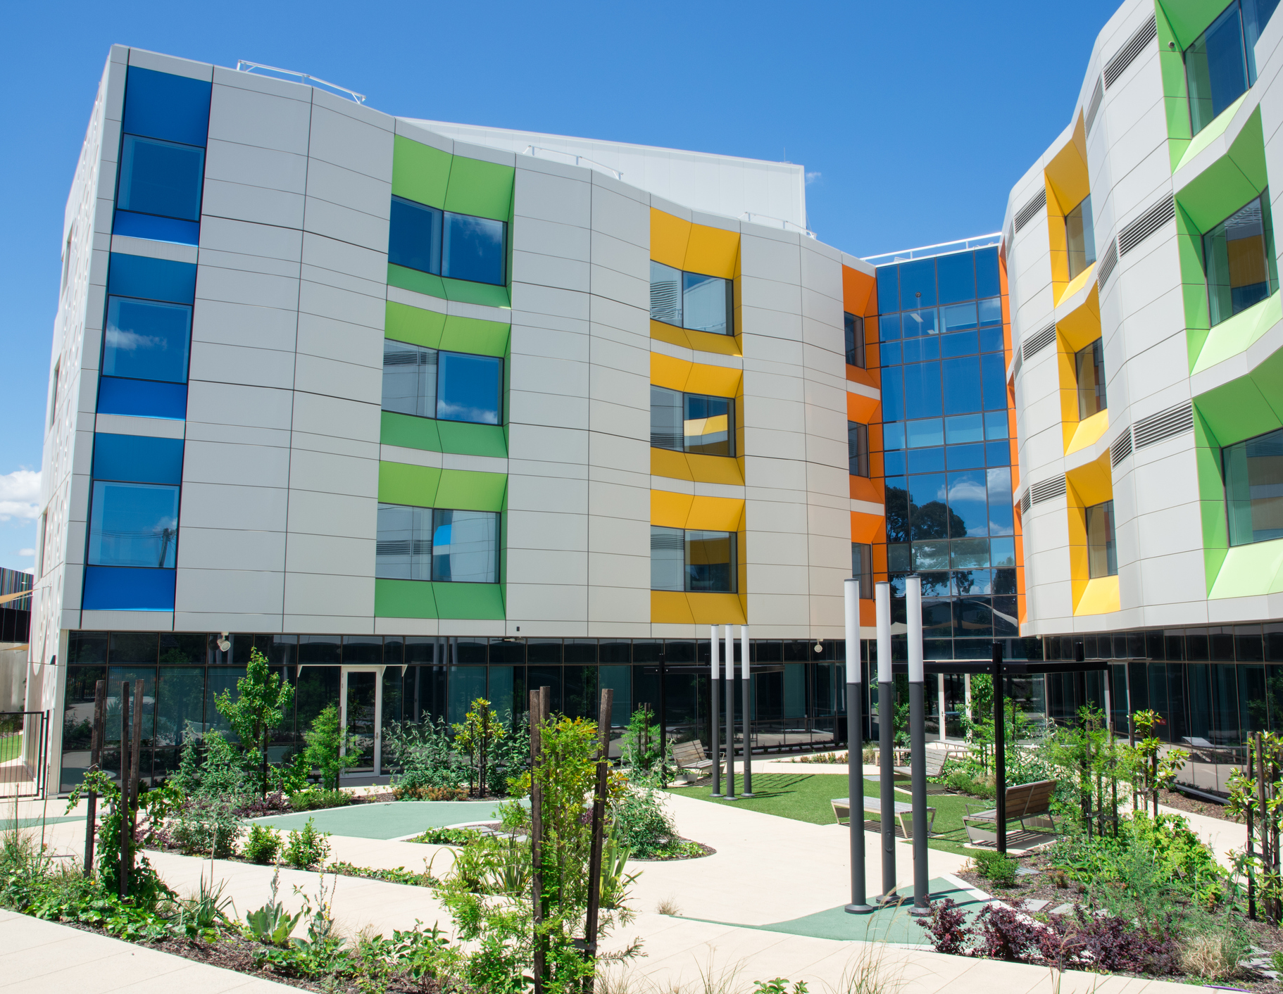
Integrated infrastructure experience
Project | Client | Description
NSW Hospital Redevelopment | Health Infrastructure | Economic analysis - multiple projects
Movement & Place Business Case Guidance | Infrastructure NSW | Policy development
NSW Schools | NSW Dept Education | Business Case – multiple projects
Hemmant Lytton Industrial Park Masterplan | Brisbane City Council | Strategy and technical advisory
Climate Risk Assessment Barangaroo | Lend Lease | Climate risk assessment of amended foreshore development
Energy & Building Efficiency Program | Monash University | Technical advisory for building upgrades and greenfield development
Concept Design Wynyard Walk | Ferrovial Watpac JV | Advisory & project management
Flinders Station Upgrade | Melbourne Metro | Sustainability Advisory
8

